Slide 1
When In-Network Processing Meets Distributed Systems
Bojie Li
Computer Network and Protocol Lab, Huawei

Slide 2
Outline
Network & System Co-design
Distributed coordination based on programmable switches
1Pipe: Scalable Total Order Communication in Data Center Networks (SIGCOMM ’21)
Abstraction
Design
Implementation
Evaluation
Case Study
Discussion
Open Questions
Notes:
This talk consists of three parts. First, we will briefly overview several related works in network and system co-design. Second, we will introduce our sigcomm work. Finally, we will propose several open questions.

Slide 3
Rethinking Distributed Systems for the Data Center
Internet
Data Center Network
Unreliable
High packet loss rate
High delay (milliseconds)
~1 Gbps bandwidth
Uncontrollable switches
Mostly reliable
Low packet loss rate
Low delay (microseconds)
~100 Gbps bandwidth
Programmable switches
Worst-case assumptions
Software processing
End hosts only
Optimize for normal case
Hardware acceleration
Network & system co-design
Notes:
Distributed systems are traditionally designed independently from the underlying network, making worst-case assumptions about its behavior. Such an approach is well-suited for the Internet, where one cannot predict what paths messages might take or what might happen to them along the way. However, many distributed applications are today deployed in datacenters, where the network is more reliable, predictable, and extensible. We argue that in these environments, it is possible to co-design distributed systems with their network layer, and doing so can offer substantial benefits.

Slide 4
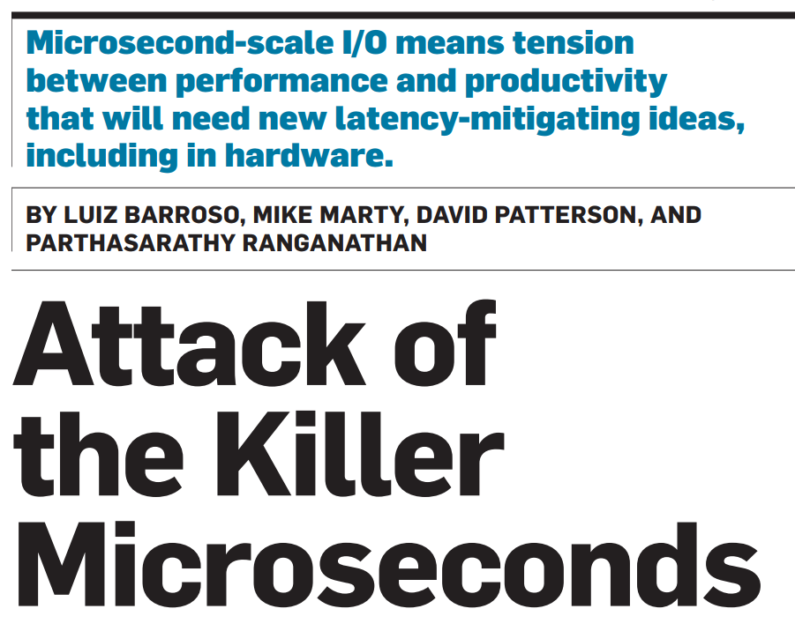
Why Computing at Microsecond Scale?
Apps perceived by humans
Apps consumed by other computing systems
~10 millisecond perceptible latency
High-frequency trading
Industrial robots & IoT
Microservices, e.g., key-value stores. Each human perceptible request is composed of hundreds of microservice invocations.
HPC, AI and big data: many iterations of communication and computation in a distributed system.
Notes:
The largest difference between data center computing and traditional distributed systems is the latency. Data center computing has microsecond-scale I/O latency. A natural question is why we need microsecond-scale latency. Some people say human can only perceive tens of milliseconds of latency, so why we bother with microsecond scale? This is because many data center applications are consumed by other computing systems. For example, high frequency trading programs compete speed with other high frequency trading programs. For microservices, … HPC, AI and big data…

Slide 5
Network & System Co-design
Host
Host
 | (Smart) NIC | Programmable Switch
Congestion control | DCQCN, TIMELY, MP-RDMA, IRN | HPCC, pFabric, DeTail, CP, NDP
Load balancer | VFP | SilkRoad
Key-value store | Pilaf, FaRM, DrTM, FaSST, KV-Direct | SwitchKV, NetCache, IncBricks
Aggregation | NetAgg, CamCube | SHARP, DAIET, SwitchML, ATP
Lock | DSLR | NetLock
Coordination / Replication | Consensus in a Box, DARE, APUS, Derecho, Mu | NetChain, NetPaxos, SpecPaxos, NOPaxos, Eris
Programming system | Floem, iPipe, StRoM, ClickNP, FairNIC, λ-NIC | SNAP, Frenetic, P4, P4visor, 𝜇P4, Domino, Lyra, Gallium
CPU
Mem
CPU
Mem
SmartNIC
SmartNIC
Programmable Switch
“Holy wars”:
Use standard RDMA or offload?
Offload to SmartNIC or Programmable Switch?
Notes:
To minimize the latency of data center applications, there have been extensive research work in network & system co-design. The main two network devices in data center are SmartNIC and Programmable Switch. SmartNIC is actually similar to a switch, because it connects multiple virtual machines and applications. The programmable switch connects multiple hosts or other switches. Many workloads can be done on the main CPU, or offloaded to SmartNIC or programmable switch, each has pros and cons. Congestion control and load balancer are network workloads. Many workloads in distributed applications, such as key-value store, aggregation, lock, coordination and replication, are offloaded to SmartNIC or programmable switch. In this talk, we focus on works that distributed coordination.

Slide 6
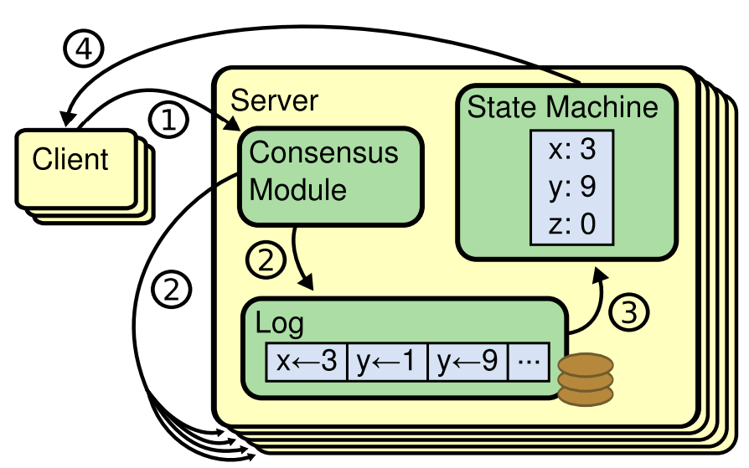
What is State Machine Replication?
The state machine is the application that we want to achieve fault tolerance.
Replicated state machines are typically implemented using a replicated log.
Each log contains the same commands in the same order, so each state machine processes the same sequence of commands.
Since the state machines are deterministic, each computes the same state and the same sequence of outputs.
Performance Problem: any single read operation needs to perform an RPC to multiple servers and await a quorum of responses, a costly remote operation.
Source: Diego Ongaro and John Ousterhout, In Search of an Understandable Consensus Algorithm, NSDI ’14
Notes:
The fundamental problem to achieve fault tolerance is the state machine replication problem.
…(text)
Next, we will outline several works using standard RDMA, host SmartNIC or network switches to achieve fast coordination.

Slide 7
Derecho [TOCS’19]: Coordination on Host with RDMA
Never block on consensus leader for correctness; leader only coordinates membership changes and system restart.
All receivers continuously and asynchronously learn about the evolving state of an underlying datastream.
Track the state of the system through all-to-all information exchanges through a table of monotonic variables: single-writer, multiple-reader counters that advance in a single direction.
Notes:
Our first case study, Derecho, uses standard RDMA NICs to achieve fast state machine replication. Different from traditional Paxos, in Derecho, the leader only coordinates membership changes and system restart.
Derecho applications store data in replicated version vectors. Versions pass through a series of stages: They are created (red), logged locally (orange), and then become stable (green). Within the stable versions, Derecho distinguishes between basic Paxos durability (all green versions) and temporal stability (darker green), which adds an additional guarantee that no update with an earlier real-time timestamp could occur.

Slide 8
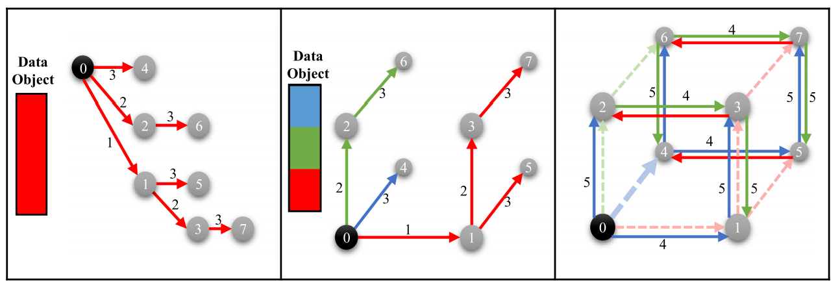
Derecho [TOCS’19]: Coordination on Host with RDMA
Notes:
A second optimization is Derecho’s RDMA multicast protocol, which breaks large messages into chunks and then forwards them chunk by chunk over a network overlay of reliable FIFO channels. Here the left diagram illustrates a binomial copying protocol, with processes represented by circles and data transfer steps represented by numbered arrows. The middle and right diagrams illustrate the idea of running three binomial protocols simultaneously on a three-dimensional hypercube. The hypercube is created as an overlay within the RDMA network. When the pipeline is fully active, every node has one block to send and one block to receive at each logical timestep.

Slide 9
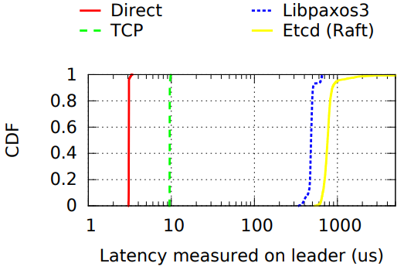
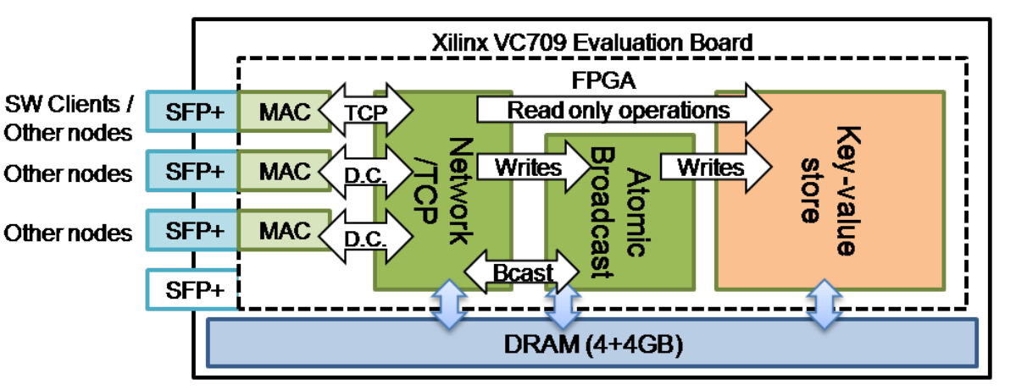
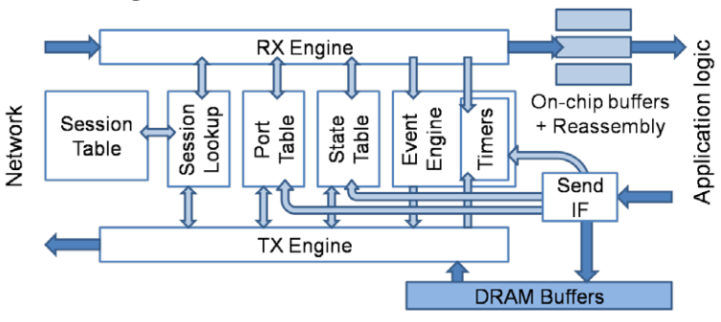
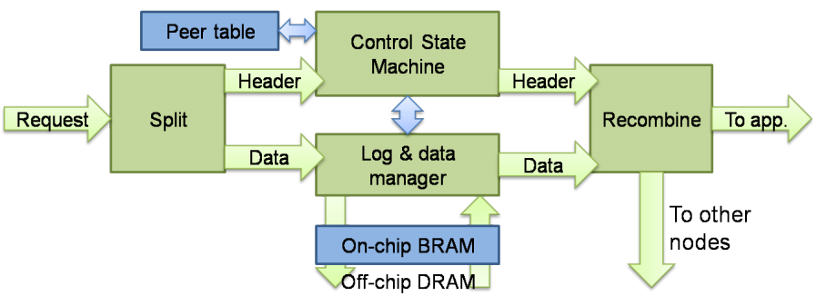
Consensus In a Box [NSDI’16]: Coordination on Host SmartNIC
Both Derecho (RDMA) and Consensus In a Box (FPGA) has microsecond-scale latency.
Notes:
The second paper we survey is much different from the first paper. Derecho proposes a new algorithm that runs in software and utilizes RDMA, while Consensus In a Box is a hardware implementation of Zookeeper protocol on FPGA-based SmartNICs. We can see the latency of FPGA is two orders of magnitude lower than the TCP-IP software based solution. Both Derecho with Consensus in a Box have microsecond-scale latency.

Slide 10
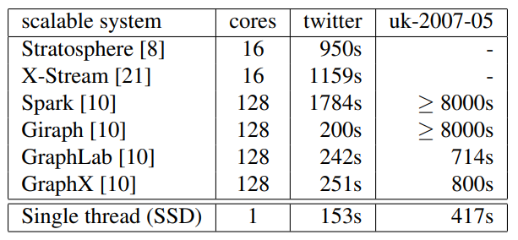
Keep Cautious on Performance Comparisons
Performance of research papers are often compared against industry standard software (e.g., ZooKeeper, etcd), which may not be well optimized.
How much performance gain comes from:
Replacing kernel TCP/IP stack by RDMA?
Replacing SSD by non-volatile memory or simply DDR?
Replacing CPU cost by programmable switch or NIC, which is what we concern most?
Scalability! But at what COST? (HotOS ’15)
Many systems with hundreds of cores simply underperform one thread.
Notes:
Scalability! But at what COST? This was an interesting paper on HotOS’15. The paper compares several state-of-the-art scalable graph processing systems with a single threaded implementation, and find that systems with hundreds of cores simply underperform one thread. The COST paper indicates that the baseline should not be too low.

Slide 11
Programmable Switches
 | Server | Switch
Example | [NetBricks, OSDI ’16] | Barefoot Tofino
Packets per second | ~30 million | > 1 billion
Bandwidth | 10-100 Gbps | 6.5 Tbps
Processing delay | 10-100 us | < 1 us
Visibility | Narrow | Wide
Memory capacity | Large | Small
Programmability | High | Low
Notes:
Next, we introduce several networks that utilize programmable network switches to do coordination.
Programmable switch has a Programmable Parser that can parse custom key-value fields in the packets. It also has a programmable match-action pipeline that can read and update key-value data at line rate.
Programmable switch has higher processing capacity than

Slide 12
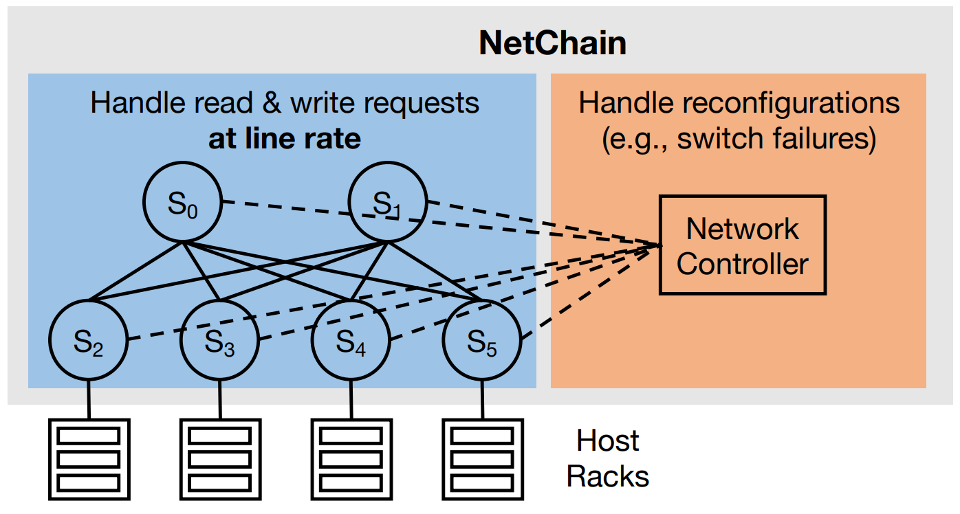
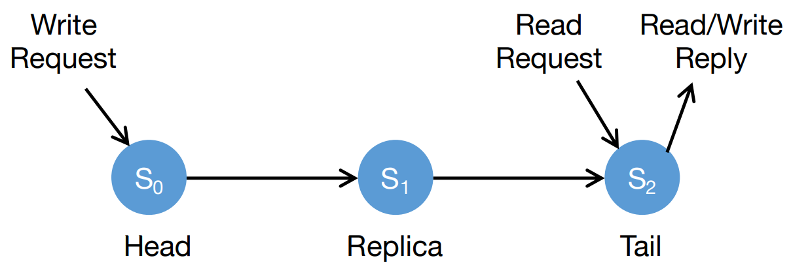
NetChain [NSDI’18]: Sub-RTT Coordination on Switches
High throughput
Low latency
Strong consistency
Fault tolerance
Directly from high-performance switches
Chain replication in the network
Notes:
NetChain saves coordination states inside network switches. A problem is, if the switch fails, the coordination state also disappears. So we need multiple replicas to save the states.
In NetChain, storage nodes are organized in a chain structure. Read operations are directly handled from the tail of the chain. Write operations are first received by the head of chain, then replicated from head to tail. This is the normal case behavior that processes read and write requests at line rate. When some switch fails or we need to add a new switch, network controller takes into effect and handle them using a traditional consensus mechanism. This separation of normal case and abnormal case is a common principle in network & system co-design, and we will see this principle repeatedly later in this talk.

Slide 13
NOPaxos [OSDI’16]: Network-Ordered Paxos on Switches
Sender 1
Receiver 1
1
2
3
4
Programmable Switch (Sequencer)
Sender 2
Receiver 2
1
2
4
DROP
Counter: 4
Sender 3
Receiver 3
1
2
3
4
Notes:
The next work we introduce is NOPaxos, which implements the Paxos consensus algorithm in programmable switches. Programmable switch acts as a sequencer to determine the order of messages, and multicast the messages to all receivers. So, during normal operation, the receivers do not require any coordination, and the operation is completed within one RTT. When a message is dropped, the receiver can detect the dropped message according to the gap in sequence numbers. When a message drop is detected, replicas run agreement via a traditional Paxos algorithm.

Slide 14
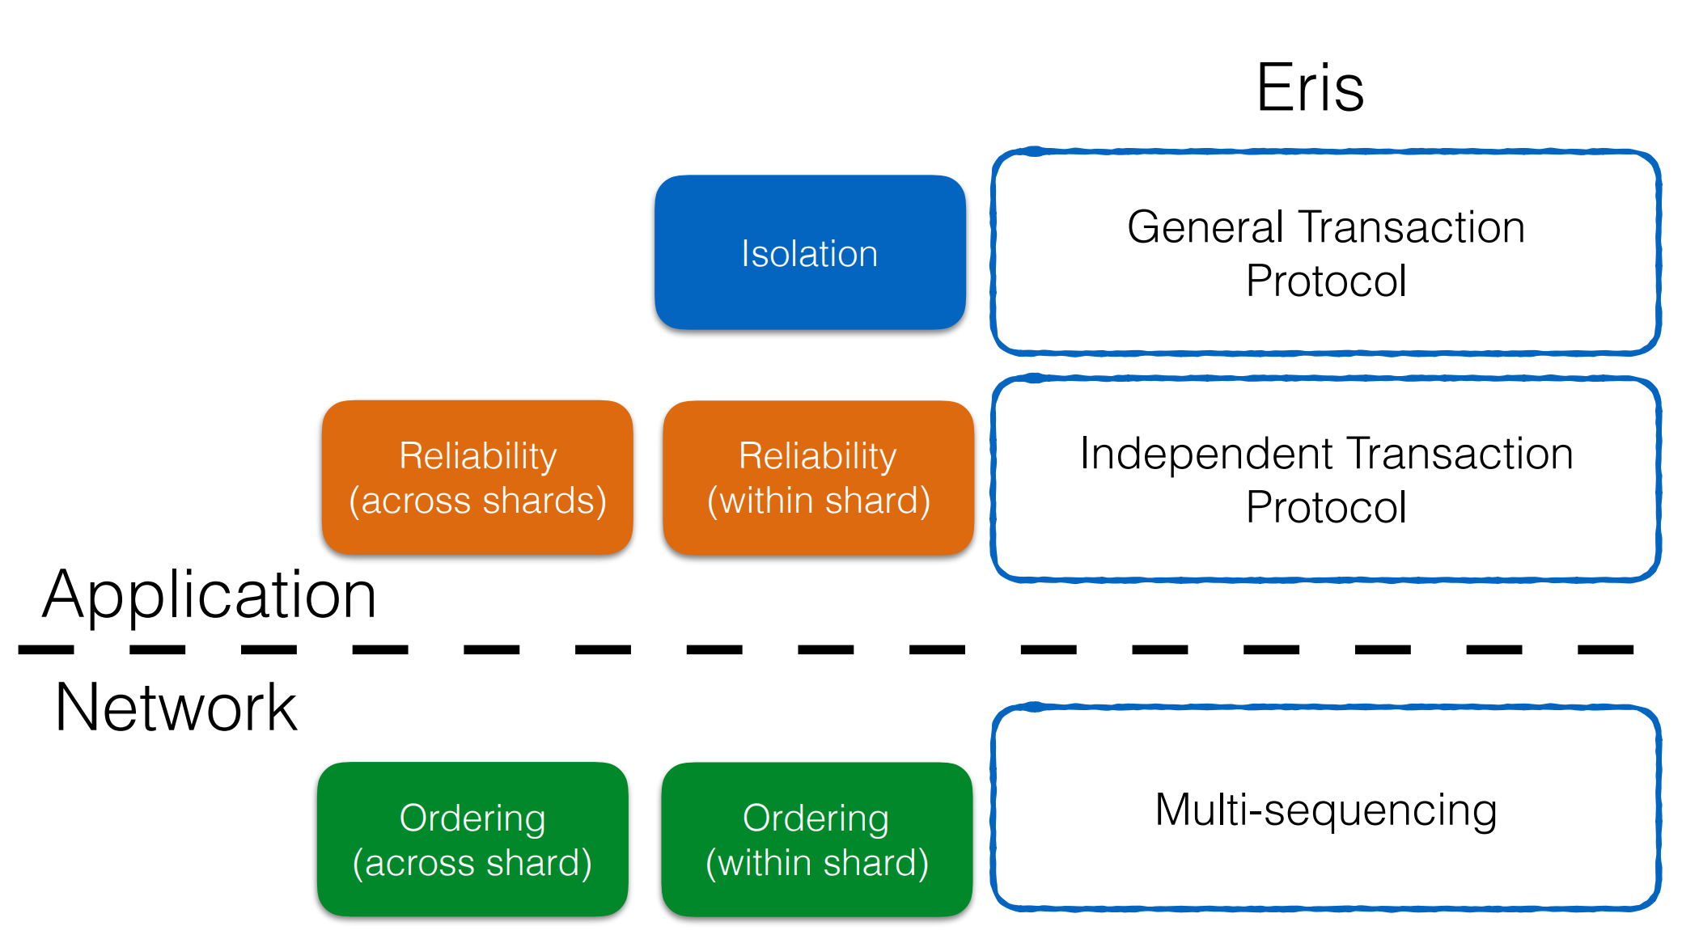
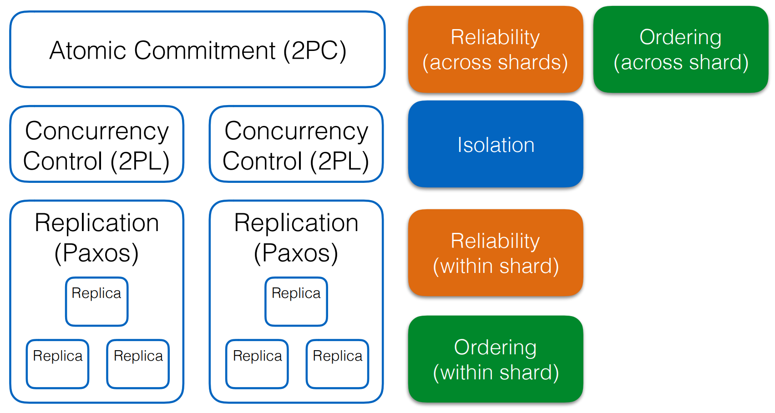
Eris [SOSP’17]: Consistent Transactions with Switches
Traditional Layered Approach
Notes:
Eris proposes a new way to divide the responsibilities for different guarantees. Traditionally, atomic commitment, concurrency control, and replication are handled by different layers of protocols. Eris splits the work between application and network. The network provides ordering across shard and within shard, while the application provides reliability and isolation via a new protocol.

Slide 15
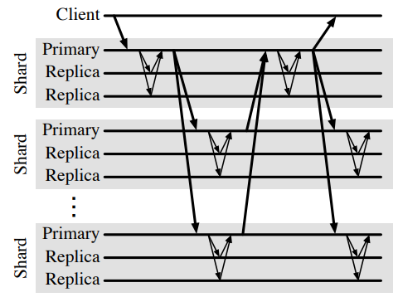
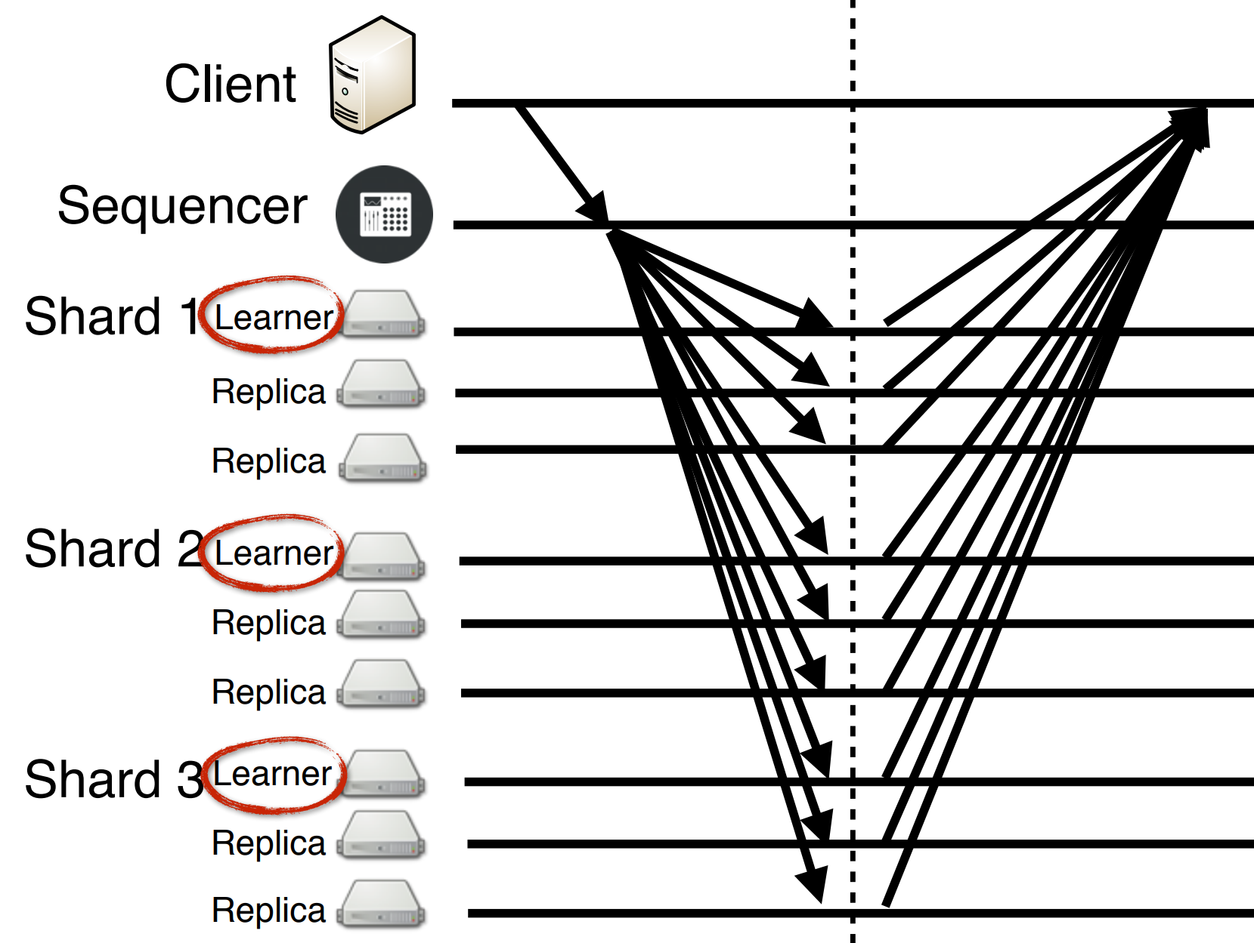
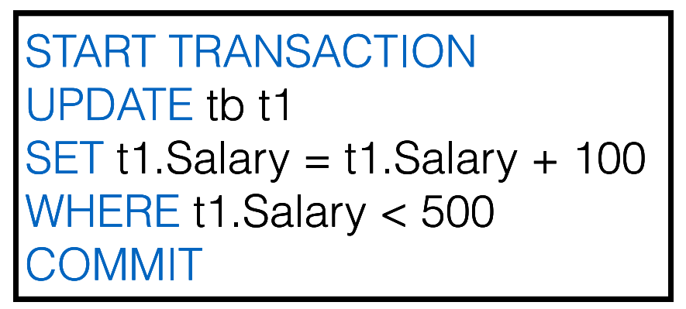
Eris [SOSP’17]: Consistent Transactions with Switches
Traditional Layered Approach
Eris: 1-RTT Independent Transaction
Independent Transactions
Notes:
An independent transaction involves multiple shards, and each shard have multiple replicas. So each packet in a transaction would be multicast to a different set of receivers. Eris multicasts the message from the client to all replicas of all related shards.

Slide 16
Eris [SOSP’17]: Consistent Transactions with Switches
A1
B1
C1
A2
B2
Sender 1
Replica Group A
ABC
Programmable Switch (Sequencer)
A1
B1
C1
B3
C2
Sender 2
AB
Replica Group B
DROP
Counter: A2 B3 C2
Sender 3
BC
A1
B1
C1
B3
C2
Replica Group C
Notes:
Because each transaction only involve a portion of shards, broadcasting each message to all shards is wasteful. To this end, Eris introduces multi-sequenced groupcast. The message header specifies a set of destination replica groups, where each replica group represents a shard. The programmable switch is the sequencer, which keeps a counter for each replica group. When a replica detects a gap in its sequence number, as shown in the red circles, the replica knows there is a lost message, the failure coordinator will use a traditional consensus algorithm to achieve consensus among replicas.

Slide 17
1Pipe: Scalable Total Order Communication in Data Center Networks
Bojie Li
Huawei Technologies
Gefei Zuo
University of Michigan
Wei Bai
Microsoft Research
Lintao Zhang
BaseBit Technologies
Notes:
Eris is a great work that achieves total order communication with a centralized sequencer. But it is not scalable because all traffic must pass through the sequencer. So we think about this problem and design 1Pipe, a scalable total order communication mechanism in data center networks.

Slide 18
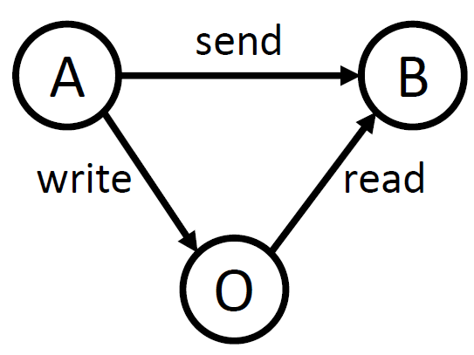
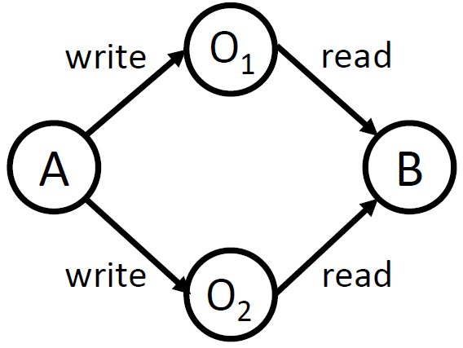
Ordering Hazards in Distributed Systems
Causal Order
Total Order & Atomicity
A write to O
A send to B
B read from O
A write metadata to O₁, A write data to O₂
B read metadata from O₁, B read data from O₂
Requirements:
Isolation
Failure atomicity
Notes:
The first thing we want to define is what kind of ordering we want to provide in a distributed system.
There are two kinds of ordering anomalies in a distributed system. The first kind violates causal ordering. For example, Host 𝐴 writes data to another host 𝑂, then sends a notification to host 𝐵. When 𝐵 receives the notification, it issues a read to 𝑂, but may not get the data due to the delay of A’s write operation.
The second kind violates total ordering or atomicity. Host 𝐴 first writes to data 𝑂1 and then writes to metadata 𝑂2. Concurrently, host 𝐵 reads metadata 𝑂2 and then reads data 𝑂1. It is possible that 𝐵 reads the metadata from 𝐴 but the data is not updated yet. This is called isolation among concurrent transactions. It is also possible that one of the two write operations fail, so the metadata and data are inconsistent. This is called failure atomicity.

Slide 19
1Pipe Abstraction
S₁
R₁
S₂
R₂
S₁→R₁
S₁→R₂
S₂→R₂
S₂→R₁
…
…
S_{n}
R_{n}
“One big pipe”:
Messages are sent in groups (called scatterings) and serialized in a virtual pipe.
Different receivers deliver messages in a consistent order, as if the scatterings are pulled out from the pipe and delivered to the receivers sequentially.
Notes:
To avoid these two kinds of ordering anomalies, we propose a “one big pipe” abstraction.
…(text)

Slide 20
1Pipe Abstraction
Formally: Causally and Totally Ordered Communication Support (CATOCS)
Total order: Messages are delivered in the same order to all receivers.
Causal order: Messages are delivered in Lamport logical clock sense.
Atomicity: Either all or none messages in a scattering are delivered.
Total Order & Atomicity
Causal Order
Notes:
(text)

Slide 21
1Pipe Abstraction: Restricted Atomicity
Full failure atomicity is impossible! [FLP theorem]
Approach of existing fault tolerant systems: Replication!
Paxos tolerates f failures with 2f+1 replicas.
Deliver M
Receiver 1
Sender 1
Deliver M
Receiver 2
If Receiver 1 can fail permanently at any time, how can Receiver 2 know whether it has delivered M or not?
Replicating every message has too much overhead.
So, 1Pipe offers restricted failure atomicity with a mechanism to invoke the application on failures.
onepipe_reliable_send(vec[dst, msg])
TS, src, msg = onepipe_reliable_recv()
onepipe_proc_fail_callback(func(proc, TS))
Design principle: optimize for the normal case because data center is mostly reliable.
Notes:
We must make it clear that 1Pipe only provides restricted failure atomicity. Because the seminal FLP theorem already said full failure atomicity is impossible. If Receiver 1 can fail permanently at any time, how can Receiver 2 know whether it has delivered M or not?
One possible way is to use an approach like NetChain to replicate every message. But we are different from NetChain. NetChain only focuses on important states that needs to be replicated. But we are a basic communication primitive. If every message is replicated, the overhead would be too high. Fortunately, we can apply the design principle of optimizing for the normal case again, because data center is mostly reliable. We need to have a mechanism to invoke the application to handle the failures.

Slide 22
Outline
Network & System Co-design
Distributed coordination based on programmable switches
1Pipe: Scalable Total Order Communication in Data Center Networks (SIGCOMM ’21)
Abstraction
Design
Implementation
Evaluation
Case Study
Discussion
Open Questions
Notes:
Now we consider the core design of 1Pipe: how to achieve total order.

Slide 23
Strawman 1: Centralized Sequencer (Eris, SOSP’17)
Receiver A
A1
B1
C1
A2
B2
Sender 1
ABC
Programmable Switch (Sequencer)
Receiver B
A1
B1
C1
B3
C2
Sender 2
AB
DROP
Counter: A2 B3 C2
Sender 3
BC
Receiver C
A1
B1
C1
B3
C2
Notes:
The first strawman is the approach of Eris. We have talked about this approach before. However, the major problem is that the switch becomes a centralized bottleneck.

Slide 24
Strawman 2: Vector Timestamp
Sender X
1: ABC
Receiver A
X1 Y2 Z0
Receiver A
X1 Y2 Z0
Sender Y
3: A
2: AB
Receiver B
X1 Y3 Z1
Receiver B
X1 Y2 Z0
Sender Z
1: BC
Receiver C
X1 Y2 Z1
Receiver C
X1 Y2 Z0
Compute MIN of receiver: If a receiver knows that all receivers have received some message, it can deliver this message in order.
Drawbacks:
All-to-all communication among receivers.
Each message is broadcast to all receivers.
Notes:
The second strawman is a classical algorithm called vector timestamp. Each sender has an increasing logical timestamp. Each message is broadcast to all receivers, regardless of the actual destination of the message. Each receiver maintains a vector of received timestamp from the senders. This is why this algorithm is called vector timestamp. Then, the critical step is that the receivers exchange the vector timestamps among each other. When a receiver knows that all receivers have received some message by computing the minimum of received timestamp, it can safely deliver this message in order. There are two drawbacks of this approach. First, receivers must use all-to-all communication to know that all other receivers have received some message. Second, each message is broadcast to all receivers.

Slide 25
Strawman 3: Physical Timestamp Aggregation
Received
Delivered
Receiver A
11:00
11:00
A
10:00 ABC
9:00
AB
9:00
BC
Sender 1
10:00 ABC
10:00
9:00
9:00
Receiver B
Sender 2
11:00
A
9:00
AB
10:00 ABC
9:00
AB
9:00
BC
10:00
9:00
9:00
BC
0:00
Sender 3
Receiver C
10:00 ABC
9:00
AB
10:00
9:00
Drawbacks:
Each message needs to broadcast to all receivers (including those not needed).
Periodic beacons needed for an idle pair of receivers (quadratic number of beacons, not scalable).
Cannot detect packet loss and failures.
Notes:
Now we come to the third strawman, which is closer to our final design. We synchronize physical time on senders. The messages are attached with physical timestamps. When a receiver receives a message, it first puts the message into receive buffer. Similar to vector timestamp, the receiver maintains a timestamp for each sender, and calculates the minimum timestamp of all senders. If the minimum timestamp is greater or equal than the timestamp of some message, then the receiver can deliver this message.
This approach also has several drawbacks. …

Slide 26
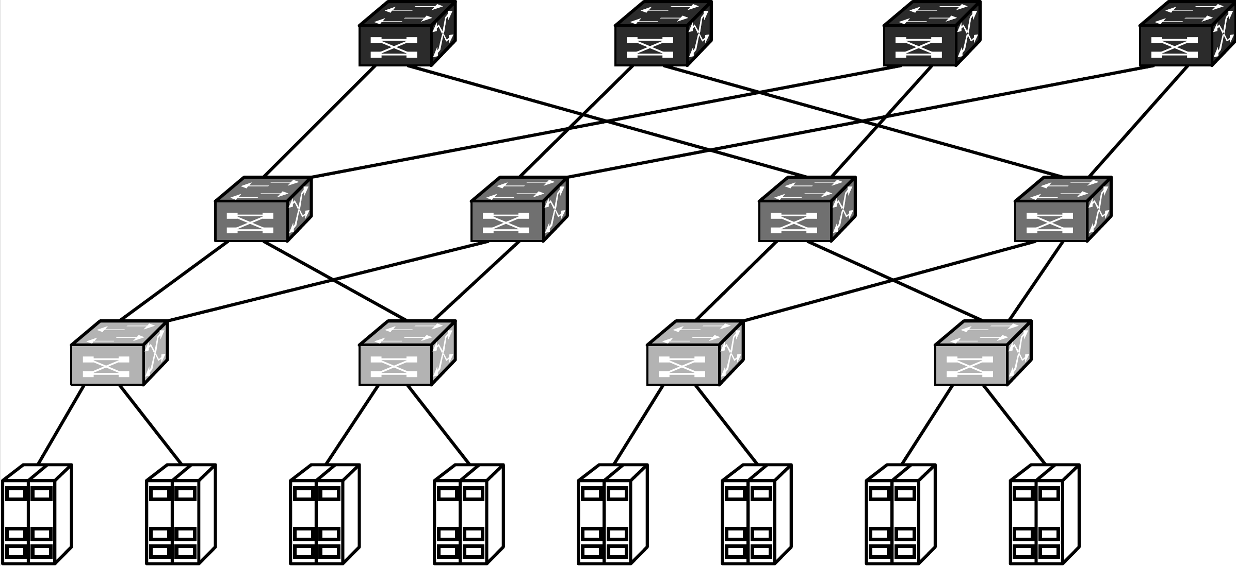
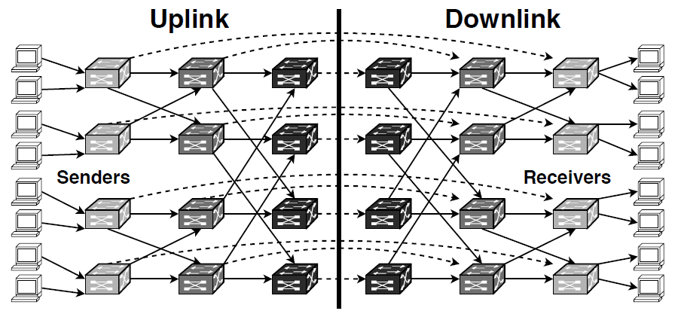
Data Center Topology
Multi-rooted Tree
Routing DAG (Directed Acyclic Graph)
Notes:
Now we design 1Pipe for the data centers. A typical data center has multi-rooted tree topology. Each host has two roles, both sender and receiver. The routing graph between sender and receiver is a directed acyclic graph. In this directed acyclic graph, each switch and host is separated into two parts, and the dashed arrows indicate a loopback on the network switch. For example, if a host wants to communicate with another host in the same rack, it goes through this dashed arrow. If a host wants to communicate a host in another cluster, it needs to go through leaf, spine, and core switches.

Slide 27
1Pipe: Deliver Minimum Timestamp Barrier
Received
Delivered
Sender 1
Msg 10:00 Barrier 10:00 A
Receiver A
Msg 10:00 Barrier 9:00
A
Programmable Switch
Sender 2
Msg 11:00
Barrier 11:00
B
Receiver B
Msg 11:00
Barrier 9:00
B
Min Barrier 9:00
Sender 3
Msg 9:00
Barrier 9:00
C
Receiver C
Msg 9:00
Barrier 9:00
C
Each message has two timestamps: message and barrier timestamp.
When a switch or a host receives a packet with barrier timestamp B from a network link L, it indicates that the message timestamp and barrier timestamp of future arrival packets from link L will be larger than B.
Notes:
The key design of 1Pipe is similar to the last strawman, which synchronizes the physical clocks on senders, aggregates the minimum timestamp on receivers, and delivers the messages in increasing timestamp order on receivers. In the last strawman, each sender needs to send beacon to each receiver. To solve this scalability problem, we use a programmable switch to aggregate the minimum timestamp of senders, and broadcast the minimum timestamp to all receivers. Each packet has two timestamps, a message timestamp and a barrier timestamp. The message timestamp does not change during forwarding, but the barrier timestamp is changed during forwarding. When a switch or a host receives a packet with some barrier timestamp from a network link, it indicates that the message timestamp and barrier timestamp of all future arrival packets from this link will be larger than the barrier timestamp.

Slide 28
1Pipe: Hierarchical Barrier Aggregation
Sender 1
Barrier 10:00
Switch 1a
Switch 1b
Barrier 7:00
Receiver 1
Barrier 9:00
Min
9:00
Min
7:00
Sender 2
Barrier 9:00
Barrier 9:00
Barrier 7:00
Receiver 2
Sender 3
Barrier 8:00
Barrier 7:00
Barrier 7:00
Receiver 3
Switch 2a
Switch 2b
Min
7:00
Barrier 7:00
Min
7:00
Sender 4
Barrier 7:00
Barrier 7:00
Receiver 4
Barrier timestamps are aggregated hierarchically through layers of switches hop-by-hop, and finally the receiver gets the barrier of all reachable hosts and links in the network.
Beacons are sent periodically on each idle link to its one-hop neighbors.
Notes:
Now let’s consider a directed acyclic graph of network switches. We can hierarchically aggregate the barrier timestamps through layers of switches hop-by-hop. For example, the switch 1a computes the minimum barrier of sender 1 and 2, and broadcasts the minimum barrier to switch 1b and switch 2b. Switch 1b and 2b also receives the minimum barrier from sender 3 and 4. So switch 1b and 2b gets the barrier of all 4 senders. In this way, each receiver gets the barrier of all reachable hosts and links in the network. We recall the barrier property that on each network link, either between host and switch or between two switches, the barrier timestamp is the minimum possible future data timestamp on this link. So, a receiver can deliver message in receive buffer when it receives a barrier timestamp higher or equal to the message timestamp.
Finally, if some network links are idle, it will stall the entire network. So, beacons are sent periodically on each idle link to its one-hop neighbors. Okay, this is how 1Pipe works.

Slide 29
How to Handle Packet Loss
Received
Delivered
Sender 1
Msg 10:00 Barrier 10:00 A
Receiver A
Msg 10:00 Barrier 10:00
A
Programmable Switch
Min Barrier 10:00
Sender 2
Msg 11:00
Barrier 11:00
B
Msg 8:00
Barrier 8:00
A
Receiver B
Msg 11:00
Barrier 10:00
B
Incorrect: Receiver A should deliver TS 8:00 from Sender 2 before delivering TS 10:00 from Sender 1, but the switch and receiver A do not know TS 8:00 has lost.
Unlike centralized sequencer, the receivers do not know whether or not a message is lost.
Adding hop-to-hop sequence number to detect packet loss is not capable for many switches.
Notes:
Now let’s consider packet losses. For example, the packet rom sender 2 to receiver A with timestamp 8:00 is lost. Receiver A should deliver TS 8:00 from Sender 2 before delivering TS 10:00 from Sender 1, but the switch and receiver A do not know TS 8:00 has lost. Then after the packets at 10:00 and 11:00 reach the programmable switch, receiver A’s barrier timestamp would be 10:00, and deliver the blue packet at 10:00. The total ordering property requires the messages to be delivered in increasing timestamp order, but receiver A has now delivered an out-of-order packet.
Unlike centralized sequencer, the receivers do not know whether or not a message is lost.
A straightforward solution is to add hop-to-hop sequence number to detect packet loss. However, this is not capable for many switches. Furthermore, even if hop-to-hop sequence number is added, detecting packet loss is not enough. If the two green packets belong to a same scattering that needs to be delivered atomically, then receiver A does not know the packet to receiver B is lost, so receiver A would deliver the packet. If in the meantime, sender 2 fails, then the lost packet can never be recovered, and receiver B cannot deliver the packet, so the atomicity of the scattering is violated.

Slide 30
Best-effort and Reliable 1Pipe
Best-effort
Reliable
onepipe_unreliable_send(vec[dst, msg])
TS, src, msg = onepipe_unreliable_recv()
onepipe_send_fail_callback(func(TS, dst, msg))
onepipe_reliable_send(vec[dst, msg])
TS, src, msg = onepipe_reliable_recv()
onepipe_proc_fail_callback(func(proc, TS))
Some use cases of 1Pipe only need ordering but do not need reliability.
For example, a read-only transaction can be safely retried if some of the messages are lost.
Best effort 1Pipe provides at-most-once delivery, and notifies application when a packet is lost (detected by timeout).
Reliable 1Pipe recovers lost packets and provides exactly once delivery at the cost of an extra RTT.
Reliable 1Pipe delivers all or none messages in a scattering when no switches or host fail permanently (i.e., if it recovers, it can deliver consistently).
Reliable 1Pipe allows the application to customize failure handling.
Notes:
Unfortunately, our solution to recover lost packets and failures require an extra round-trip time. So we provide two kinds of services: a best effort service that provides at-most-once delivery, and a reliable service that provides exactly once delivery at the cost of an extra round-trip time.
Why do we need a best-effort service? … (text)

Slide 31
Reliable 1Pipe: Two-Phase Commit
Sender
Switch
Receiver 1
Receiver 2
Prepare 9:00
ACK 9:00
Commit 9:00
To achieve reliability, 1Pipe adds one round-trip of prepare phase.
Prepare and ACK messages do not need ordered delivery.
When a sender collects all ACKs below or equal to timestamp T, it sends a commit message to the neighbor switch.
The switches aggregate min timestamp of commit messages as in best-effort 1Pipe.
A receiver delivers messages below or equal to commit timestamp.
Notes:
Reliable 1Pipe achieves reliability with a two-phase commit approach. The sender first sends a prepare message to the receiver. The prepare message contains a message timestamp which is the wall clock time of the sender. The receiver puts the message into the receive buffer. Then the receiver responds with an ACK message. The Prepare and ACK messages do not need ordered delivery.
When a sender collects all ACKs below or equal to timestamp T, it sends a commit message to the neighbor switch. This commit message means to deliver all messages below or equal to the commit timestamp. Notice that the commit message no longer carry two timestamps. It does not need the message timestamp. Only the barrier timestamp is needed, and it is now renamed as commit timestamp.
The switches aggregates minimum timestamp of commit messages as in best-effort 1Pipe.
The commit timestamp still has the monotonic property.
When a receiver receives a commit timestamp, it delivers buffered messages below or equal to the commit timestamp.

Slide 32
Reliable 1Pipe: Packet Loss Handling
Sender
Switch
Receiver 1
Receiver 2
Prepare 9:00
End-to-end loss detection via timeout or duplicate ACK
ACK 9:00
ACK 9:00
Retransmitted Prepare 9:00
Beacon or next commit message
ACK 9:00
Commit 9:00
Commit 10:00
Lost Prepare and ACK messages are retransmitted end-to-end.
Lost Commit messages are retransmitted hop-by-hop (notice the monotonicity of commit timestamp).
Notes:
Now let’s see how reliable 1Pipe handles lost packets. In the first example, the ACK packet of a Prepare message is lost. The sender can detect this lost packet via end-to-end transport mechanisms such as timeout or duplicate ACK. After the retransmitting the prepare message and the ACK message is successfully received by the sender, the sender can send out the commit message.
In the second example, the commit message is lost. Actually we do not need to retransmit commit messages. Because commit timestamp is monotonic, committing timestamp 10:00 implies committing timestamp 9:00. Even if there are no other messages to commit, we have periodic beacons on each network link, so the commit timestamp will be automatically retransmitted.

Slide 33
Failure Recovery of Hosts and Switches
Detect failure via beacon timeout, and report to controller.
Controller determines failed process P and failure timestamp T based on the routing graph.
Controller broadcasts failure notification.
Each process discards messages sent from P or to P with timestamp before T.
If a discarded message is in a scattering, to achieve atomicity, the sender recalls other messages in the same scattering from the receiver.
Each process executes user-defined callback function (e.g., traditional consensus to sync replicas).
Controller removes failed process and resumes commit timestamp propagation.
②Determine
Controller
③Broadcast
④Discard
①Detect
Host
⑥Callback
⑤Recall
⑦Resume
④Discard
Data Plane Switch
Host
⑥Callback
①Detect
(beacon timeout)
Host
Notes:
After handling packet loss, now we come to failure recovery of hosts and switches.

Slide 34
Recovery of Simultaneous Failures
Failure timestamp = max(8:00, 9:00, 10:00).
Any component that disconnects from the controller is considered to fail.
The failure timestamp of P is a commit timestamp sent by P but not propagated to any receiver.
Sent by P : all receivers have received messages before failure timestamp in receive buffer, so all these messages can be delivered if no receiver fails permanently.
Not propagated to any receiver: no messages after failure timestamp have been delivered.
It is computed as the maximum last commit timestamp reported by neighbors of P.
A scattering with timestamp T should be delivered if and only if the sender’s failure timestamp is after T (or did not fail), and the sender does not recall it (due to a receiver failure before ACK).
Host
Host
Received Commit 10:00
Received Commit 9:00
Switch 2
Host
Received Commit 8:00
Switch 1
Host
Received Commit ???
Sent Commit ???
Notes:
Now we consider the recovery of simultaneous failures. For example, in the figure, the host and switch 1 fails simultaneously. Failure recovery is directed by the controller. The controller needs to determine which components have failed and when each component fails. The former question is easy to answer. But the latter question is hard to answer. The failure timestamp of a component determines which messages should be delivered for scatterings sent from or to the failed component, so it needs to be carefully determined.
…

Slide 35
Limitations of Failure Recovery
Sender
What if a receiver fails permanently?
We do not know the last timestamp A has delivered, so the other receiver B of the same scattering does not know whether A has delivered TS 9:00.
We only ensure atomicity in fail-recover model: when receiver A recovers from the failure, it communicates with the controller to determine which messages in the receive buffer should be delivered.
Scatter to 2 receivers
Switch
Sent Commit 10:00
Receiver A
Receiver B
Received Commit ???
Received Commit 9:00
Notes:
As we have already noted, failure recovery has its limitations. If receiver A crashes at some unknown time, we do not know the last timestamp A has delivered, so the other receiver B of the same scattering does not know whether A has delivered TS 9:00. …
The controller records failure timestamps of senders and undeliverable recall messages, so that recovered receivers can deliver or discard messages consistently in each scattering.

Slide 36
Outline
Network & System Co-design
Distributed coordination based on programmable switches
1Pipe: Scalable Total Order Communication in Data Center Networks (SIGCOMM ’21)
Abstraction
Design
Implementation
Evaluation
Case Study
Discussion
Open Questions
Notes:
Now we come to the implementation of 1Pipe.

Slide 37
1Pipe Implementation on Hosts
Host
Application 3
Application 2
lib1pipe
Application 1
lib1pipe
lib1pipe
1Pipe API
Reliable Sending
Packet Reordering
Time Synchronizer
Send Buffer
Receive Buffer
Flow and Congestion Control
Beacon Generator
RDMA UD
Standard RDMA NIC
Notes:
We implement 1Pipe using RDMA Unreliable Datagram. This is because if we use RDMA reliable connection, each QP will buffer several messages, and we cannot ensure the ordering among these messages on the network link. Ideally, we would like to use a SmartNIC to assign timestamps at the egress of the NIC. But we do not have access to such a SmartNIC, so we used a software approach instead. The transport is implemented in software. 1Pipe has a polling thread per host to synchronize the clock and generate periodic beacons to the top-of-rack switch.

Slide 38
1Pipe Implementation on Switches
Programmable Switch
Timestamp 100
Barrier 100
Timestamp 300
Barrier 100
Payload A
Payload B
Egress link
Egress link
Programmable Switch
Switch Barrier 100
Link Barrier 100
Link Barrier 200
Ingress link
Ingress link
Timestamp 100
Barrier 100
Timestamp 300
Barrier 200
Payload A
Payload B
Delay = base_delay + beacon_interval + clock_skew
Notes:
For implementation on network switches, we consider three types of network switches with different programmability. Using a programmable switch, the switch data plane can aggregate barrier timestamps in the header of each packet. Because a switch has multiple input ports, the switch actually uses a binary tree of registers in multiple stages to compute the minimum barrier of all input ports. The forwarding delay of programmable switch is base delay plus beacon interval plus skew in clock synchronization.

Slide 39
1Pipe Implementation on Switches
Programmable Switch
Switch CPU
Timestamp 100
Barrier 100
Timestamp 300
Barrier 100
Timestamp 200
Payload A
Payload A
Payload B
Beacon barrier 100
Egress link
Egress link
Egress link
Commodity Switch
Programmable Switch
Packet Forwarding ASIC
Switch CPU
Switch Barrier 100
Switch Barrier 100
Link Barrier 100
Link Barrier 200
Link Barrier 200
Ingress link
Ingress link
Ingress link
Timestamp 100
Barrier 100
Timestamp 300
Barrier 200
Timestamp 200
Payload A
Payload A
Payload B
Beacon barrier 200
Delay = base_delay + beacon_interval + clock_skew
Delay = base_delay + switch_processing_delay * number_of_hops + beacon_interval + clock_skew
Notes:
For a commodity switch without a programmable switching chip, for example Broadcom switching chips, we implement in-network processing on the switch CPU. Although it cannot process packets in data plane, they have a CPU to process control-plane packets, analogous to directly connecting a server to a port of the switch. Compared to a typical server, the switch CPU is typically less powerful and has lower bandwidth. Because the switch CPU cannot process every packet, data packets are forwarded by the switching chip directly. The CPU sends beacons periodically on each output link, regardless of whether the link is idle or busy.
Compared with the programmable chip, switch CPU slacks the barriers because 1) CPU processing has
delay and 2) the barriers are updated by periodical beacons instead of by every packet.

Slide 40
1Pipe Implementation on Switches (cont’d)
Delegate Switch Processing to a Host
Delay = base_delay + number_of_hops * (RTT_between_switch_and_host_representative + host_processing_delay) + beacon_interval + clock_skew
Notes:
If the switch vendor does not expose access interfaces to switch CPUs, we can offload the beacon processing to end hosts. The challenge is to maintain the FIFO property on network links, i.e., beacons with barrier timestamps on a network link must pass through the link. This is a requirement of best effort 1Pipe, but not reliable 1Pipe. To this end, we designate an end-host representative for each network switch. If the routing path between two representative hosts does not go through the link between the switches, beacon packets needs to detour by using source routing.

Slide 41
Outline
Network & System Co-design
Distributed coordination based on programmable switches
1Pipe: Scalable Total Order Communication in Data Center Networks (SIGCOMM ’21)
Abstraction
Design
Implementation
Evaluation
Case Study
Discussion
Open Questions

Slide 42
Testbed Setup
3-layer fat-tree topology with 32 servers and 10 switches
Each rack has 8 servers
Number of processes: 2, 4, …, 512
2, 4, 8 processes: each process on a host in a same rack
16 processes: each process on a host in 2 racks
32 processes: each process on a host in 4 racks
64, 128, 256, 512 processes: multiple processes on each host
Traffic pattern: all-to-all, no locality
8 servers
8 servers
8 servers
8 servers

Slide 43
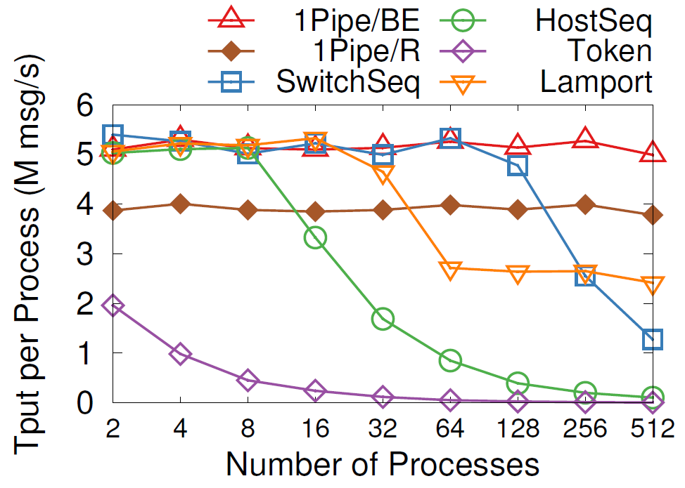
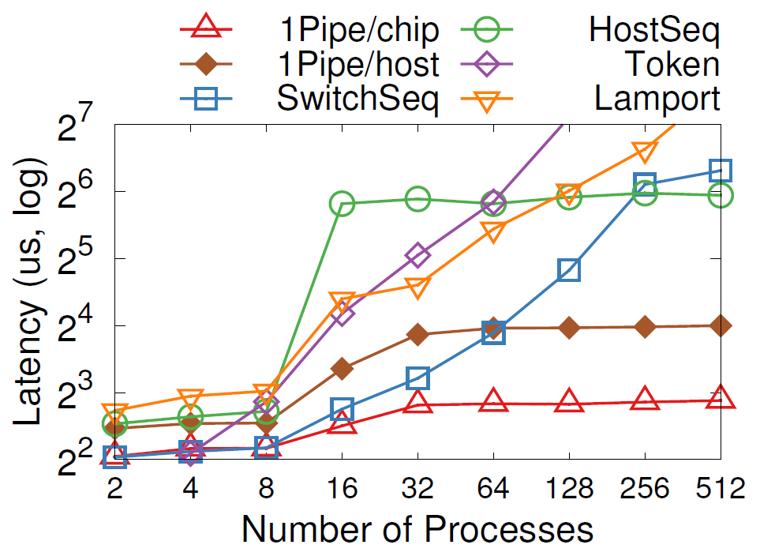
Microbenchmarks
Throughput
Latency
BE: best-effort, R: reliable
Notes:
Now we compare 1Pipe with other total-order broadcast algorithms. 1Pipe scales linearly to 512 processes, achieving 5M messages per second per process (i.e., 80M msg/s per host). The throughput of 1Pipe is limited by CPU processing and RDMA messaging rate. Reliable 1Pipe has 25% lower throughput than best effort 1Pipe due to two-phase commit overhead.
In contrast, if we use switch or host as a sequencer, the sequencer is a central bottleneck and introduces extra network delays to detour packets. The latency soars when throughput of sequencer saturates and congestion appears.
Best effort 1Pipe with reconfigurable chip delivers the lowest latency overhead compared to the unordered baseline. The average overhead (1~2𝜇s) is almost constant with different number of network layers and processes. End host representatives introduce extra forwarding delay from the switch to the end host. Reliable 1Pipe adds an RTT to Best effort 1Pipe. For different number of processes, the RTT and host forwarding delay are proportional to network hop count.

Slide 44
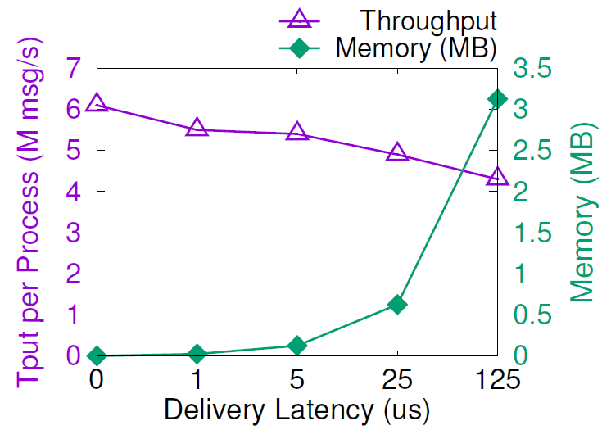
1Pipe Has Low Overhead
Periodic beacons: 3 𝜇s in testbed
CPU processing overhead: one CPU core per server
Network bandwidth overhead: 0.3% of 100 Gbps link
Beacon is hop-by-hop, so, its overhead is fixed for any network scale
Reordering overhead at senders and receivers
Send and receive buffer: a few megabytes
Throughput: 4~6 M messages per second per core
Packet header overhead: 24 bytes
Notes:
The CPU overhead of 1Pipe has two parts: reordering at receivers and beacon processing at switches. Processing beacons needs one CPU core per server. For reordering at receivers, the message delivery throughput degrades slightly with more messages to reorder.
The network bandwidth overhead of 1Pipe is mainly packet header overhead and beacon overhead. The packet header overhead is 24 bytes per packet. Beacons require 3 in a thousand bandwidth of 100 Gbps link.
Finally there is a memory overhead for send and receive buffer. As the Figure shows, the send and receive buffer size increases linearly with latency, but only takes a few megabytes on a 100 Gbps link.

Slide 45
Outline
Network & System Co-design
Distributed coordination based on programmable switches
1Pipe: Scalable Total Order Communication in Data Center Networks (SIGCOMM ’21)
Abstraction
Design
Implementation
Evaluation
Case Study
Discussion
Open Questions

Slide 46
Case Study: Transactional Key-Value Store
Best effort 1Pipe:
Read(A) Read(B) Read(C)
Read Client
Storage A
Storage servers execute the Read and Write requests delivered by 1Pipe.
Write Client
Storage B
Reliable 1Pipe:
Write(B) Write(C)
Storage C
R/W Client
Reliable 1Pipe:
Read(B) Write(C)
Notes:
The first case study is a transactional key-value store.
For read-only transactions, we use best effort 1Pipe because it does not have any side effect. If any of the Read request fails, the client can simply retry the request.
This is why we design best effort 1Pipe.
Transactions including at least write operation needs to use reliable 1Pipe to ensure atomicity.
In normal cases, the transaction is completed in one RTT.

Slide 47
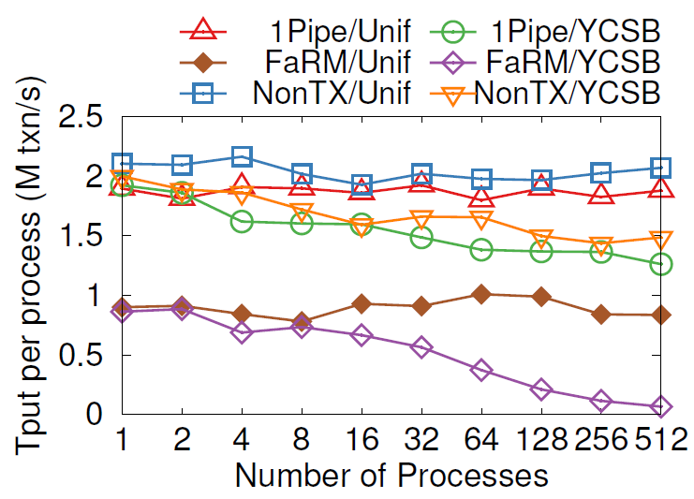
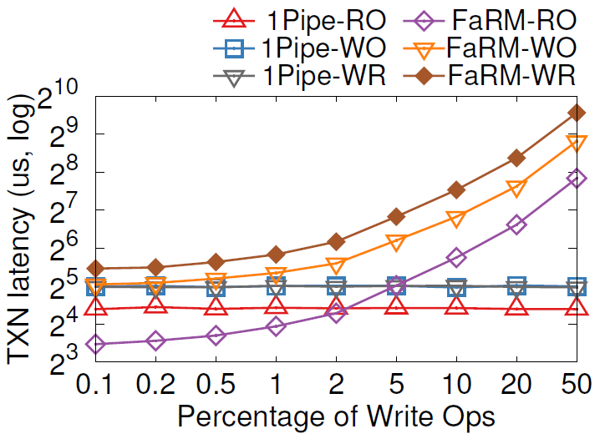
Case Study: Transactional Key-Value Store
Throughput
Latency
RO = Read Only
WO = Write Only
WR = Read + Write
Notes:
In both uniform and YCSB distribution, 1Pipe delivers scalable throughput, which is 90% of a non-transactional
key-value store. As number of processes increase, YCSB scales not as linearly as uniform, because contention on hot keys lead to load imbalance of different servers.
The latency of 1Pipe is almost constant because servers process read and write ops on a same key in order. Write-only and Read-Write transactions use reliable 1Pipe, which is slower than read-only transactions that uses best effort 1Pipe. With high write percentage, FaRM latency skyrockets due to lock contention on hot keys and transaction aborts due to inconsistent read version.

Slide 48
Case Study: Log Replication (Traditional)
Leader-follower
Sequencer
Log Generator 1
Log Generator 2
Log Generator 1
Log Generator 2
Leader
Sequencer
Replica 1
Replica 2
Replica 1
Replica 2
Both need 2 RTTs!
Notes:
The second case is log replication. Traditionally we have two ways for log replication. The leader-follower approach first replicates data to a leader node, then the leader node replicates to several replica nodes. The sequencer approach first obtains a sequence number from a sequencer, then replicates to all replicas directly. All replicas order requests according to the sequence number. Both methods need two RTTs for replication.

Slide 49
Case Study: 1-RTT Log Replication
Newer
Older
Best-effort 1Pipe
Log Generator 1
Replica 1
TS 3
Checksum 6
TS 2
Checksum 3
TS 1
Checksum 1
TS 1 lost packet
TS 3 checksum mismatch
Replica 2
TS 3
Checksum 5
TS 2
Checksum 2
DROP
Log Generator 2
Replica 3
TS 1
Checksum 6
TS 2
Checksum 3
TS 1
Checksum 1
TS 2 checksum mismatch
Recovery Controller
Notes:
Using 1Pipe, log replication can be achieved with only 1 RTT. This is because 1Pipe removes the need of sequencer in the traditional approach. We use best effort 1Pipe to achieve minimum latency, and let the sender detect packet loss. Here is how we do. Each replica maintains a checksum, which is the sum of all timestamps the replica has received. If checksum match, then all replicas have received the log entry in a consistent order. If the checksums do not match, then at least one log entry is lost. The log generator notifies the controller when there is any checksum mismatch, and the controller uses a traditional consensus algorithm to synchronize the log entries on replicas. After that, the replicas resume accepting new logs.

Slide 50
Case Study: Independent Transactions
Recall Eris [SOSP’17]
Notes:
The last case study is independent transactions. Recall that independent transactions involve multiple hosts but the input of each host does not depend on the output of other hosts. The two most frequent transactions in TPC-C benchmark (New-Order and Payment) are independent transactions. Similar to Eris, we use reliable 1Pipe to send commands in an independent transaction to all replicas in relevant shards. In normal cases, the transaction can be completed in one round-trip, similar to Eris. But remember that we have better scalability.

Slide 51
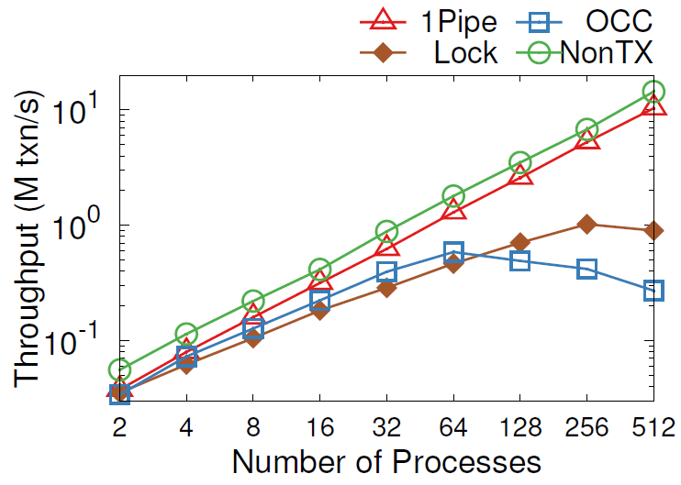
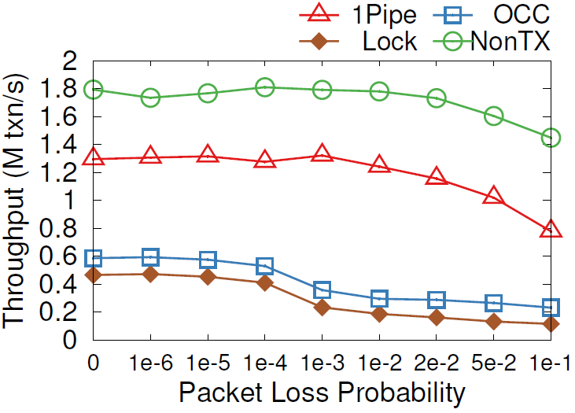
Case Study: Independent Transactions
Scalability
Resilience of Packet Loss
Notes:
We benchmark New-Order and Payment transactions in TPC-C workload. As shown in the left figure, two-phase locking and OCC do not scale, because each Payment transaction updates its corresponding warehouse entry and each New-Order reads it, leading to one hot entry in each warehouse. Because the benchmark only have 4 warehouses, the 4 entries become a bottleneck. In contrast, 1Pipe scales linearly with number of processes.
The figure on the right shows the performance under packet loss. We can see that 1Pipe is more resilient to packet loss than traditional concurrency control mechanisms. This is because in the commit phase of 2PL and OCC, a locked object cannot be released until the transaction completes. So, the latency increases with packet loss rate because replicas wait for the last retransmitted packet to maintain sequential log ordering. In contrast, 1Pipe do not lock records. Lost packets only impact latency but have a low impact on throughput.

Slide 52
Outline
Network & System Co-design
Distributed coordination based on programmable switches
1Pipe: Scalable Total Order Communication in Data Center Networks (SIGCOMM ’21)
Abstraction
Design
Implementation
Evaluation
Case Study
Discussion
Open Questions

Slide 53
Critics on CATOCS
Can’t say for sure (unrecognized causality at semantic level):
1Pipe is not a panacea. Semantic ordering is still needed in applications.
Can’t say together (lack of serialization ability):
1Pipe provides scattering primitive and restricted failure atomicity.
Can’t say efficiently:
1Pipe is low latency, high throughput and low overhead in data center networks.
Notes:
CATOCS is an age-old controversial topic. There has been a famous paper “Understanding the Limitations of CATOCS”. It points out three drawbacks.

Slide 54
Limitations of 1Pipe
Cannot achieve atomicity of scattering under permanent failures.
System stalls on failures, and invokes the application to recover failures.
1Pipe handles normal cases, and application handles corner cases.
Require hosts to synchronize clocks at microsecond accuracy.
Bad clocks will impact delivery latency but not violate correctness.
During the research, we explored other ways to synchronize logical timestamps, but did not find enough advantage over physical time.
A straggler host or network link will slow down the entire network.
A possible approach: partition the network into multiple instances.
The protocol is not resistant to adversarial nodes.

Slide 55
Conclusion
1Pipe proposes a causal and total order communication abstraction that delivers groups of messages in sender’s clock time order with restricted failure atomicity.
1Pipe achieves scalability and efficiency by utilizing programmable switches to aggregate ordering information while forwarding data packets as usual.
1Pipe can simplify and accelerate many applications including transactional key-value store, replication, independent transactions, and distributed data structures.
CATOCS is a controversial topic since 1980s. 1Pipe puts new insight into it in the context of data center networks. We expect future work to explore the border between network transport and applications.

Slide 56
Outline
Network & System Co-design
Distributed coordination based on programmable switches
1Pipe: Scalable Total Order Communication in Data Center Networks (SIGCOMM ’21)
Abstraction
Design
Implementation
Evaluation
Case Study
Discussion
Open Questions
Notes:
At the end of this talk, we will propose several open questions in network and system co-design.

Slide 57
Heterogenous Data Access Methods
Compute at Client
Compute at Server
(Home Node of Data)
Memory-mapped Load/Store
(CXL, Gen-Z, etc.)
In-Network Computation
SmartNIC Offloading
RPC on CPU
Asynchronous Read/Write
(one-sided RDMA)
Load/Store: low overhead per operation, but synchronous; may have cache and buffer
Read/Write: high overhead per operation, but each op can transfer a large block, and many ops can work in parallel
Switch: high throughput but low programmability and buffer size
SmartNIC: high parallelism but high PCIe latency and low buffer size
RPC on CPU: close to memory, easy to program but high cost
Notes:
Now we have heterogenous methods to access a piece of remote data in data center networks. Traditionally, the only way to access remote data is by executing RPC on the remote CPU. Then we have RDMA technology to directly copy the data to local buffer and do computation. If the data structure is complicated, we may need multiple network round-trips to RDMA the data. But because it removes the cost to invoke an RPC on the remote CPU, which is mainly the TCP/IP and RPC protocol stack, the overall performance may be still higher. Next we have smartNIC offloading and in-network computation. SmartNIC is high parallelism but its main drawback is high PCIe latency and low on-chip buffer size. Network switches also have low buffer size but high throughput. In the next a few years we will have memory-mapped load/store over network, which has lower per-operation overhead compared to reads and writes, but each operation only accesses a cache line of data. In summary, we have a wide spectrum of data access methods, and we need some way to choose among them.

Slide 58
Distributed Applications in the Microsecond Era
Traditional OS and hardware mechanisms are designed for millisecond-scale I/O (Networking and Storage).
RDMA and Flash devices now have microsecond-scale latency. How to use them efficiently?
RPC protocol contributes a large portion of latency, and it is hard to offload.
Serialization/deserialization is language dependent.
Most RDMA applications use polling mode because interrupt mode has too much latency overhead.
The latency overhead is mainly due to the OS, can we reduce it?
Can we dynamically switch between polling and interrupt mode?

Slide 59
Distributed Applications in the Big Memory Era
Tiered storage:
DDR
Storage-class memory (NVM, Optane)
Flash
Remote memory (may be faster than Flash)
Distributed applications need a big memory abstraction consisting of tiered storage.
Hot and cold data needs placement and migration.
If data is migratable among hosts, how to address a memory object?
Do we need to replicate memory objects, or make the memory objects durable?
RDMA memory needs to be pinned, which prevents swapping.
ODP performance is limited.
Can we design a virtual memory system to integrate communication memory and compute memory?
Should the swap in/out be fully in software or use software-hardware co-design?
Switch
Host 3
Host 2
Host 1
RDMA NIC
Local App
DDR (~256 GB)
Swap in/out
Flash (~2 TB)

Slide 60
Thanks
Ad: Welcome to Computer Network and Protocol Lab in Huawei.
Contact Info:
WeChat: bojustc
E-mail: bojieli@gmail.com
Homepage: https://ring0.me (slides will be available on my homepage)

Slide 61
Fault Tolerance of Stateful In-Network Processing
Programmable Switch
Stateful Processing
States
Billions of packets per second
For stateful processing, billions of state changes per second
Hard to be stored in durable storage
Replication to other switches (like NetChain) also consumes a lot of bandwidth
Tbps bandwidth
Hard to buffer output packets until checkpointing states
Notes:
States are stored inside the switches. NetChain replicates the states to other programmable switches, but it requires significant bandwidth, and it is not durable in the case of power failure. Because the processing capacity of switch is far larger than the throughput of durable storage, writing states to durable storage is too costly. If saving state changes in batch, then externally observable outputs also need to be batched, which require too much buffer on switches.

