Slide 1
ClickNP: Highly Flexible and High Performance Network Processing with Reconfigurable Hardware
Bojie Li^{1,2}, Kun Tan¹, Layong (Larry) Luo¹, Yanqing Peng^{1,3}, Renqian Luo^{1,2}, Ningyi Xu¹, Yongqiang Xiong¹, Peng Cheng¹, Enhong Chen²
¹Microsoft Research, ²USTC, ³SJTU
Notes:
Thanks Professor Nate Foster for the introduction.
Hello everyone.
I’m Bojie Li, a second-year Ph.D. student in a joint research program with USTC and Microsoft Research.
My topic today is ClickNP, a highly flexible and high performance network processing platform with reconfigurable hardware.
I did this work with my collaborators during an internship with Microsoft Research Asia.

Slide 2









Virtualized network functions
Dedicated hardware NFs are not flexible
Virtualized NFs on servers to maximize flexibility
Load
Balancer
NAT
Firewall
IPSec
Gateway
Load
Balancer
VMs
Firewall
VMs
NAT
VMs
IPSec
Gateway
VMs
Notes:
Multi-tenant datacenters requires flexible network functions to ensure security and performance isolation.
Dedicated hardware network function are not flexible enough to support multi-tenancy and respond to changing requirements.
Therefore, almost all cloud providers have been deploying virtualized network functions on servers to maximize flexibility.

Slide 3
Scale-up challenges for software NF
Limited processing capacity
  Number of CPU cores needed for 40 Gbps line rate
Network function | Implementation | 1500B pkt @ 40 Gbps (normal case) | 64B pkt @ 40 Gbps (worst-case estimate)
NVGRE tunnel encapsulation | Hyper-V virtual switch | 5 | 100
Firewall (8K rules) | Linux iptables | 21 | 480
Notes:
However, there are two major challenges for software network functions.
First, software network functions have limited processing capacity.
For example, for NVGRE tunnel encapsulation, the virtual switch requires 5 CPU cores to sustain 40 gigabit line rate.
In the worst case, when all the packets are tiny, it requires as many as 100 cores to sustain line rate.
This is only a roughly estimation, but the order of magnitude should make sense.

Slide 4
Scale-up challenges for software NF
Limited processing capacity
  Number of CPU cores needed for 40 Gbps line rate
Inflated and unstable latency
  Add tens of microseconds to milliseconds latency to data plane
  Latency may grow to milliseconds under high load
  1 ms occasional delay would violate SLA (e.g., trading services)
Network function | Implementation | 1500B pkt @ 40 Gbps (normal case) | 64B pkt @ 40 Gbps (worst-case estimate)
NVGRE tunnel encapsulation | Hyper-V virtual switch | 5 | 100
Firewall (8K rules) | Linux iptables | 21 | 480
Notes:
Second, software network functions have inflated and unstable latency.
A software-based network function adds tens of microseconds to milliseconds latency to the data plane.
When the load is high, this latency may grow to several milliseconds.
However, an occasional delay of one millisecond would already violate the service level agreement for delay sensitive applications.

Slide 5
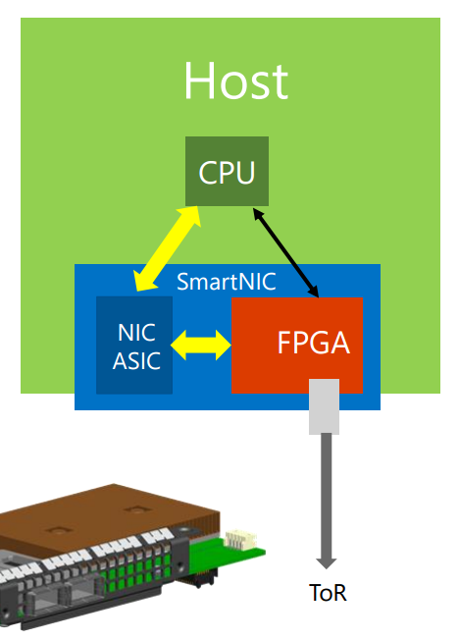
FPGA in the cloud
FPGA-based SmartNIC
  Bump-in-the-wire processing between
  NIC and ToR switch^{[1]}
[1] SIGCOMM’15 keynote (also the image source)
Notes:
To accelerate network functions in servers, we have deployed FPGA-based SmartNICs at scale in Microsoft datacenters.
The FPGA performs bump-in-the-wire processing between commodity NIC and top-of-rack switch.

Slide 6
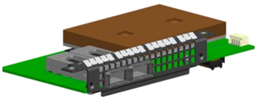
FPGA in the cloud
FPGA-based SmartNIC
  Bump-in-the-wire processing between
  NIC and ToR switch^{[1]}
Why FPGA?
  Massive parallelism
  - Millions of logic elements Thousands of “cores” in parallel
  - Thousands of memory blocks TB/s memory bandwidth
  Low power consumption (~20W)
  General computing platform (vs. GPU, NP)
  to accelerate various cloud services
  Mature technology with a reasonable price
[1] SIGCOMM’15 keynote (also the image source)
Notes:
There are several reasons for choosing FPGA as the accelerator.
First, FPGA has massive parallelism.
It has millions of logic elements, which can build thousands of “cores” running in parallel.
FPGA also has thousands of memory blocks, which can produce terabytes per second aggregated memory bandwidth.
Second, FPGA has low power utilization.
Third, FPGA is a general computing platform to accelerate various cloud services, for example Bing search ranking.
Finally, FPGA is a mature technology with reasonable price in recent years.

Slide 7
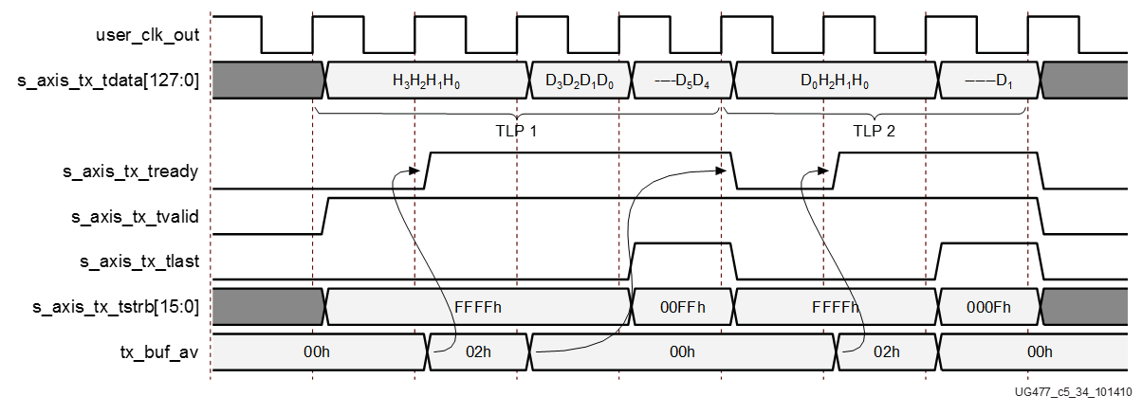

FPGA challenge: Programmability
Hardware description language (HDL): push many software developers away
PCIe Core
DMA Engine
always @ (posedge SYSCLK or negedge RST_B)
begin
if(!RST_B)
DMA_TX_DATA <= `UD 8'hff;
else
DMA_TX_DATA <= `UD DMA_TX_DATA_N;
end
//send: "hello world !"
always @ (posedge SYSCLK)
begin
if (rst) begin
dma_data <= 88’h0;
dma_valid <= 1’b0;
else
if (dma_start) begin
dma_data <= 88’h68656C6C6F20776F726C64;
dma_valid <= 1’b1;
end
else begin
dma_data <= 88’h0;
dma_valid <= 1’b0;
end
end
end
Ahhhhhhhhhhhh!
Notes:
The main challenge to use FPGA is programmability.
Conventionally, FPGA is programmed with low-level hardware description languages, such as Verilog and VHDL.
This example shows a HelloWorld program in Verilog.
To print a HelloWorld string on the screen, we first need to translate the string into ASCII codes.
In order to send the codes to the host memory, we need to write a DMA engine.
The DMA engine needs to call a PCI express IP core, which requires reading three hundred pages of manual to understand the interface.
The difficulty of hardware description languages have pushed many software developers away for years.

Slide 8
Project ClickNP
Making FPGA accessible to software developers
Flexibility: fully programmable using high-level language
Modularized: Click abstractions familiar to software developers; easy code reuse
High performance: high throughput; microsecond-scale latency
Joint CPU/FPGA packet processing: FPGA is no panacea; fine-grained processing separation
Notes:
In this work, we present ClickNP, a platform to make FPGA accessible to software developers.
We have several design goals.
First, the platform should be fully programmable using high-level languages.
Second, the platform should have a modular architecture familiar to software developers. In particular, we choose abstractions similar to the Click modular router for easy code reuse.
Third, the platform should provide high performance, both in terms of throughput and latency.
Finally, the platform should support joint CPU and FPGA packet processing. That’s because FPGA is not suitable for every kind of workload. We should support fine-grained processing separation between CPU and FPGA. This requires high performance and low latency communication between CPU and FPGA.

Slide 9
Programming model
as if programming on a multi-core processor
cores (elements) running in parallel
A
B
C
mem
mem
mem
communicate via channels, not shared memory
Notes:
ClickNP provides a modular programming model similar to the Click modular router.
Therefore, programming in ClickNP is much like programming on a multi-core processor.
There is one important difference, though.
In conventional multi-core processing, threads communicate via shared memory.
However, In ClickNP, the cores communicate via channels instead of shared memory.
Channel-based communication is more efficient in FPGA compared to shared global memory, because the shared global memory would be the bottleneck.

Slide 10
Element: single-threaded core
states
(reg/mem)
Process handler
input channels
output channels
(main thread)
(I/O)
(I/O)
Signal handler
(ISR)
signal/control from host
(interrupt)
Notes:
In ClickNP, the basic processing module is called an element, which resembles a single-threaded core.
Each element has the following components.
First, a set of local states that are only accessible inside the element.
Second, input and output channels to communicate with other elements.
Third, process handler, which is the main thread to read input channels, do processing and write to output channels in an infinite loop.
Finally, signal handler, which receives and processes commands from the manager thread in host program running on CPU. Signals resemble interrupts in CPU.

Slide 11
Extension 1: CPU element
  Write once, run on both FPGA and CPU
  Compile to a logic block on FPGA or a binary running on CPU
  Enable joint CPU/FPGA programming
  Simplify debugging
  PCIe I/O channel
  Enable fast communication between elements on FPGA and CPU
  Low latency: 1 μs
  High throughput: 25.6 Gbps (PCIe Gen2 x8)
Element A
(FPGA)
Element B
(CPU)
mem
mem
PCIe I/O
channel
Notes:
Because elements are written in C language, they can run on both FPGA and CPU.
Each element can be configured to compile to a logic block on FPGA, or compile to a thread running on CPU.
CPU elements enable joint CPU/FPGA programming and simplifies debugging. We can debug the elements with familiar debugging tools on CPU.
FPGA elements communicate with CPU elements via PCIe I/O channel.
It enables low latency and high throughput communication between elements on FPGA and CPU.

Slide 12
Extension 2: Verilog Element
  Embedding native Verilog code in ClickNP element
  Enable hybrid C/Verilog programming
  (analog to C/ASM in CPU world)
Notes:
A second extension to the element abstraction is Verilog element.
This is not in the paper, but current ClickNP also support that.
Verilog element enables hybrid C and Verilog programming, which is similar to C and assembly in CPU world.

Slide 13
Architecture
ClickNP host process
ClickNP elements
Mgr thrd
Worker thrd
ClickNP library
ClickNP host mgr
ClickNP script
PCIe I/O channel
vendor libs
Host
Catapult PCIe Driver
ClickNP compiler
FPGA
Intermediate C files
Catapult shell
ClickNP
C compiler
vendor HLS
Verilog
vendor specific runtime
Cross-platform toolchain
Altera OpenCL / Vivado HLS
Visual Studio / GCC
Notes:
Here we look at the architecture of the ClickNP toolchain.
A ClickNP program is divided into three parts, a set of ClickNP elements, a ClickNP script to define the connections among elements, and a ClickNP host manager program.

Slide 14
Architecture
ClickNP host process
ClickNP elements
Mgr thrd
Worker thrd
ClickNP library
ClickNP host mgr
ClickNP script
PCIe I/O channel
vendor libs
Host
Catapult PCIe Driver
ClickNP compiler
FPGA
Intermediate C files
Catapult shell
ClickNP
C compiler
vendor HLS
Verilog
vendor specific runtime
Cross-platform toolchain
Altera OpenCL / Vivado HLS
Visual Studio / GCC
Notes:
The ClickNP compiler first compiles the ClickNP program to intermediate C code.

Slide 15
Architecture
ClickNP host process
ClickNP elements
Mgr thrd
Worker thrd
ClickNP library
ClickNP host mgr
ClickNP script
PCIe I/O channel
vendor libs
Host
Catapult PCIe Driver
ClickNP compiler
FPGA
Intermediate C files
Catapult shell
ClickNP
C compiler
vendor HLS
Verilog
vendor specific runtime
Cross-platform toolchain
Altera OpenCL / Vivado HLS
Visual Studio / GCC
Notes:
Then we call a vendor HLS tool, for example Altera OpenCL or Vivado HLS, to compile the intermediate C code into Verilog code.

Slide 16
Architecture
ClickNP host process
ClickNP elements
Mgr thrd
Worker thrd
ClickNP library
ClickNP host mgr
ClickNP script
PCIe I/O channel
vendor libs
Host
Catapult PCIe Driver
ClickNP compiler
FPGA
Intermediate C files
Catapult shell
ClickNP
C compiler
vendor HLS
Verilog
vendor specific runtime
Cross-platform toolchain
Altera OpenCL / Vivado HLS
Visual Studio / GCC
Notes:
Finally we call the hardware synthesis toolchain to generate the FPGA bitstream.

Slide 17
Architecture
ClickNP host process
ClickNP elements
Mgr thrd
Worker thrd
ClickNP library
ClickNP host mgr
ClickNP script
PCIe I/O channel
vendor libs
Host
Catapult PCIe Driver
ClickNP compiler
FPGA
Intermediate C files
Catapult shell
ClickNP
C compiler
vendor HLS
Verilog
vendor specific runtime
Cross-platform toolchain
Altera OpenCL / Vivado HLS
Visual Studio / GCC
Notes:
And call a standard C compiler to compile the ClickNP host program.

Slide 18
Architecture
ClickNP host process
ClickNP elements
Mgr thrd
Worker thrd
ClickNP library
ClickNP host mgr
ClickNP script
PCIe I/O channel
vendor libs
Host
Catapult PCIe Driver
ClickNP compiler
FPGA
Intermediate C files
Catapult shell
ClickNP
C compiler
vendor HLS
Verilog
vendor specific runtime
Cross-platform toolchain
Altera OpenCL / Vivado HLS
Visual Studio / GCC
Notes:
In runtime environment, the Catapult shell is the operating system on the FPGA, which was developed by the Microsoft Catapult team.
The Catapult shell provides resource abstractions to the ClickNP application logic.
On host side, the ClickNP library provides PCIe I/O channel abstraction to the CPU elements, and enables the host program to communicate with FPGA elements via signals.

Slide 19
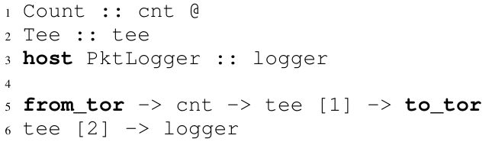
Example: Packet logger
from_tor
Count
Tee
to_tor
FPGA
CPU
logger
ClickNP Configuration:
Notes:
Here we look at an example network function, packet logger.
It receives packets from top-of-rack switch, counts number of packets in Count element, then makes a copy in Tee element.
One copy is forwarded back to ToR switch, the other copy is forwarded to a host element PktLogger running on CPU.
We can see that this PacketLogger needs only 5 lines of code for ClickNP configuration.

Slide 20
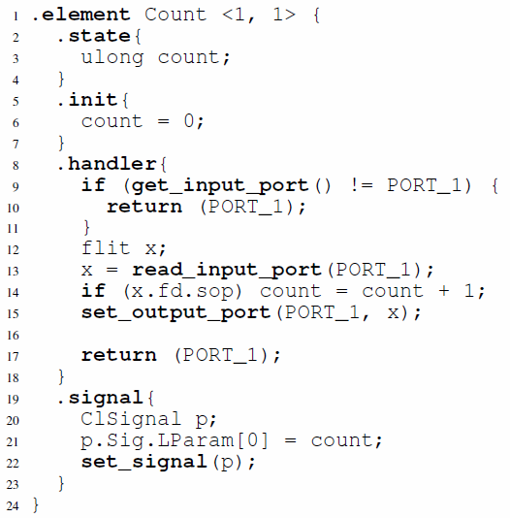
Example: Packet logger
from_tor
Count
Tee
to_tor
Count element:
FPGA
CPU
logger
ClickNP Configuration:
Notes:
Now we look at details of the Count element.
The first line of code shows that the Count element has one input channel and one output channel.
There is only one state variable, count, and initialized to zero.
In the handler, we first check whether or not the input channel has data to read. If so, we read a block of packet data from the input channel.
If the metadata indicates that it is start of packet, we increment the counter by one.
Finally we forward the data to the output port.
The signal handler simply writes the counter to a special structure called ClSignal, which is then returned to the manager thread in host program.

Slide 21
Parallelizing in FPGA
Parallelism across elements
  Pipeline parallelism
  Data parallelism
Parallelism inside an element
  Minimize memory dependency
  Use registers
  Delayed write
  Memory scattering
  Balance pipeline stages
  Unroll loops
  Offload slow path to another element
Notes:
Now we come to optimizations in ClickNP.
As we know, efficient FPGA code must utilize parallelism, which basically includes parallelism across elements and parallelism inside an element.
Due to time limitations, here I’m only going to discuss several of them. For the remaining ones, please refer to the paper.

Slide 22
Parallelism across elements
Pipeline parallelism
Duplicate pipeline to leverage data parallelism
e1
e2
e3
e1
e2
e3
demux
mux
e1
e2
e3
Notes:
First, parallelism across elements.
In ClickNP, packets flow from one element to another via a processing pipeline. Different pipeline stages, which means different elements, are processing different data in parallel. This is called pipeline parallelism.
If a single pipeline cannot sustain the required throughput, we can duplicate the pipeline to leverage data parallelism.

Slide 23
Parallelism inside element (1)
Element is synthesized into a pipeline
Loop
s
0
1
2
s
0
1
2
s
0
1
2
s
0
1
2
Output
+
+
+
Input pkt
Input
s += pkt[0]
time
s += pkt[1]
Input
+
+
+
Output
s += pkt[2]
Input
+
+
+
Output
Output s
Input
+
+
+
Output
Input
+
+
+
Output
Notes:
Next, parallelism inside element.
In ClickNP, each element is synthesized into a processing pipeline.
Different pipeline stages are processing different data in parallel.
Every clock cycle, one input datum is read, each pipeline stage moves to the next stage, and one output datum is written.
So the throughput is one datum per clock cycle.

Slide 24
Parallelism inside element (2)
Principle 1: Minimize memory dependency
time
Loop
Read
Inc
Write
Read input
Read
Inc
Write
Read mem
Read
Inc
Write
Increment
Memory dependency:
Read cannot start before last write,
because read and write addresses may conflict.
Write mem
Write out
Notes:
However, this efficient pipeline processing could break in several situations.
First, when there is memory dependency.
This example shows a most common case of memory dependency, the read-write dependency.
If the read and write operation accesses the same memory block, the read operation cannot start before last write operation, because read and write addresses may conflict.
Our principle is to minimize memory dependency.

Slide 25
Parallelism inside element (3)
Delayed write to remove read-write dependency
Loop
Loop
Memory read and write can operate in parallel:
Read in.addr, Write buf.addr
Different memory addresses!
Read input
Read input
Read mem
Y
in.addr = buf.addr?
N
Increment
Read buf
Read mem
Write mem
Mux
Write mem
Increment
Write out
Delayed write:
Buffer new data in a register
Delay memory write until next read
Write buf
Write out
Notes:
To resolve the read-write memory dependency, we use a technique called delayed write.
We buffer the new data in a register, and delay the memory write operation until the next read operation.
If the next read operation accesses the same memory address, we read the value from the buffer register directly.
Otherwise, the memory read and memory write can operate in parallel, because they access different memory addresses.
The ClickNP compiler can perform this delayed write optimization automatically.

Slide 26
Parallelism inside element (4)
Principle 2: Balance pipeline stages
Loop
time
Read Cache
Cache
Read DRAM
Output
Y
Cache
Read DRAM
Output
Hit?
N
Cache
Read DRAM
Output
Read DRAM
DRAM read is an unbalanced pipeline stage.
Pipeline is scheduled with a fixed interval to cover the worst-case latency.
So throughput is bottlenecked by DRAM read latency.
Output
Notes:
Except for memory dependency, another source of inefficiency in elements is unbalanced pipeline stages.
In this example, we first lookup the cache, if cache hit, directly output, if cache miss, then lookup the DRAM.
DRAM read has high latency, which is an unbalanced pipeline stage.
However, the pipeline is scheduled with a fixed interval to cover the worst-case latency.
So the throughput of the element is therefore bottlenecked by the DRAM read latency.

Slide 27
Parallelism inside element (5)
Offload slow path to another element
Original
Fast path
Slow path
Loop
Loop
Loop
Read Cache
Read Cache
From fast path
Y
Y
Hit?
Hit?
Read DRAM
N
N
Read DRAM
To slow path
From slow path
To fast path
Output
Output
Notes:
In this case, our solution is to offload the slow path to another element.
We move the “Read DRAM” part to another element called slow path.
The fast path element and slow path element are coordinated via channels.

Slide 28
Parallelism inside element (6)
Offload slow path to another element
time
3 cache hits:
Cache
Output
Cache
Output
Cache
Output
1 cache hit, 1 cache miss, 1 cache hit:
Cache
Output
Cache
To slow
Read DRAM
To fast
Output
Cache
Output
Notes:
After offloading, the fast path is no longer bottlenecked by the DRAM read.
If all packets hit the cache, then the fast path can process one packet per clock cycle.
If a packet is cache miss, then the fast path needs to wait for the slow path to read the DRAM.

Slide 29
ClickNP element library
Element | Fmax (MHz) | Peak Throughput | Delay (cycles) | Resource LE % | Resource BRAM %
L4_Parser | 221.9 | 113.6 Gbps | 11 | 0.8% | 0.2%
IPChecksum | 226.8 | 116.1 Gbps | 18 | 2.3% | 1.3%
NVGRE_Encap | 221.8 | 113.6 Gbps | 9 | 1.5% | 0.6%
AES_CTR | 217.0 | 27.8 Gbps | 70 | 4.0% | 23.1%
SHA1 | 220.8 | 113.0 Gbps | 105 | 7.9% | 6.6%
CuckooHash | 209.7 | 209.7 Mpps | 38 | 2.0% | 65.5%
HashTCAM | 207.4 | 207.4 Mpps | 48 | 18.7% | 22.0%
LPM_Tree | 221.8 | 221.8 Mpps | 181 | 4.3% | 13.2%
SRPrioQueue | 214.5 | 214.5 Mpps | 41 | 2.6% | 0.6%
RateLimiter | 141.5 | 141.5 Mpps | 14 | 16.9% | 14.1%
Throughput: 200 Mpps / 100 Gbps
Mean delay: 0.19 us, max delay: 0.8 us
Mean LoC: 80, max LoC: 196
Nearly 100 elements
20% re-factored from Click modular router
Cover packet parsing, checksum, tunnel
encap/decap, crypto, hash tables, prefix matching, packet scheduling, rate limiting…
Notes:
We have built a ClickNP element library with nearly 100 elements.
About 20% of them are re-factored from Click modular router, and the remaining ones cover lots of network functions.
This table shows some common elements in the element library, which cover packet parsing, checksum, tunnel encapsulation, crypto, hash tables, prefix matching, packet scheduling and rate limiting.

Slide 30
ClickNP element library
Element | Fmax (MHz) | Peak Throughput | Delay (cycles) | Resource LE % | Resource BRAM %
L4_Parser | 221.9 | 113.6 Gbps | 11 | 0.8% | 0.2%
IPChecksum | 226.8 | 116.1 Gbps | 18 | 2.3% | 1.3%
NVGRE_Encap | 221.8 | 113.6 Gbps | 9 | 1.5% | 0.6%
AES_CTR | 217.0 | 27.8 Gbps | 70 | 4.0% | 23.1%
SHA1 | 220.8 | 113.0 Gbps | 105 | 7.9% | 6.6%
CuckooHash | 209.7 | 209.7 Mpps | 38 | 2.0% | 65.5%
HashTCAM | 207.4 | 207.4 Mpps | 48 | 18.7% | 22.0%
LPM_Tree | 221.8 | 221.8 Mpps | 181 | 4.3% | 13.2%
SRPrioQueue | 214.5 | 214.5 Mpps | 41 | 2.6% | 0.6%
RateLimiter | 141.5 | 141.5 Mpps | 14 | 16.9% | 14.1%
Throughput: 200 Mpps / 100 Gbps
Mean delay: 0.19 us, max delay: 0.8 us
Mean LoC: 80, max LoC: 196
Nearly 100 elements
20% re-factored from Click modular router
Cover packet parsing, checksum,
encap/decap, hash tables, prefix matching,
rate limiting, crypto, packet scheduling…
Notes:
Leveraging the optimization techniques we just discussed, each element can achieve high throughput.

Slide 31
ClickNP element library
Element | Fmax (MHz) | Peak Throughput | Delay (cycles) | Resource LE % | Resource BRAM %
L4_Parser | 221.9 | 113.6 Gbps | 11 | 0.8% | 0.2%
IPChecksum | 226.8 | 116.1 Gbps | 18 | 2.3% | 1.3%
NVGRE_Encap | 221.8 | 113.6 Gbps | 9 | 1.5% | 0.6%
AES_CTR | 217.0 | 27.8 Gbps | 70 | 4.0% | 23.1%
SHA1 | 220.8 | 113.0 Gbps | 105 | 7.9% | 6.6%
CuckooHash | 209.7 | 209.7 Mpps | 38 | 2.0% | 65.5%
HashTCAM | 207.4 | 207.4 Mpps | 48 | 18.7% | 22.0%
LPM_Tree | 221.8 | 221.8 Mpps | 181 | 4.3% | 13.2%
SRPrioQueue | 214.5 | 214.5 Mpps | 41 | 2.6% | 0.6%
RateLimiter | 141.5 | 141.5 Mpps | 14 | 16.9% | 14.1%
Throughput: 200 Mpps / 100 Gbps
Mean delay: 0.19 us, max delay: 0.8 us
Mean LoC: 80, max LoC: 196
Nearly 100 elements
20% re-factored from Click modular router
Cover packet parsing, checksum,
encap/decap, hash tables, prefix matching,
rate limiting, crypto, packet scheduling…
Notes:
The delay of each element is also low. The maximum delay is below 1 microsecond.

Slide 32
ClickNP element library
Element | Fmax (MHz) | Peak Throughput | Delay (cycles) | Resource LE % | Resource BRAM %
L4_Parser | 221.9 | 113.6 Gbps | 11 | 0.8% | 0.2%
IPChecksum | 226.8 | 116.1 Gbps | 18 | 2.3% | 1.3%
NVGRE_Encap | 221.8 | 113.6 Gbps | 9 | 1.5% | 0.6%
AES_CTR | 217.0 | 27.8 Gbps | 70 | 4.0% | 23.1%
SHA1 | 220.8 | 113.0 Gbps | 105 | 7.9% | 6.6%
CuckooHash | 209.7 | 209.7 Mpps | 38 | 2.0% | 65.5%
HashTCAM | 207.4 | 207.4 Mpps | 48 | 18.7% | 22.0%
LPM_Tree | 221.8 | 221.8 Mpps | 181 | 4.3% | 13.2%
SRPrioQueue | 214.5 | 214.5 Mpps | 41 | 2.6% | 0.6%
RateLimiter | 141.5 | 141.5 Mpps | 14 | 16.9% | 14.1%
Throughput: 200 Mpps / 100 Gbps
Mean delay: 0.19 us, max delay: 0.8 us
Mean LoC: 80, max LoC: 196
Nearly 100 elements
20% re-factored from Click modular router
Cover packet parsing, checksum,
encap/decap, hash tables, prefix matching,
rate limiting, crypto, packet scheduling…
Notes:
Resource utilization of each element is also modest.
The BRAM usage typically depends on element configuration, for example flow table size.

Slide 33
Sample network functions
  Each NF takes about one week to develop
Network Function | Lines of Code * | Number of Elements | Resource LE % | Resource BRAM %
Pkt generator | 13 | 6 | 16% | 12%
Pkt capture | 12 | 11 | 8% | 5%
OpenFlow firewall | 23 | 7 | 32% | 54%
IPSec gateway | 37 | 10 | 35% | 74%
L4 load balancer | 42 | 13 | 36% | 38%
pFabric scheduler | 23 | 7 | 11% | 15%
* ClickNP configuration file
Notes:
Using the 100 elements in ClickNP, we have built several sample network functions.
Each network function only needs tens of lines of code for the ClickNP configuration file.
Each network function only takes about one week to develop.

Slide 34
Case study: IPSec gateway (1)
  Why IPSec datapath offloading?
  CPU is the bottleneck for computation intensive processing
  Even with AES-NI, software AES processing is far from 40 Gbps
  Currently X86 has no SHA-1 acceleration instructions
Notes:
For case study, here we show an example network function, IPSec gateway.
The datapath of IPSec gateway uses AES for encryption and SHA-1 for authentication, which is computation intensive.
Although CPU has AES-NI acceleration instructions, the throughput of software AES processing is still far from 40 Gbps.
Furthermore, currently there is no instructions to accelerate SHA-1 operations.

Slide 35
Case study: IPSec gateway (1)
  Why IPSec datapath offloading?
  CPU is the bottleneck for computation intensive processing
  Even with AES-NI, software AES processing is far from 40 Gbps
  Currently X86 has no SHA-1 acceleration instructions
Challenges to FPGA offloading
AES
Single AES element throughput is 27.8 Gbps (< 40 Gbps)
SHA-1
Packet payload is split into 64-byte data blocks
Dependency between successive data blocks in a packet
Only 1.07 Gbps if processed sequentially!
Notes:
There are two challenges in offloading IPSec datapath to FPGA.
For the AES part, a single AES element does not have enough throughput.
For the SHA-1 part, each packet payload is split into 64-byte data blocks.
There is dependency between successive data blocks in a packet, which means a data block cannot start processing before the previous one is finished.
If the packets are processed sequentially, the throughput will only be 1 Gbps.

Slide 36
Case study: IPSec gateway (2)
  Solution: Parallelizing in FPGA
AES-256-CTR: Leverage data parallelism
AES
Split
Merge
AES
Notes:
Our solution is to leverage two kinds of parallelism in FPGA.
AES encryption in counter mode can be parallelized relatively easily.
We leverage data parallelism and duplicate the AES element.

Slide 37
Case study: IPSec gateway (2)
  Solution: Parallelizing in FPGA
AES-256-CTR: Leverage data parallelism
SHA-1: Leverage packet-level parallelism
AES
Split
Merge
AES
  Process data blocks from different packets in parallel
Reservo
pkt 1
Reorder Buffer
…
scheduler
pkt n
SHA-1
Notes:
For the SHA-1 part, we leverage packet-level parallelism, because data blocks from different packets can be processed in parallel.
The reservo element buffers all the packets and schedules independent data blocks to the SHA-1 element.
Another subtle problem is packet out-of-order.
Because larger packets have more data blocks and have higher processing latency, the output packets from the Reservo element may get out of order.
So we add a reorder buffer element to recover the original packet ordering according to packet sequence number.
The reservo buffer size and reorder buffer size are less than 100 kilobytes.

Slide 38
Case study: IPSec gateway (2)
  Solution: Parallelizing in FPGA
AES-256-CTR: Leverage data parallelism
SHA-1: Leverage packet-level parallelism
AES
Split
Merge
AES
  Process data blocks from different packets in parallel
Reservo
pkt 1
Reorder Buffer
…
scheduler
pkt n
SHA-1
Notes:
Due to the flexibility of ClickNP, leveraging data and packet-level parallelism is pretty easy.
With C language and ClickNP framework, the three elements require less than five hundred lines of code and the development only takes one week.
However, if we use Verilog, it may require several thousand line of code and the development may take several weeks or even several months, if you are unlucky.

Slide 39
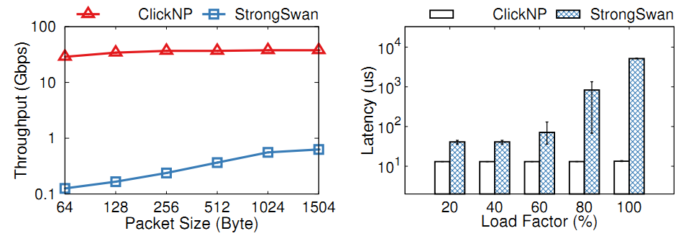
Case study: IPSec gateway (3)
  Single-tunnel performance
 | ClickNP | StrongSwan / Linux (out of the box)
Throughput | 37.8 Gbps | 628 Mbps
Latency | 13 us (stable) | 50us ~ 5ms
Notes:
We evaluate the single-tunnel performance of ClickNP, compared to a software network function, StrongSwan on Linux.
We used StrongSwan out of the box and did not try to optimize it.
Our IPSec gateway implementation on FPGA achieves 40 Gbps line-rate for any packet size.
The latency of our IPSec gateway is also much lower and much more stable than the CPU counterpart.
When the load factor is high, The latency of Linux will grow quickly.

Slide 40
Case study: L4 load balancer (1)
  Requires per-flow states for many flows
  32M concurrent flows in off-chip DRAM
  16K flow cache in on-chip BRAM
Network in
Parser
Flow cache
Mux
DRAM
Tunnel encap
Nexthop allocation
Network out
CPU element
Notes:
The second application I want to show here is a layer-4 load balancer.
L4 load balancer is a critical network function for Azure data center.
Every packet going into the data center hits the L4 load balancer.
So the L4 load balancer requires per-flow states for a large number of flows.
We maintain per-flow states in off-chip DRAM for 32 million concurrent flows.
Because DRAM access is slow, we design a flow cache with 16 thousand entries.

Slide 41
Case study: L4 load balancer (1)
  Requires per-flow states for many flows
  32M concurrent flows in off-chip DRAM
  16K flow cache in on-chip BRAM
  Requires complex nexthop allocation policy
  Nexthop allocation in CPU element: joint CPU/FPGA processing
Network in
Parser
Flow cache
Mux
DRAM
Tunnel encap
Nexthop allocation
Network out
CPU element
Notes:
The second requirement is complex nexthop allocation policy.
This policy is more suitable to run on CPU.
So we put the nexthop allocation element on CPU, which is an example for joint CPU and FPGA processing.

Slide 42
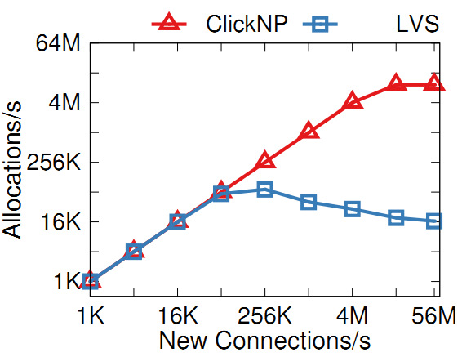
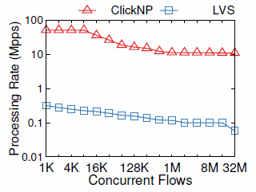
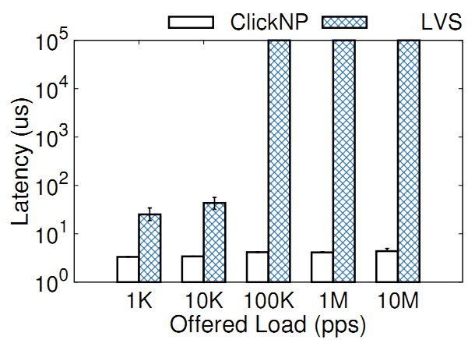
Case study: L4 load balancer (2)
  Performance
  10M new flows per second
  51Mpps for 8K flows
  11Mpps for 32M flows
  4us stable latency
Notes:
The L4 load balancer can sustain 10 million new connections per second.
The bottleneck is DRAM random access, instead of PCIe I/O channel to communicate with the nexthop allocation element on CPU.
When the number of concurrent flows is small, the throughput can achieve 50 million packets per second.
When the number of concurrent flows exceed flow cache size, the throughput begins to decrease due to cache miss.
The L4 load balancer also has microsecond-scale stable latency.

Slide 43
Area cost
Overhead compared to hand-written Verilog
NetFPFA Function | Resource Utilization Min / Max
 | LUTs | Registers | BRAMs
Input arbiter | 2.1x / 3.4x | 1.8x / 2.8x | 0.9x / 1.3x
Output queue | 1.4x / 2.0x | 2.0x / 3.2x | 0.9x / 1.2x
Header parser | 0.9x / 3.2x | 2.1x / 3.2x | N/A
Openflow table | 0.9x / 1.6x | 1.6x / 2.3x | 1.1x / 1.2x
IP checksum | 4.3x / 12.1x | 9.7x / 32.5x | N/A
Encap | 0.9x / 5.2x | 1.1x / 10.3x | N/A
Notes:
Finally, we study the area cost overhead of ClickNP compared to hand-written Verilog.
We pick up NetFPGA, which comes from Stanford and has good code quality.
For ClickNP, we implement equivalent functionality of several NetFPGA functions.
For most elements, overall the area cost overhead is less than two times.

Slide 44
Area cost
Overhead compared to hand-written Verilog
NetFPFA Function | Resource Utilization Min / Max
 | LUTs | Registers | BRAMs
Input arbiter | 2.1x / 3.4x | 1.8x / 2.8x | 0.9x / 1.3x
Output queue | 1.4x / 2.0x | 2.0x / 3.2x | 0.9x / 1.2x
Header parser | 0.9x / 3.2x | 2.1x / 3.2x | N/A
Openflow table | 0.9x / 1.6x | 1.6x / 2.3x | 1.1x / 1.2x
IP checksum | 4.3x / 12.1x | 9.7x / 32.5x | N/A
Encap | 0.9x / 5.2x | 1.1x / 10.3x | N/A
Notes:
For small elements, the overhead is relatively large, but the absolute overhead is small.
This is because every element is compiled to a logic block. High-level synthesis tools generate a wrapper with a fixed logic overhead.

Slide 45
Area cost
Overhead compared to hand-written Verilog
NetFPFA Function | Resource Utilization Min / Max
 | LUTs | Registers | BRAMs
Input arbiter | 2.1x / 3.4x | 1.8x / 2.8x | 0.9x / 1.3x
Output queue | 1.4x / 2.0x | 2.0x / 3.2x | 0.9x / 1.2x
Header parser | 0.9x / 3.2x | 2.1x / 3.2x | N/A
Openflow table | 0.9x / 1.6x | 1.6x / 2.3x | 1.1x / 1.2x
IP checksum | 4.3x / 12.1x | 9.7x / 32.5x | N/A
Encap | 0.9x / 5.2x | 1.1x / 10.3x | N/A
Area cost will be less of a concern
Quickly growing FPGA capacity: 1x (2013), 2.5x (2015), 10x (2018)
Notes:
Furthermore, the capacity of FPGA is growing quickly in recent years.
We believe that the area cost will be less of a concern in the future.

Slide 46
Conclusion
FPGA in the cloud
  Fast, general and mature
ClickNP: programming hardware as software
  Highly flexible: Program with high-level language
  Modular: Click-like abstractions
  High performance: Utilize massive parallelism in FPGA
  Joint CPU/FPGA packet processing
Start from network processing, but it goes beyond…
  General framework for programming on FPGA
  Azure storage, Bing search, machine learning…
Notes:
Finally, the conclusion.
FPGA is fast, general and mature, so we have deployed FPGA at scale in the cloud.
This work presents ClickNP, a network processing platform to enable software developers to program hardware, which is highly flexible, modular, high performance and supports joint CPU/FPGA packet processing.
In addition to network processing, ClickNP is a general framework for programming on FPGA.
With FPGAs in datacenters, we can go beyond the memory wall and reach a fully programmable world.

Slide 47
Thank you!
Questions!
Check out our demo on Thursday!
Notes:
Please check out our demo on Thursday.
Thank you for listening!

Slide 50
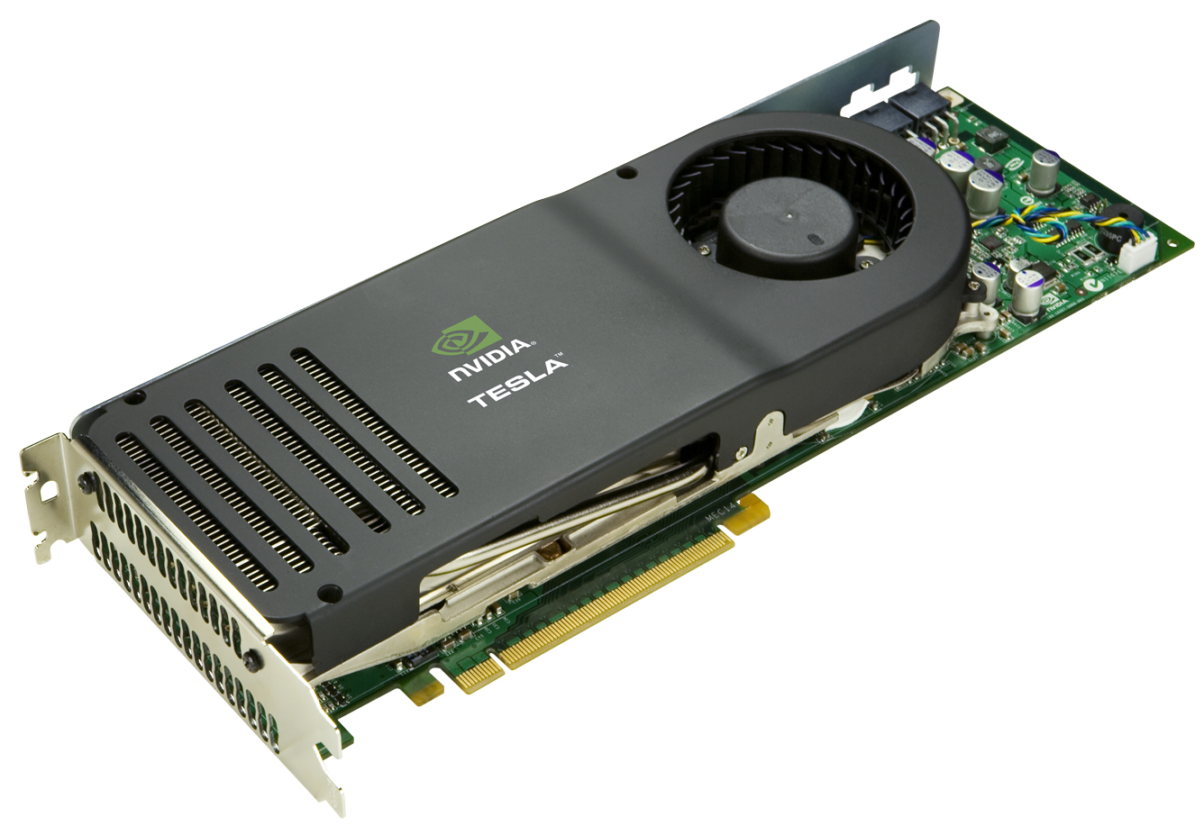
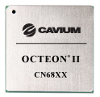
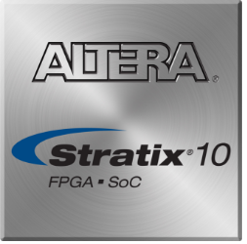
Acceleration in host
Offloading software NFs to accelerator
 | GPU | NP | FPGA
Throughput | High | High | High
Latency | High | Low | Low
Power | High | Low | Low
General computing | Yes | No | Yes
Notes:
To accelerate software network functions, while keeping flexibility, recent works have proposed to offload software network functions to hardware accelerators, including GPU, network processor and FPGA.
Compared to GPU, FPGA has lower latency and is more power efficient.
Compared to network processors, FPGA is more flexible and can be programmed for general computing.

Slide 51
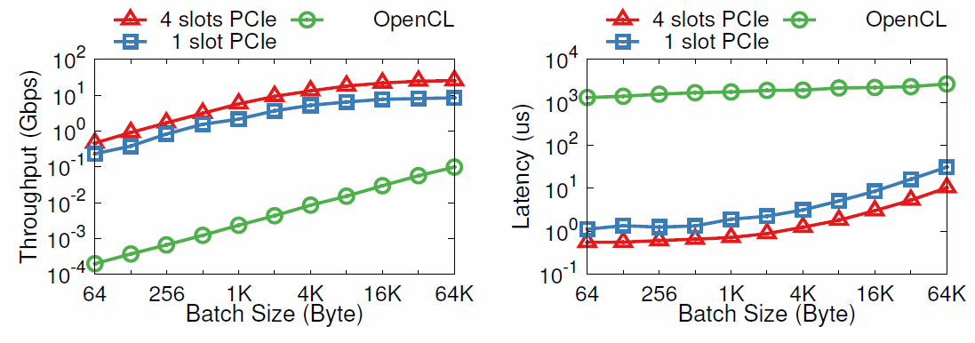
Performance of PCIe I/O channel

Slide 52
High level synthesis not sufficient
HLS tools (e.g. Vivado HLS)
  Only auxiliary tools for HDL tool chains
  Generated hardware modules (IP cores) need to be integrated manually
OpenCL (e.g. Altera)
  The OpenCL programming model is designed for batch processing in GPU => high latency
  Packet processing should use stream processing model
  Does not support joint CPU/FPGA processing well
  Click2NetFPGA
  Low performance because not fully pipelined
  Unable to update configuration while data plane running
Notes:
There have been many high level synthesis tools to compile code in high-level language to hardware description languages, but none of them is suitable for network function processing.
Most HLS tools are only supplementary tools for hardware development toolchains. The generated hardware modules need to be integrated manually to an HDL project, which is an impossible mission for most software programmers.
Recently there are several frameworks based on OpenCL that treat FPGA as a co-processor of CPU and provides an integrated development environment that resembles GPU programming.
eral However, the OpenCL programming model is designed for batch processing in GPU, which incurs high latency.
Packet processing should use stream processing model, which is more natural for FPGA.
Furthermore, OpenCL does not support joint CPU/FPGA processing well. All communication between FPGA and CPU must go through on-board DRAM and cannot be pipelined, which has very high latency and low throughput.
Click2NetFPGA directly compiles a Click modular router program into FPGA.
But the performance is much lower than ClickNP due to several bottlenecks in the Click program which does not fit FPGA architecture.
Click2NetFPGA also does not support joint CPU/FPGA processing. Therefore, we cannot update configuration or read states while data plane is running.

Slide 53
cross-platform toolchain
three parts of source files
  Define elements ➔ ClickNP extended C
  Define a configuration of elements ➔ ClickNP script language
  Host manager program ➔ C/C++
make tool to glue all compile procedures
  Source files (.cl/.cfg/.cpp)→ ClickNP compiler (clc) → intermediate source files (.cl/.cpp)
  FPGA program → aoc/Vivado
  Host program → Microsoft cl + OpenCL libs
platform supported
Windows/Linux, Altera/Xilinx
ChinaSys 2016, Beijing

Slide 54
Why do not simply use OpenCL?
OpenCL is for batch processing on GPU
A
B
C
mem
mem
mem
Shared On-board DRAM
Communicate by sharing memory
Shared memory is the bottleneck!
Batch processing has large latency!
Notes:
On the last slides, I mentioned that we compile ClickNP to OpenCL, then use an HLS tool to compile OpenCL to Verilog.
It is natural to ask, is it possible to directly use OpenCL for network processing?
Our answer is no.
OpenCL is designed for batch processing on GPU.
The kernels communicate by shared memory, which corresponds to the on-board DRAM.
First, a single shared DRAM has limited throughput, which will be the bottleneck.
Second, DRAM random access throughput is much lower than sequential access. So we need to access DRAM in large chunks in order to use it efficiently.
This would require processing packets in batches, which would introduce non-trivial latency.

Slide 55
Programming model
ClickNP is for stream processing on FPGA
A
B
C
mem
mem
mem
Channels: more efficient than shared memory
Do not communicate by sharing memory;
instead, share memory by communicating.
-- The slogan of Go language
Notes:
On the other hand, ClickNP is designed for stream processing on FPGA.
In the ClickNP programming model, there is no shared memory among elements.
We do not communicate by sharing memory; instead, share memory by communicating.
Message-based coordination allows more parallelism and is more efficient in FPGA.

Slide 56
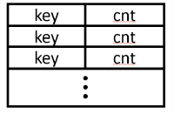
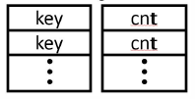
Parallelism inside element (2)
Memory scattering: avoid false dependency
Loop
Read key
Normal memory placement
After memory scattering
Check key
Read
Check
Read
Inc
Write
Read
Check
Read
Inc
Write
Read counter
Increment
R1
C1
R2
I2
W2
Write counter
R1
C1
R2
I2
W2
Notes:
There may be also be false memory dependency in an array of packed structures.
For example, assume there is an array of keys and counters.
In normal memory placement, key and counter will be packed together, so they have to be read and written together.
There will be false memory dependency between the increment operation and check key operation, even after data forwarding.
To remove such dependency, we scatter an array of structure to several independent arrays. So accesses to key and counter fields will no longer depend on each other.

Slide 57
Parallelism inside element (3)
Unroll loops to balance pipeline stages
Loop
Input
Loop
Input
sum
Cksum
Input
Input
Input
i<4
Cksum
Cksum
unroll
i=0
sum
sum += pkt[0]
Cksum
Cksum
i<4
Cksum
Cksum
Inner loop
sum += pkt[1]
sum
Output
Cksum
sum += pkt[i]
i<4
sum += pkt[2]
Output
i<4
sum
sum += pkt[3]
i<4
Output
Output
Output
Input
sum
Notes:
Another source of inefficiency in elements is unbalanced pipeline stages.
The inner loop is a fat pipeline stage which takes multiple cycles to finish, significantly reducing the throughput of the pipeline.
We unroll the loop because the number of loop iterations can be determined at compilation time.
After unroll, the loop breaks into a sequence of small operations.
Then the element can be pipelined.

Slide 58
Parallelism inside element (4)
Offload slow path to another element
Loop
Read
Throughput constrained by slow path
Slow
path
After offloading:
Read Cache
Hit?
Loop
Slow element
Slow path
Output
Read
Read Cache
Slow path
Slow
path
Hit?
To slow element
Output
Output
Output
Output
Notes:
For other fat pipeline stages that cannot be unrolled, we offload the slow path to another element.
Before offloading, the throughput is constrained by the slow path.
After offloading the slow “else” branch to another element, the fast path is no longer blocked by the slow path and can process packets in pipeline.

