Slide 1
Towards SmartNICs in Data Center Systems
Bojie Li
Computer Network and Protocol Lab, Huawei

Slide 2
Thanks
Thank the ACM China Doctoral Dissertation Award committee and the ACM ChinaSys Doctoral Dissertation Award committee for nominating me for the award.
Thank my advisors Prof. Enhong Chen, Prof. Lintao Zhang, and Prof. Kun Tan for the guidance during my joint Ph.D. program at USTC and MSRA (2014-2019).
Thank all collaborators of my research projects.

Slide 3
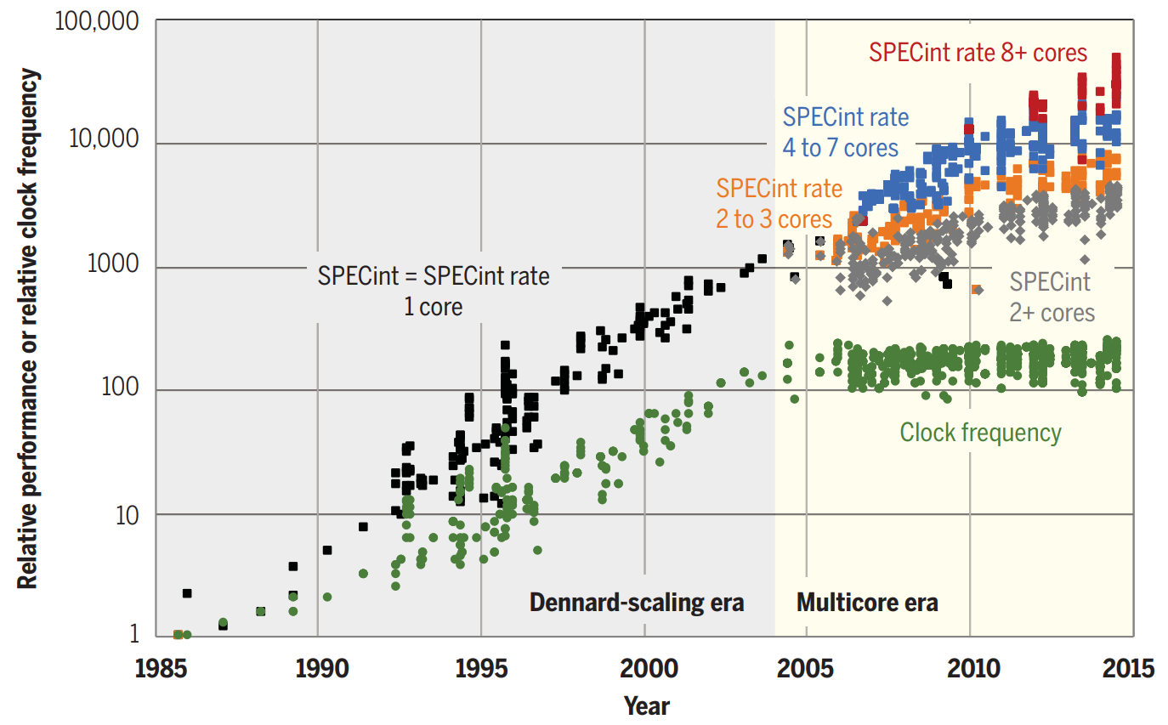
There’s plenty of room at the Top
The miniaturization of semiconductor transistors has driven the growth in computer performance for more than 50 years.
  There’s plenty of room at the Bottom – Richard Feynman, 1959.
As miniaturization approaches its limits, bringing an end to Moore’s law, performance gains will need to come from software, algorithms, and hardware.
Source: There’s plenty of room at the Top: What will drive computer performance after Moore’s law?

Slide 4
Network & storage still follow Moore’s Law
Throughput (Gbps)
NVMM, 16 GB/s
40 GbE
50 GbE
100 GbE
10 GbE
NVMe SSD, 4 GB/s
Moore’s Law
(2x per 1.5 years)
LOG SCALE
SATA SSD, 1 GB/s
1 GbE
HDD, 40 MB/s
Estimated Year of Deployment

Slide 5
Challenges for software network functions
Limited processing capacity
  Number of CPU cores needed for 40 Gbps line rate
Inflated and unstable latency
  Add tens of microseconds to milliseconds latency to data plane
  Latency may grow to milliseconds under high load
  1 ms occasional delay would violate SLA (e.g., trading services)
Network function | Implementation | 1500B pkt @ 40 Gbps (normal case) | 64B pkt @ 40 Gbps (worst-case estimate)
NVGRE tunnel encapsulation | Hyper-V virtual switch | 5 | 100
Firewall (8K rules) | Linux iptables | 21 | 480
Notes:
Second, software network functions have inflated and unstable latency.
A software-based network function adds tens of microseconds to milliseconds latency to the data plane.
When the load is high, this latency may grow to several milliseconds.
However, an occasional delay of one millisecond would already violate the service level agreement for delay sensitive applications.

Slide 6
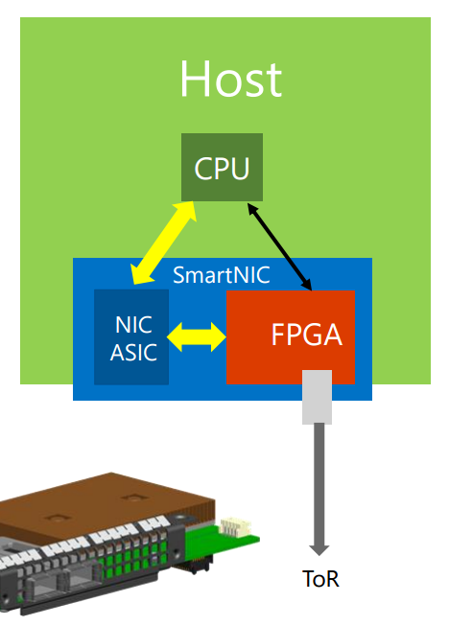
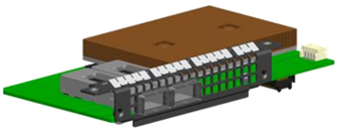
FPGAs in the cloud
FPGA-based SmartNIC
  Bump-in-the-wire processing between
  NIC and ToR switch^{[1]}
Why FPGA?
  Massive parallelism
  - Millions of logic elements Thousands of “cores” in parallel
  - Thousands of memory blocks TB/s memory bandwidth
  Low power consumption (~20W)
  General computing platform (vs. GPU, NP)
  to accelerate various cloud services
  Mature technology with a reasonable price
[1] Albert Greenberg, SIGCOMM’15 keynote (also the image source)
Notes:
There are several reasons for choosing FPGA as the accelerator.
First, FPGA has massive parallelism.
It has millions of logic elements, which can build thousands of “cores” running in parallel.
FPGA also has thousands of memory blocks, which can produce terabytes per second aggregated memory bandwidth.
Second, FPGA has low power utilization.
Third, FPGA is a general computing platform to accelerate various cloud services, so the hardware investment can be amortized by multiple applications.
Finally, FPGA is a mature technology with reasonable price in recent years.

Slide 7
1. Network Function Acceleration
Compute Node
Network Node
Hypervisor
Programmable
NIC
VNF Data Plane
VNF Control Plane
VM1
VM2
VM3
App
App
App
Storage Node
OS
OS
OS
Virt Disk
Virt Disk
Virt Net
Data Structure
NIC
DDR / Flash
NIC
DDR / Flash
Data center network

Slide 8
ClickNP: Highly Flexible and High Performance Network Processing with Reconfigurable Hardware
SIGCOMM’16
Bojie Li^{1,2}, Kun Tan¹, Layong (Larry) Luo¹, Yanqing Peng^{1,3}, Renqian Luo^{1,2}, Ningyi Xu¹, Yongqiang Xiong¹, Peng Cheng¹, Enhong Chen²
¹Microsoft Research, ²USTC, ³SJTU

Slide 9
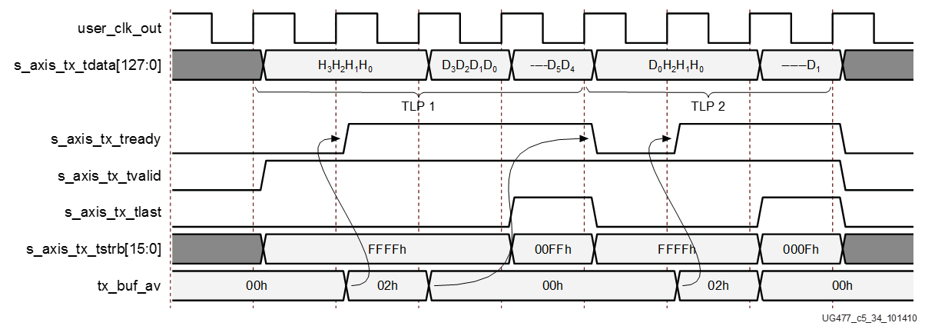

FPGA challenge: Programmability
Hardware description language (HDL): push many software developers away
PCIe Core
DMA Engine
always @ (posedge SYSCLK or negedge RST_B)
begin
if(!RST_B)
DMA_TX_DATA <= `UD 8'hff;
else
DMA_TX_DATA <= `UD DMA_TX_DATA_N;
end
//send: "hello world !"
always @ (posedge SYSCLK)
begin
if (rst) begin
dma_data <= 88’h0;
dma_valid <= 1’b0;
else
if (dma_start) begin
dma_data <= 88’h68656C6C6F20776F726C64;
dma_valid <= 1’b1;
end
else begin
dma_data <= 88’h0;
dma_valid <= 1’b0;
end
end
end
Ahhhhhhhhhhhh!
Notes:
The main challenge to use FPGA is programmability.
Conventionally, FPGA is programmed with low-level hardware description languages, such as Verilog and VHDL.
This example shows a HelloWorld program in Verilog.
To print a HelloWorld string on the screen, we first need to translate the string into ASCII codes.
In order to send the codes to the host memory, we need to write a DMA engine.
The DMA engine needs to call a PCI express IP core, which requires reading three hundred pages of manual to understand the interface.
The difficulty of hardware description languages have pushed many software developers away for years.

Slide 10
Project ClickNP
Making FPGA accessible to software developers
Flexibility: fully programmable using high-level language
Modularized: Click abstractions familiar to software developers; easy code reuse
High performance: high throughput; microsecond-scale latency
Joint CPU/FPGA packet processing: FPGA is no panacea; fine-grained processing separation
Notes:
In this work, we present ClickNP, a platform to make FPGA accessible to software developers.
We have several design goals.
First, the platform should be fully programmable using high-level languages.
Second, the platform should have a modular architecture familiar to software developers. In particular, we choose abstractions similar to the Click modular router for easy code reuse.
Third, the platform should provide high performance, both in terms of throughput and latency.
Finally, the platform should support joint CPU and FPGA packet processing. That’s because FPGA is not suitable for every kind of workload. We should support fine-grained processing separation between CPU and FPGA. This requires high performance and low latency communication between CPU and FPGA.

Slide 11
Programming model
as if programming on a multi-core processor
cores (elements) running in parallel
A
B
C
mem
mem
mem
communicate via channels, not shared memory
Notes:
ClickNP provides a modular programming model similar to the Click modular router.
Therefore, programming in ClickNP is much like programming on a multi-core processor.
There is one important difference, though.
In conventional multi-core processing, threads communicate via shared memory.
However, In ClickNP, the cores communicate via channels instead of shared memory.
Channel-based communication is more efficient in FPGA compared to shared global memory, because the shared global memory would be the bottleneck.

Slide 12
Element: single-threaded core
states
(reg/mem)
Process handler
input channels
output channels
(main thread)
(I/O)
(I/O)
Signal handler
(ISR)
signal/control from host
(interrupt)
Notes:
In ClickNP, the basic processing module is called an element, which resembles a single-threaded core.
Each element has the following components.
First, a set of local states that are only accessible inside the element.
Second, input and output channels to communicate with other elements.
Third, process handler, which is the main thread to read input channels, do processing and write to output channels in an infinite loop.
Finally, signal handler, which receives and processes commands from the manager thread in host program running on CPU. Signals resemble interrupts in CPU.

Slide 13
Architecture
ClickNP host process
ClickNP elements
Mgr thrd
Worker thrd
ClickNP library
ClickNP host mgr
ClickNP script
PCIe I/O channel
vendor libs
Host
Catapult PCIe Driver
ClickNP compiler
FPGA
Intermediate C files
Catapult shell
ClickNP
C compiler
vendor HLS
Verilog
vendor specific runtime
Cross-platform toolchain
Altera OpenCL / Vivado HLS
Visual Studio / GCC
Notes:
In runtime environment, the Catapult shell is the operating system on the FPGA, which was developed by the Microsoft Catapult team.
The Catapult shell provides resource abstractions to the ClickNP application logic.
On host side, the ClickNP library provides PCIe I/O channel abstraction to the CPU elements, and enables the host program to communicate with FPGA elements via signals.

Slide 14
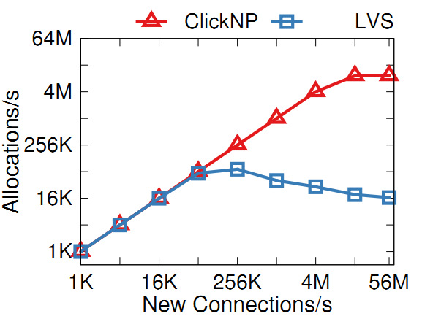
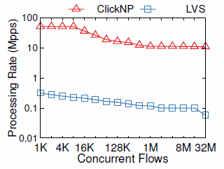
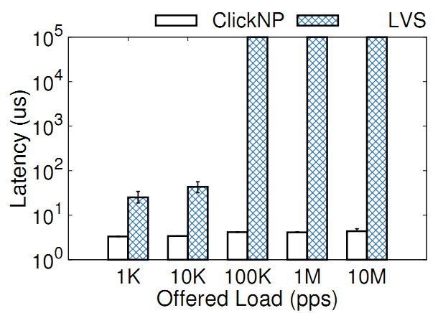
Case study: L4 load balancer
  Performance
  10M new flows per second
  51Mpps for 8K flows
  11Mpps for 32M flows
  4us stable latency
Notes:
The L4 load balancer can sustain 10 million new connections per second.
The bottleneck is DRAM random access, instead of PCIe I/O channel to communicate with the nexthop allocation element on CPU.
When the number of concurrent flows is small, the throughput can achieve 50 million packets per second.
When the number of concurrent flows exceed flow cache size, the throughput begins to decrease due to cache miss.
The L4 load balancer also has microsecond-scale stable latency.

Slide 15
2. Data Structure Acceleration
Compute Node
Network Node
Hypervisor
Programmable
NIC
VNF Data Plane
VNF Control Plane
VM1
VM2
VM3
App
App
App
Storage Node
OS
OS
OS
Virt Disk
Virt Disk
Virt Net
Programmable
NIC
Data Structure Control Plane
Data Structure Data Plane
DDR / Flash
NIC
DDR / Flash
Data center network

Slide 16
KV-Direct: High-Performance In-Memory Key-Value Store with Programmable NIC
SOSP ’17
Bojie Li^{1,2} Zhenyuan Ruan^{1,3} Wencong Xiao^{1,4} Yuanwei Lu^{1,2} Yongqiang Xiong¹ Andrew Putnam¹ Enhong Chen²
Lintao Zhang¹
¹Microsoft Research ²USTC ³UCLA ⁴Beihang University
Notes:
Thanks Adita for the introduction.
Hello everyone, I’m Bojie Li, a fourth year PhD student in a joint PhD program of USTC and Microsoft Research.
In this session we have seen two wonderful works, Eris and NetCache to use in-network processing with dataplane programmable switches to accelerate systems.
Now I will show programmable NICs can also be very useful in accelerating datacenter workloads.
Our KV-Direct work is done during internship in Microsoft Research Asia with my colleagues. Zhenyuan Ruan and me are co-first authors who design and implement this system together.

Slide 17

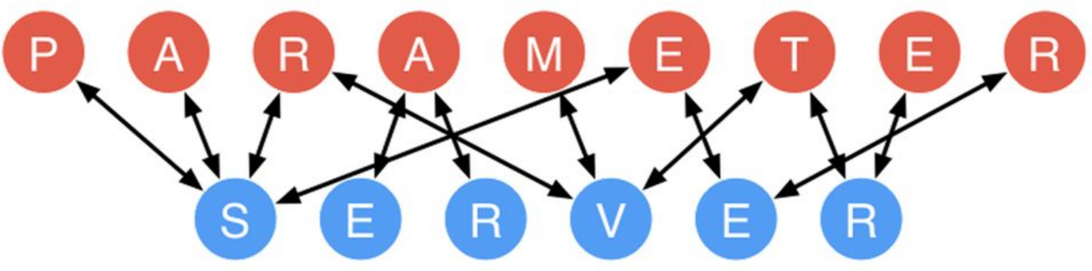
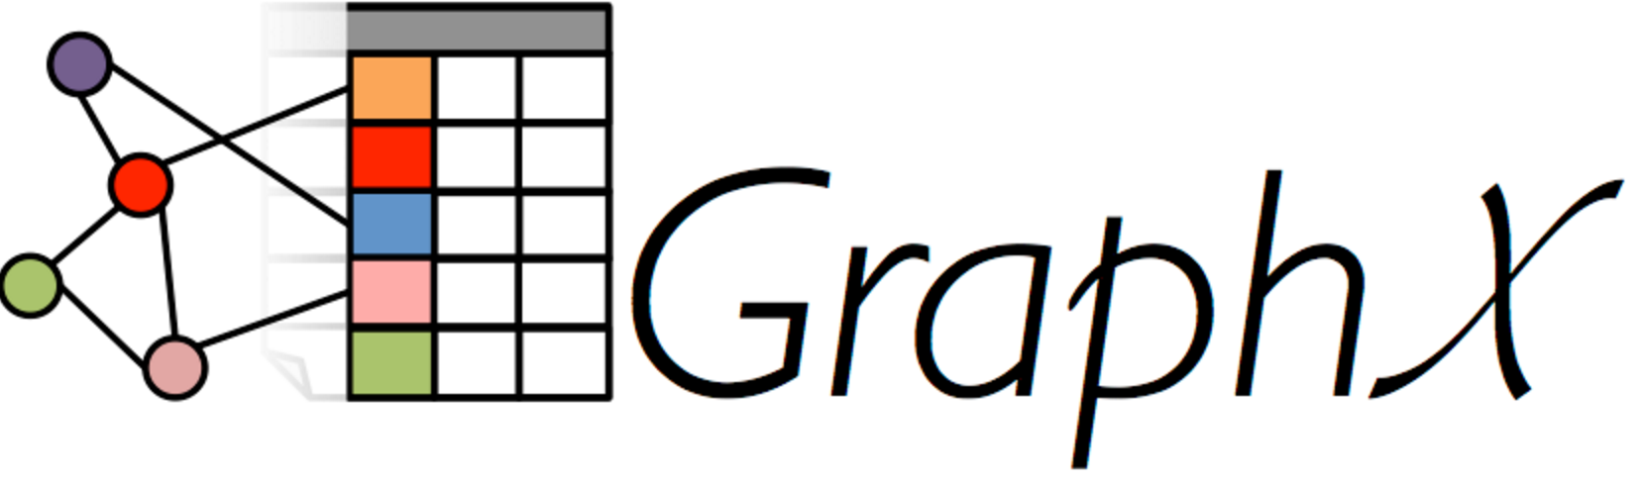

Key-Value Store in Data Centers
Web Cache
Shared Data Structure
Key
Value
Key
Value
User ID
Recent Tweets
Graph node
List of edges
SQL
Query result
Feature
Weight
Session
Browser cookies
Shard
Sequence number
More demanding workload
Notes:
In recent years, key-value store goes beyond object caching and becomes an infrastructure service to store shared data structure in a distributed system.
Examples include parameter servers in machine learning, graph computing engine and sequencers for distributed transactions, as the Eris paper in this session just said.
Shared data structure stores demands more performance compared to web cache.

Slide 18
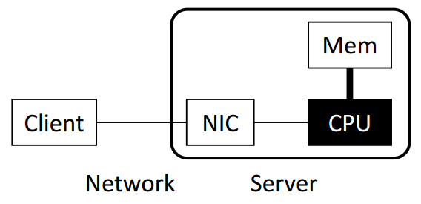
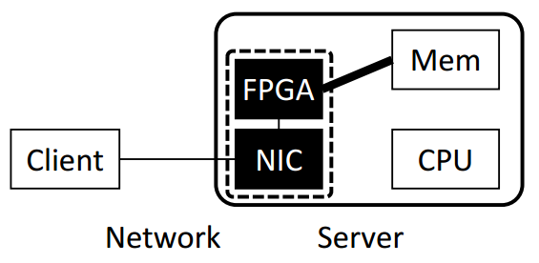
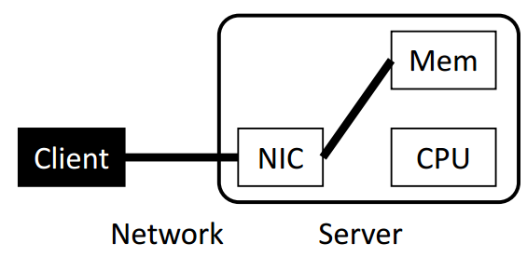
Key-Value Store Architectures
Software
(Kernel TCP/IP)
Bottleneck: OS TCP/IP Stack
Software
(Kernel Bypass)
Bottleneck: CPU random memory access & KV processing
KV-Direct FPGA + NIC
Offload KV processing on CPU
to Programmable NIC
One-sided RDMA
Leverage the SmartNIC to access remote data structures in host memory without involving CPU
Key-value store is only an example
Bottlenecks:
1. Multiple round-trips per KV op
2. Synchronization among writes
Notes:
We propose KV-Direct to offload KV processing on CPU to programmable NIC.
The name of KV-Direct means that the NIC directly fetches data and applies updates in the host memory to serve KV requests, completely bypassing server CPU.

Slide 19
Performance Challenges
40 GbE
Reconfigurable NIC
NIC
ToR switch
On-board DRAM (4 GB)
FPGA
Header overhead and limited parallelism:
Be frugal on
memory accesses
PCIe Gen3
x16 DMA
13 GB/s
120 Mops
Host DRAM (256 GB)
CPU
Notes:
First, our PCIe interface between FPGA and host memory has limited throughput.
There is something worse. PCIe transport layer packets has header overhead, and the PCIe IP core in our FPGA has limited parallelism, which limits our PCIe throughput to 120 million operations per second.
So we need to be frugal on memory accesses.

Slide 20
Performance Challenges
40 GbE
Reconfigurable NIC
NIC
ToR switch
On-board DRAM (4 GB)
FPGA
Atomic operations have dependency:
PCIe latency hiding
PCIe Gen3
x16 DMA
1us delay
120 Mops
Host DRAM (256 GB)
CPU
Notes:
Second, the PCIe bus has delay of nearly 1 microsecond, due to additional delay in the PCIe IP core in our FPGA.
When atomic operations operate on the same key, they depend on the result of each other and needs to executed one by one.
Therefore, we need to hide the PCIe latency, otherwise the throughput will degrade to 1 million operations per second.

Slide 21
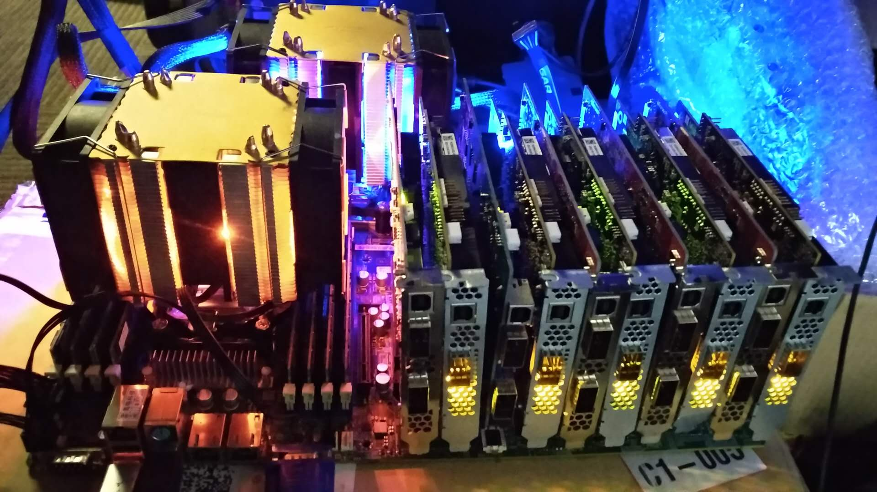
KV-Direct Performance
1.22 billion KV op/s
357 watts power
Notes:
This photo is our test server with 10 programmable NICs, two Xeon E5 processors and 128 Gigabytes of memory.
Each programmable NIC is connected to the motherboard via 8 lanes of PCIe Gen3, so the 10 NICs saturate the 80 PCIe lanes from two Xeon E5 processors.
(click) With 10 programmable NICs, KV-Direct achieves 1.2 billion key-value operations per second with less than 400 watts of power consumption, setting a new milestone for general purpose key-value stores.

Slide 22
We expect future SmartNICs to tightly integrate with host CPU
SoC
Core 1
Core 2
Core 3
Core 1
Core 2
Core 3
PCIe RC
Mem controller
NIC
Mem controller
PCIe
DDR
DDR
NIC
Recall: why we need to be frugal on memory accesses? Why we need to hide PCIe latency?

Slide 23
3. Acceleration of OS Communication Primitives
Compute Node
Network Node
Hypervisor
Programmable
NIC
VNF Data Plane
VNF Control Plane
VM1
VM2
VM3
App
App
App
OS (Socket)
OS (Socket)
OS (Socket)
Storage Node
vNIC1
vNIC2
vNIC3
Programmable
NIC
Data Structure Control Plane
Data Structure Data Plane
Programmable
NIC
Virt Disk
Mem / Flash
Virt Net
DDR / Flash
Communication Protocol
Data Center Network

Slide 24
SocksDirect: Datacenter Sockets can be Fast and Compatible
SIGCOMM ‘19
Bojie Li*^{1,2} Tianyi Cui*³ Zibo Wang^{1,2} Wei Bai¹ Lintao Zhang¹
¹Microsoft Research ²USTC ³University of Washington
* Co-first authors

Slide 25
Socket: a Performance Bottleneck
Socket syscall time >> user application time
Socket latency >> hardware transport latency
Notes:
Traditionally, sockets are implemented in the OS kernel. We all know that kernel socket is very slow. To show this point, we profile several popular applications in data centers. We can see that 70% to 90% of CPU time is used in OS kernel, which means it is handling the socket system calls. If we could eliminate the overhead of OS kernel and all CPU time can be utilized by the user space application, the application throughput will improve by several times.
Next we look at the latency, and the problem is more severe than throughput. For communication between two directly connected servers, socket latency is 17x of RDMA. For intra-host communication, socket latency is 40x of shared memory queue. In this work, we try to answer one question: is this socket overhead an intrinsic property of the socket abstraction, or we can do something to eliminate the socket overhead?

Slide 26
High Performance Socket Systems
Kernel Optimization
User-space TCP/IP
Offload to RDMA NIC
User App
User App
User App
User App
User App
User App
Kernel VFS
User-space VFS
User-space VFS
User-space VFS
User-space VFS
Kernel TCP/IP
User-space TCP/IP
User-space TCP/IP
NIC RDMA API
Hardware-based Transport
NIC packet API
NIC packet API
TCP/IP
Host 1
TCP/IP
Host 1
RDMA
Host 1
Host 2
Host 2
Host 2
NIC packet API
NIC packet API
NIC RDMA API
Kernel
User-space Stack
User-space VFS
User App
User App
User App
FastSocket, Megapipe, StackMap…
IX, Arrakis, SandStorm, mTCP,
LibVMA, OpenOnload…
Rsocket, SDP, FreeFlow…
Notes:
There have been extensive research to improve the performance of socket systems.
The first category is to optimize the kernel. A socket stack basically divides into three layers. The first layer is the virtual file system, VFS, because each socket connection is regarded as a file in Linux, and a file descriptor is mapped for the socket. The second layer is the kernel TCP/IP stack that provides the transport function. The third layer is the hardware interface layer. Linux kernel uses a packet API.
The second category is to implement the VFS abstraction and TCP/IP transport in the user space. It not only move the kernel functions into user space, but also greatly simplify the functions, for example, use polling to avoid the interrupt and process scheduling overheads.
The third category is to offload the transport to the NIC. Here we recall some history of hardware-based transports. TCP offload is not a new thing. In 1990s, there has been Ethernet cards that

Slide 27
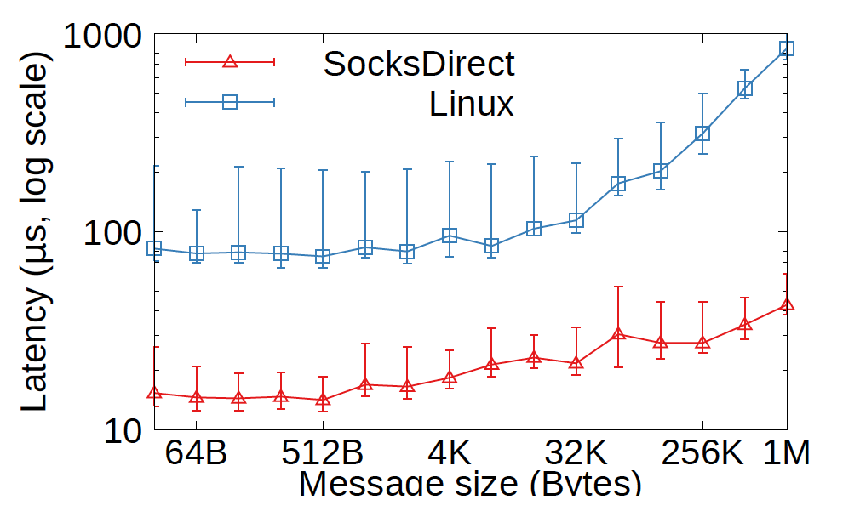
Application Performance
Nginx HTTP server request latency
Notes:
Nginx HTTP server between two hosts: small HTTP messages, 5x lower than Linux. For large message, 13x lower than Linux due to zero copy.

Slide 28


The Future of SmartNICs
Data center as a computer
SmartNICs build the hardware acceleration plane
DRAM
DRAM
Hardware acceleration plane
CPU
CPU
Deep neural networks
UPI
SQL
Web search ranking
SDN offload
Fast Bus
Web search ranking
GPU/NPU
Program-mable NIC
2
Traditional software (CPU) server plane
Network
ToR
The best way to predict the future is to create it.

Slide 29
Disaggregated Pool of Tiered Memory
Towards memory disaggregation in a cluster
  Motivation 1: 40% hardware cost of cloud servers is DDR. VM memory usage is highly unbalanced, and 40% provisioned memory capacity is unused. Borrowing unused memory from other nodes in the cluster can expand memory capacity.
  Motivation 2: Big data and database applications require PB-scale storage, which needs to store large data structures in a memory cluster.
Towards disaggregated pool of tiered memory
  DDR/Optane/Flash are different classes of storage with different capacity, price, and persistence.
  DDR should be a performance layer holding the hot data.

Slide 30
Disaggregated Pool of Tiered Memory
Host 1
Host 2
Host 3
CPU
CPU
CPU
DDR
DDR
DDR
DDR latency = 0.1 us
Flash
Flash
Flash
Flash latency = 30 us
Network RTT = 3 us
Problem: latency of remote memory and Flash storage is much higher than local DDR access!
  One way: can we build a (co-)processor with hardware multithreading to hide the latency of slow memory accesses?
  The other way: can we move computation to data?

Slide 31
Heterogenous Data Access Methods
Compute at Client
Compute at Server
(Home Node of Data)
Memory-mapped Load/Store
(CXL, Gen-Z, etc.)
In-Network Computation
SmartNIC Offloading
RPC on CPU
Asynchronous Read/Write
(one-sided RDMA)
Load/Store: low overhead per operation, but synchronous; may have cache and buffer
Read/Write: high overhead per operation, but each op can transfer a large block, and many ops can work in parallel
Switch: high throughput but low programmability and buffer size
SmartNIC: high parallelism but high PCIe latency and low buffer size
RPC on CPU: close to memory, easy to program but high cost
How to choose data access methods?
Can we have a unified programming framework?
Notes:
Now we have heterogenous methods to access a piece of remote data in data center networks. Traditionally, the only way to access remote data is by executing RPC on the remote CPU. Then we have RDMA technology to directly copy the data to local buffer and do computation. If the data structure is complicated, we may need multiple network round-trips to RDMA the data. But because it removes the cost to invoke an RPC on the remote CPU, which is mainly the TCP/IP and RPC protocol stack, the overall performance may be still higher. Next we have smartNIC offloading and in-network computation. SmartNIC is high parallelism but its main drawback is high PCIe latency and low on-chip buffer size. Network switches also have low buffer size but high throughput. In the next a few years we will have memory-mapped load/store over network, which has lower per-operation overhead compared to reads and writes, but each operation only accesses a cache line of data. In summary, we have a wide spectrum of data access methods, and we need some way to choose among them.

Slide 32
Improving Data Locality
In a disaggregated pool of tiered memory:
  When using remote memory to expand local memory, hot data should be in local memory.
  Hot data in the cluster should be in DDR rather than slow storage media.
Open question: how to do data hotness measurement and migration?
  Current approach: LRU, LFU, random…
  How to choose among them? See paper: Adaptive Page Migration Policy with Huge Pages in Tiered Memory Systems.
  Can we use AI to predict data hotness?
Can we cache hot data at clients?
  How to maintain cache coherence among clients and server?

Slide 33
Conclusion
Infrastructure services in data centers mainly use software processing on general processors, whose performance lags behind networking, storage and customized computing hardware.
To provide high performance and flexibility, recent years witnessed large scale deployment of programmable NICs (SmartNICs) in data centers.
We use SmartNICs to offload network functions, remote data structures, and OS communication primitives.
We expect future SmartNICs will be tightly integrated with host CPU, support programmable offloading, and build the data plane for disaggregated pool of tiered memory.

Slide 34
Thanks
Ad: Welcome to Computer Network and Protocol Lab in Huawei.
We work on next-generation data center interconnects and networked systems.
Contact Info:
WeChat: bojustc (or 15011272877)
E-mail: bojieli@gmail.com
Homepage: https://ring0.me (slides will be available on my homepage)

