Slide 1
Towards SmartNICs in Data Center Systems
Bojie Li
Computer Network and Protocol Lab, Huawei

Slide 2
Outline
Why SmartNICs
SmartNIC applications
  ClickNP: highly flexible and high performance network processing with FPGA
  KV-Direct: a high-performance in-memory key-value store with FPGA
  SocksDirect: high performance socket communication
  DUA: making data center resources available to FPGA
The future of SmartNIC architecture

Slide 3
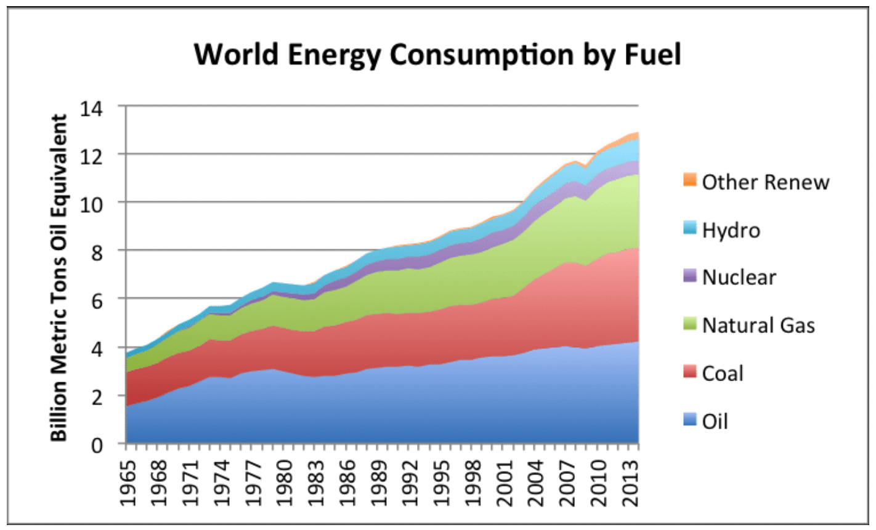
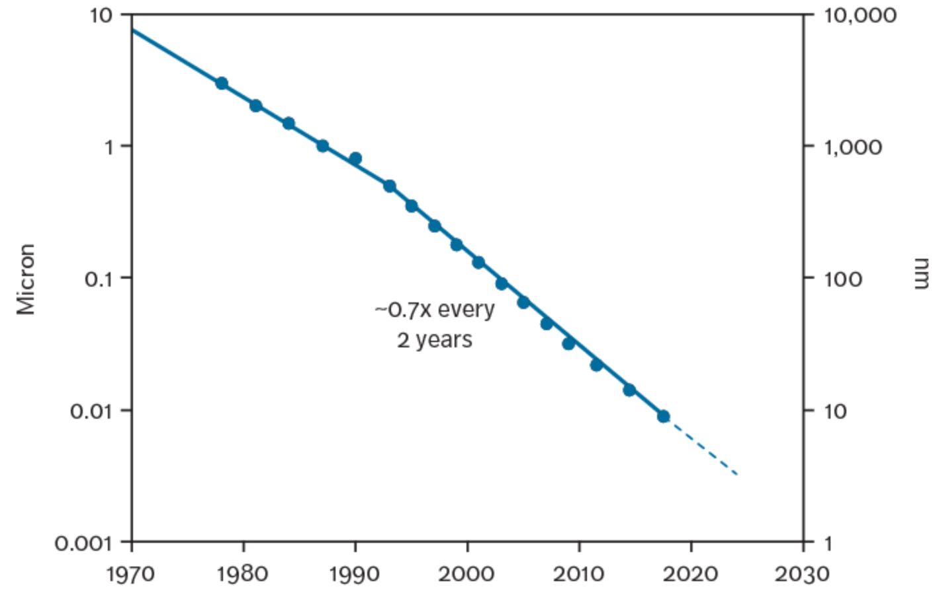
There’s plenty of room at the Bottom
– Richard Feynman, 1959
Source: EXPERIMENT ON MULTI BLEND BIODIESEL USING JATROPHA AND PONGAMIA BIODIESEL ON SINGLE CYLINDER DIESEL ENGINE WITH BASE LINE OF DIESEL FUEL
Source: CMOS Scaling Trends and Beyond, IEEE Micro 2017
The miniaturization of semiconductor transistors has driven the growth in computer performance for more than 50 years.

Slide 4
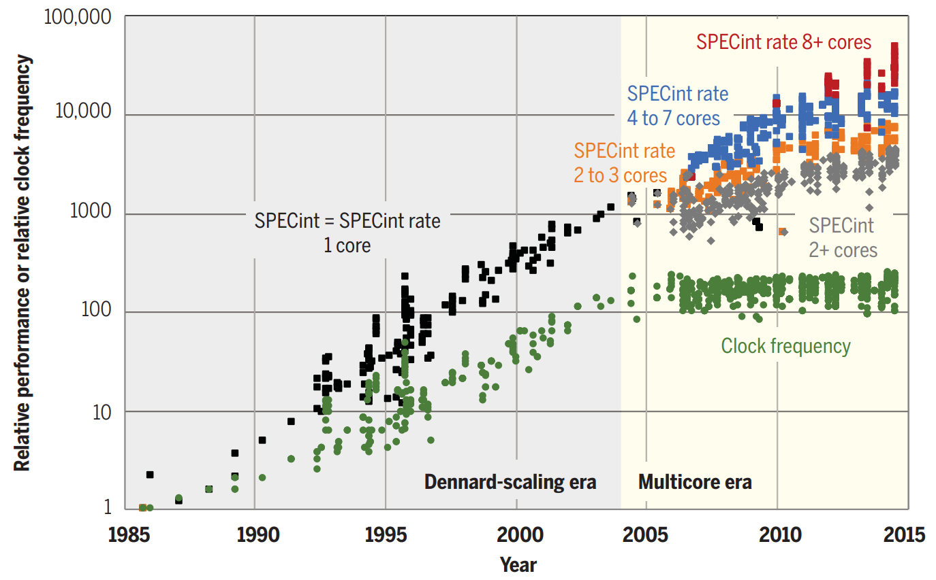
There’s plenty of room at the Top
As miniaturization approaches its limits, bringing an end to Moore’s law, performance gains will need to come from software, algorithms, and hardware.
Source: There’s plenty of room at the Top: What will drive computer performance after Moore’s law?

Slide 5
Accelerators still follow Moore’s Law
Note: assumes power consumption of 160W/TPU2 chip (not confirmed)
Moore’s Law (2x per 1.5 years)
Still working for specialized hardware
LOG SCALE
CPU: End of frequency & Dennard scaling
Notes:
Although many people are saying the Moore’s law is ending, it is about the CPU. The end of frequency and Dennard scaling has caused the performance of CPUs to improve slowly in recent years.
On the other hand, accelerators are

Slide 6
Network & storage follow Moore’s Law
Throughput (Gbps)
NVMM, 16 GB/s
40 GbE
50 GbE
100 GbE
10 GbE
NVMe SSD, 4 GB/s
Moore’s Law
(2x per 1.5 years)
LOG SCALE
SATA SSD, 1 GB/s
1 GbE
HDD, 40 MB/s
Estimated Year of Deployment

Slide 7
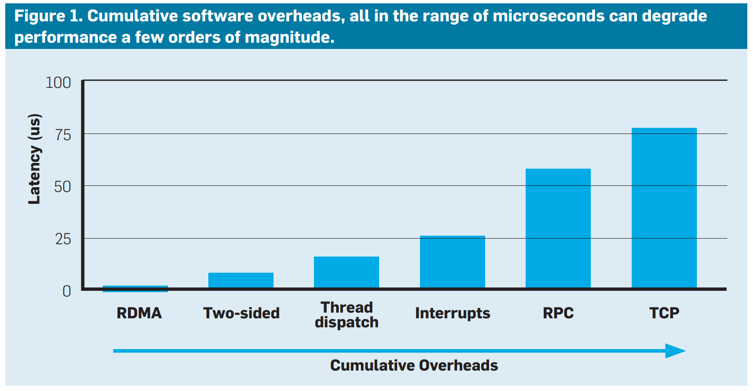
How to waste a fast datacenter network
Source: Attack of the Killer Microseconds, Communications of the ACM, 2017

Slide 8
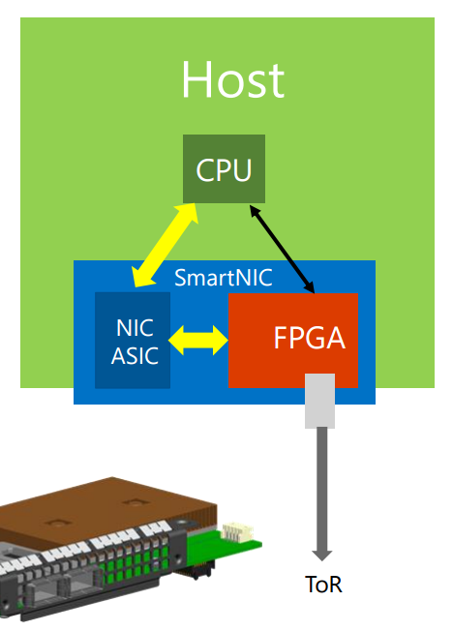
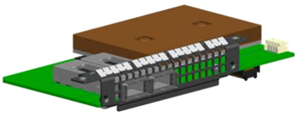
FPGAs in the cloud
FPGA-based SmartNIC
  Bump-in-the-wire processing between
  NIC and ToR switch^{[1]}
Why FPGA?
  Massive parallelism
  - Millions of logic elements Thousands of “cores” in parallel
  - Thousands of memory blocks TB/s memory bandwidth
  Low power consumption (~20W)
  General computing platform (vs. GPU, NP)
  to accelerate various cloud services
  Mature technology with a reasonable price
[1] Albert Greenberg, SIGCOMM’15 keynote (also the image source)
Notes:
There are several reasons for choosing FPGA as the accelerator.
First, FPGA has massive parallelism.
It has millions of logic elements, which can build thousands of “cores” running in parallel.
FPGA also has thousands of memory blocks, which can produce terabytes per second aggregated memory bandwidth.
Second, FPGA has low power utilization.
Third, FPGA is a general computing platform to accelerate various cloud services, so the hardware investment can be amortized by multiple applications.
Finally, FPGA is a mature technology with reasonable price in recent years.

Slide 9
Outline
Why SmartNICs
SmartNIC applications
  ClickNP: highly flexible and high performance network processing with FPGA
  KV-Direct: a high-performance in-memory key-value store with FPGA
  SocksDirect: high performance socket communication
  DUA: making data center resources available to FPGA
The future of SmartNIC architecture

Slide 10
Cloud Datacenter Architecture
Bottlenecks at compute, network, and storage nodes
Compute Node
Network Node
Hypervisor
Virtual Net Func
NIC
VM1
VM2
VM3
App
App
App
Storage Node
OS
OS
OS
Virt Disk
Virt Disk
Virt Net
Data Structure
NIC
DDR / Flash
NIC
DDR / Flash
Data center network

Slide 11
1.1. Virtual Network Acceleration
Compute Node
Network Node
Hypervisor
Virtual Net Func
NIC
VM1
VM2
VM3
App
App
App
Storage Node
OS
OS
OS
vNIC1
vNIC2
vNIC3
Data Structure
NIC
Virt Disk
Virt Disk
DDR / Flash
DDR / Flash
Programmable
NIC
Virt Net
Data Center Network

Slide 12
1.2. Network Function Acceleration
Compute Node
Network Node
Hypervisor
Programmable
NIC
VNF Data Plane
VNF Control Plane
VM1
VM2
VM3
App
App
App
Storage Node
OS
OS
OS
Virt Disk
Virt Disk
Virt Net
Data Structure
NIC
DDR / Flash
NIC
DDR / Flash
Data center network

Slide 13
ClickNP: Highly Flexible and High Performance Network Processing with Reconfigurable Hardware
SIGCOMM’16
Bojie Li^{1,2}, Kun Tan¹, Layong (Larry) Luo¹, Yanqing Peng^{1,3}, Renqian Luo^{1,2}, Ningyi Xu¹, Yongqiang Xiong¹, Peng Cheng¹, Enhong Chen²
¹Microsoft Research, ²USTC, ³SJTU

Slide 14
Scale-up challenges for software NF
Limited processing capacity
  Number of CPU cores needed for 40 Gbps line rate
Network function | Implementation | 1500B pkt @ 40 Gbps (normal case) | 64B pkt @ 40 Gbps (worst-case estimate)
NVGRE tunnel encapsulation | Hyper-V virtual switch | 5 | 100
Firewall (8K rules) | Linux iptables | 21 | 480
Notes:
However, there are two major challenges for software network functions.
First, software network functions have limited processing capacity.
For example, for NVGRE tunnel encapsulation, the virtual switch requires 5 CPU cores to sustain 40 gigabit line rate.
In the worst case, when all the packets are tiny, it requires as many as 100 cores to sustain line rate.
This is only a roughly estimation, but the order of magnitude should make sense.

Slide 15
Scale-up challenges for software NF
Limited processing capacity
  Number of CPU cores needed for 40 Gbps line rate
Inflated and unstable latency
  Add tens of microseconds to milliseconds latency to data plane
  Latency may grow to milliseconds under high load
  1 ms occasional delay would violate SLA (e.g., trading services)
Network function | Implementation | 1500B pkt @ 40 Gbps (normal case) | 64B pkt @ 40 Gbps (worst-case estimate)
NVGRE tunnel encapsulation | Hyper-V virtual switch | 5 | 100
Firewall (8K rules) | Linux iptables | 21 | 480
Notes:
Second, software network functions have inflated and unstable latency.
A software-based network function adds tens of microseconds to milliseconds latency to the data plane.
When the load is high, this latency may grow to several milliseconds.
However, an occasional delay of one millisecond would already violate the service level agreement for delay sensitive applications.

Slide 16
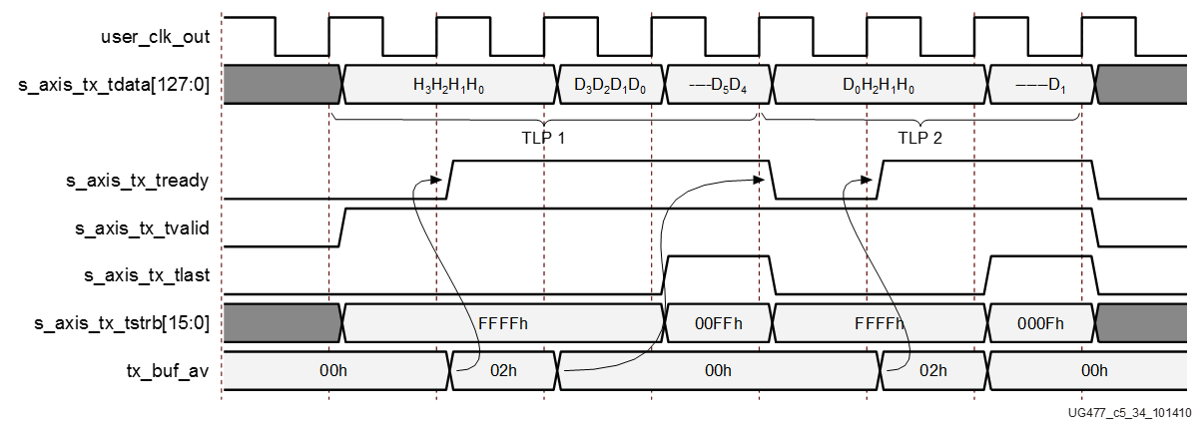

FPGA challenge: Programmability
Hardware description language (HDL): push many software developers away
PCIe Core
DMA Engine
always @ (posedge SYSCLK or negedge RST_B)
begin
if(!RST_B)
DMA_TX_DATA <= `UD 8'hff;
else
DMA_TX_DATA <= `UD DMA_TX_DATA_N;
end
//send: "hello world !"
always @ (posedge SYSCLK)
begin
if (rst) begin
dma_data <= 88’h0;
dma_valid <= 1’b0;
else
if (dma_start) begin
dma_data <= 88’h68656C6C6F20776F726C64;
dma_valid <= 1’b1;
end
else begin
dma_data <= 88’h0;
dma_valid <= 1’b0;
end
end
end
Ahhhhhhhhhhhh!
Notes:
The main challenge to use FPGA is programmability.
Conventionally, FPGA is programmed with low-level hardware description languages, such as Verilog and VHDL.
This example shows a HelloWorld program in Verilog.
To print a HelloWorld string on the screen, we first need to translate the string into ASCII codes.
In order to send the codes to the host memory, we need to write a DMA engine.
The DMA engine needs to call a PCI express IP core, which requires reading three hundred pages of manual to understand the interface.
The difficulty of hardware description languages have pushed many software developers away for years.

Slide 17
Project ClickNP
Making FPGA accessible to software developers
Flexibility: fully programmable using high-level language
Modularized: Click abstractions familiar to software developers; easy code reuse
High performance: high throughput; microsecond-scale latency
Joint CPU/FPGA packet processing: FPGA is no panacea; fine-grained processing separation
Notes:
In this work, we present ClickNP, a platform to make FPGA accessible to software developers.
We have several design goals.
First, the platform should be fully programmable using high-level languages.
Second, the platform should have a modular architecture familiar to software developers. In particular, we choose abstractions similar to the Click modular router for easy code reuse.
Third, the platform should provide high performance, both in terms of throughput and latency.
Finally, the platform should support joint CPU and FPGA packet processing. That’s because FPGA is not suitable for every kind of workload. We should support fine-grained processing separation between CPU and FPGA. This requires high performance and low latency communication between CPU and FPGA.

Slide 18
Programming model
as if programming on a multi-core processor
cores (elements) running in parallel
A
B
C
mem
mem
mem
communicate via channels, not shared memory
Notes:
ClickNP provides a modular programming model similar to the Click modular router.
Therefore, programming in ClickNP is much like programming on a multi-core processor.
There is one important difference, though.
In conventional multi-core processing, threads communicate via shared memory.
However, In ClickNP, the cores communicate via channels instead of shared memory.
Channel-based communication is more efficient in FPGA compared to shared global memory, because the shared global memory would be the bottleneck.

Slide 19
Element: single-threaded core
states
(reg/mem)
Process handler
input channels
output channels
(main thread)
(I/O)
(I/O)
Signal handler
(ISR)
signal/control from host
(interrupt)
Notes:
In ClickNP, the basic processing module is called an element, which resembles a single-threaded core.
Each element has the following components.
First, a set of local states that are only accessible inside the element.
Second, input and output channels to communicate with other elements.
Third, process handler, which is the main thread to read input channels, do processing and write to output channels in an infinite loop.
Finally, signal handler, which receives and processes commands from the manager thread in host program running on CPU. Signals resemble interrupts in CPU.

Slide 20
Architecture
ClickNP host process
ClickNP elements
Mgr thrd
Worker thrd
ClickNP library
ClickNP host mgr
ClickNP script
PCIe I/O channel
vendor libs
Host
Catapult PCIe Driver
ClickNP compiler
FPGA
Intermediate C files
Catapult shell
ClickNP
C compiler
vendor HLS
Verilog
vendor specific runtime
Cross-platform toolchain
Altera OpenCL / Vivado HLS
Visual Studio / GCC
Notes:
Here we look at the architecture of the ClickNP toolchain.
A ClickNP program is divided into three parts, a set of ClickNP elements, a ClickNP script to define the connections among elements, and a ClickNP host manager program.

Slide 21
Architecture
ClickNP host process
ClickNP elements
Mgr thrd
Worker thrd
ClickNP library
ClickNP host mgr
ClickNP script
PCIe I/O channel
vendor libs
Host
Catapult PCIe Driver
ClickNP compiler
FPGA
Intermediate C files
Catapult shell
ClickNP
C compiler
vendor HLS
Verilog
vendor specific runtime
Cross-platform toolchain
Altera OpenCL / Vivado HLS
Visual Studio / GCC
Notes:
The ClickNP compiler first compiles the ClickNP program to intermediate C code.

Slide 22
Architecture
ClickNP host process
ClickNP elements
Mgr thrd
Worker thrd
ClickNP library
ClickNP host mgr
ClickNP script
PCIe I/O channel
vendor libs
Host
Catapult PCIe Driver
ClickNP compiler
FPGA
Intermediate C files
Catapult shell
ClickNP
C compiler
vendor HLS
Verilog
vendor specific runtime
Cross-platform toolchain
Altera OpenCL / Vivado HLS
Visual Studio / GCC
Notes:
Then we call a vendor HLS tool, for example Altera OpenCL or Vivado HLS, to compile the intermediate C code into Verilog code.

Slide 23
Architecture
ClickNP host process
ClickNP elements
Mgr thrd
Worker thrd
ClickNP library
ClickNP host mgr
ClickNP script
PCIe I/O channel
vendor libs
Host
Catapult PCIe Driver
ClickNP compiler
FPGA
Intermediate C files
Catapult shell
ClickNP
C compiler
vendor HLS
Verilog
vendor specific runtime
Cross-platform toolchain
Altera OpenCL / Vivado HLS
Visual Studio / GCC
Notes:
Finally we call the hardware synthesis toolchain to generate the FPGA bitstream.

Slide 24
Architecture
ClickNP host process
ClickNP elements
Mgr thrd
Worker thrd
ClickNP library
ClickNP host mgr
ClickNP script
PCIe I/O channel
vendor libs
Host
Catapult PCIe Driver
ClickNP compiler
FPGA
Intermediate C files
Catapult shell
ClickNP
C compiler
vendor HLS
Verilog
vendor specific runtime
Cross-platform toolchain
Altera OpenCL / Vivado HLS
Visual Studio / GCC
Notes:
And call a standard C compiler to compile the ClickNP host program.

Slide 25
Architecture
ClickNP host process
ClickNP elements
Mgr thrd
Worker thrd
ClickNP library
ClickNP host mgr
ClickNP script
PCIe I/O channel
vendor libs
Host
Catapult PCIe Driver
ClickNP compiler
FPGA
Intermediate C files
Catapult shell
ClickNP
C compiler
vendor HLS
Verilog
vendor specific runtime
Cross-platform toolchain
Altera OpenCL / Vivado HLS
Visual Studio / GCC
Notes:
In runtime environment, the Catapult shell is the operating system on the FPGA, which was developed by the Microsoft Catapult team.
The Catapult shell provides resource abstractions to the ClickNP application logic.
On host side, the ClickNP library provides PCIe I/O channel abstraction to the CPU elements, and enables the host program to communicate with FPGA elements via signals.

Slide 26
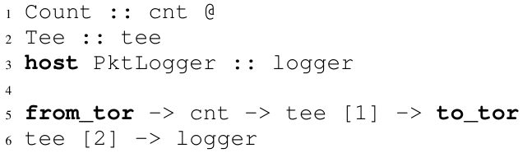
Example: Packet logger
from_tor
Count
Tee
to_tor
FPGA
CPU
logger
ClickNP Configuration:
Notes:
Here we look at an example network function, packet logger.
It receives packets from top-of-rack switch, counts number of packets in Count element, then makes a copy in Tee element.
One copy is forwarded back to ToR switch, the other copy is forwarded to a host element PktLogger running on CPU.
We can see that this PacketLogger needs only 5 lines of code for ClickNP configuration.

Slide 27
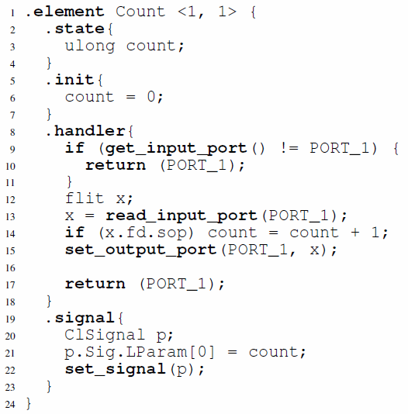
Example: Packet logger
from_tor
Count
Tee
to_tor
Count element:
FPGA
CPU
logger
ClickNP Configuration:
Notes:
Now we look at details of the Count element.
The first line of code shows that the Count element has one input channel and one output channel.
There is only one state variable, count, and initialized to zero.
In the handler, we first check whether or not the input channel has data to read. If so, we read a block of packet data from the input channel.
If the metadata indicates that it is start of packet, we increment the counter by one.
Finally we forward the data to the output port.
The signal handler simply writes the counter to a special structure called ClSignal, which is then returned to the manager thread in host program.

Slide 28
Parallelizing in FPGA
Parallelism across elements
  Pipeline parallelism
  Data parallelism
Parallelism inside an element
  Minimize memory dependency
  Use registers
  Delayed write
  Memory scattering
  Balance pipeline stages
  Unroll loops
  Offload slow path to another element
Notes:
Now we come to optimizations in ClickNP.
As we know, efficient FPGA code must utilize parallelism, which basically includes parallelism across elements and parallelism inside an element.
Due to time limitations, here I’m only going to discuss several of them. For the remaining ones, please refer to the paper.

Slide 29
ClickNP element library
Element | Fmax (MHz) | Peak Throughput | Delay (cycles) | Resource LE % | Resource BRAM %
L4_Parser | 221.9 | 113.6 Gbps | 11 | 0.8% | 0.2%
IPChecksum | 226.8 | 116.1 Gbps | 18 | 2.3% | 1.3%
NVGRE_Encap | 221.8 | 113.6 Gbps | 9 | 1.5% | 0.6%
AES_CTR | 217.0 | 27.8 Gbps | 70 | 4.0% | 23.1%
SHA1 | 220.8 | 113.0 Gbps | 105 | 7.9% | 6.6%
CuckooHash | 209.7 | 209.7 Mpps | 38 | 2.0% | 65.5%
HashTCAM | 207.4 | 207.4 Mpps | 48 | 18.7% | 22.0%
LPM_Tree | 221.8 | 221.8 Mpps | 181 | 4.3% | 13.2%
SRPrioQueue | 214.5 | 214.5 Mpps | 41 | 2.6% | 0.6%
RateLimiter | 141.5 | 141.5 Mpps | 14 | 16.9% | 14.1%
Throughput: 200 Mpps / 100 Gbps
Mean delay: 0.19 us, max delay: 0.8 us
Mean LoC: 80, max LoC: 196
Nearly 200 elements
20% re-factored from Click modular router
Cover packet parsing, checksum, tunnel
encap/decap, crypto, hash tables, prefix matching, packet scheduling, rate limiting…
Notes:
We have built a ClickNP element library with nearly 200 elements.
About 20% of them are re-factored from Click modular router, and the remaining ones cover lots of network functions.
This table shows some common elements in the element library, which cover packet parsing, checksum, tunnel encapsulation, crypto, hash tables, prefix matching, packet scheduling and rate limiting.

Slide 30
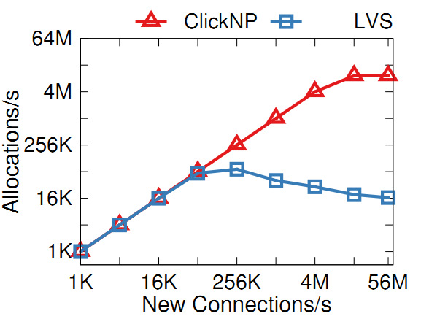
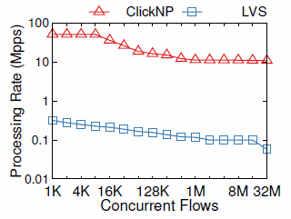
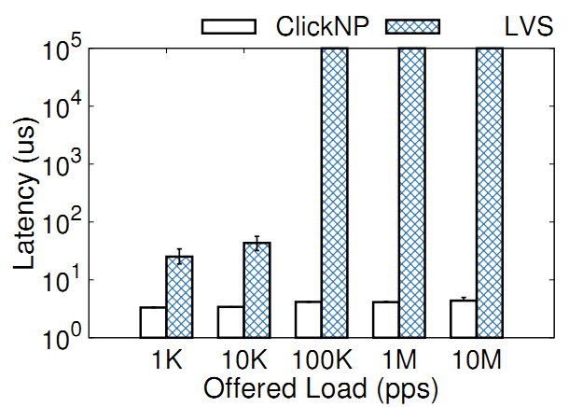
Case study: L4 load balancer
  Performance
  10M new flows per second
  51Mpps for 8K flows
  11Mpps for 32M flows
  4us stable latency
Notes:
The L4 load balancer can sustain 10 million new connections per second.
The bottleneck is DRAM random access, instead of PCIe I/O channel to communicate with the nexthop allocation element on CPU.
When the number of concurrent flows is small, the throughput can achieve 50 million packets per second.
When the number of concurrent flows exceed flow cache size, the throughput begins to decrease due to cache miss.
The L4 load balancer also has microsecond-scale stable latency.

Slide 31
Area cost
Overhead compared to hand-written Verilog
NetFPFA Function | Resource Utilization Min / Max
 | LUTs | Registers | BRAMs
Input arbiter | 2.1x / 3.4x | 1.8x / 2.8x | 0.9x / 1.3x
Output queue | 1.4x / 2.0x | 2.0x / 3.2x | 0.9x / 1.2x
Header parser | 0.9x / 3.2x | 2.1x / 3.2x | N/A
Openflow table | 0.9x / 1.6x | 1.6x / 2.3x | 1.1x / 1.2x
IP checksum | 4.3x / 12.1x | 9.7x / 32.5x | N/A
Encap | 0.9x / 5.2x | 1.1x / 10.3x | N/A
Notes:
Finally, we study the area cost overhead of ClickNP compared to hand-written Verilog.
We pick up NetFPGA, which comes from Stanford and has good code quality.
For ClickNP, we implement equivalent functionality of several NetFPGA functions.
For most elements, overall the area cost overhead is less than two times.

Slide 32
Area cost
Overhead compared to hand-written Verilog
NetFPFA Function | Resource Utilization Min / Max
 | LUTs | Registers | BRAMs
Input arbiter | 2.1x / 3.4x | 1.8x / 2.8x | 0.9x / 1.3x
Output queue | 1.4x / 2.0x | 2.0x / 3.2x | 0.9x / 1.2x
Header parser | 0.9x / 3.2x | 2.1x / 3.2x | N/A
Openflow table | 0.9x / 1.6x | 1.6x / 2.3x | 1.1x / 1.2x
IP checksum | 4.3x / 12.1x | 9.7x / 32.5x | N/A
Encap | 0.9x / 5.2x | 1.1x / 10.3x | N/A
Notes:
For small elements, the overhead is relatively large, but the absolute overhead is small.
This is because every element is compiled to a logic block. High-level synthesis tools generate a wrapper with a fixed logic overhead.

Slide 33
Area cost
Overhead compared to hand-written Verilog
NetFPFA Function | Resource Utilization Min / Max
 | LUTs | Registers | BRAMs
Input arbiter | 2.1x / 3.4x | 1.8x / 2.8x | 0.9x / 1.3x
Output queue | 1.4x / 2.0x | 2.0x / 3.2x | 0.9x / 1.2x
Header parser | 0.9x / 3.2x | 2.1x / 3.2x | N/A
Openflow table | 0.9x / 1.6x | 1.6x / 2.3x | 1.1x / 1.2x
IP checksum | 4.3x / 12.1x | 9.7x / 32.5x | N/A
Encap | 0.9x / 5.2x | 1.1x / 10.3x | N/A
Area cost will be less of a concern
Quickly growing FPGA capacity: 1x (2013), 2.5x (2015), 10x (2018)
Notes:
Furthermore, the capacity of FPGA is growing quickly in recent years.
We believe that the area cost will be less of a concern in the future.

Slide 34
Conclusion
FPGA in the cloud
  Fast, general and mature
ClickNP: programming hardware as software
  Highly flexible: Program with high-level language
  Modular: Click-like abstractions
  High performance: Utilize massive parallelism in FPGA
  Joint CPU/FPGA packet processing
Notes:
Finally, the conclusion.
FPGA is fast, general and mature, so we have deployed FPGA at scale in the cloud.
This work presents ClickNP, a network processing platform to enable software developers to program hardware, which is highly flexible, modular, high performance and supports joint CPU/FPGA packet processing.
In addition to network processing, ClickNP is a general framework for programming on FPGA.
With FPGAs in datacenters, we can go beyond the memory wall and reach a fully programmable world.

Slide 35
Development after the paper
Network → general stream processing
FPGA development platform for research and engineering projects in our research team
Applications:
Hardware-based Network Transport (Yuanwei Lu, APNet’17)
In-memory Key-value Store (Zhenyuan Ruan, SOSP’17)
HTTPS (RSA) Accelerator (Guo Chen and Tianyi Cui, MS Hackathon’16)
DeepCrossing DNN inference (Qiang Lou, Bing)
Regex Matching (Guo Chen, MS Techfest’17)
Multi-path RDMA (Yuanwei Lu)
Container Networking (Zibo Wang, MS Hackathon’17, SOSP’17 SRC)
Total-Order Multicast (Gefei Zuo, SOSP’17 SRC)
And more…
Extending ClickNP framework:
Distributed ClickNP (Guo Chen)
And more…
Notes:
After the paper submission, the ClickNP project does not end.
ClickNP moves from network processing to general stream processing, and enables multiple research and engineering projects in our team, including applications. For example, Yuanwei’s paper on Memory Efficient Loss Recovery, which he will present this afternoon.
And extending the ClickNP framework to distribute to a cluster of FPGAs, and use Go language to support concurrency more naturally.

Slide 36
2.1. Virtual Storage Acceleration
Compute Node
Network Node
Hypervisor
Programmable
NIC
VNF Data Plane
VNF Control Plane
VM1
VM2
VM3
App
App
App
Storage Node
OS
OS
OS
vNIC1
vNIC2
vNIC3
Data Structure
NIC
Programmable
NIC
Virt Disk
DDR / Flash
Mem / Flash
Virt Net
Data Center Network

Slide 37
2.2. Data Structure Acceleration
Compute Node
Network Node
Hypervisor
Programmable
NIC
VNF Data Plane
VNF Control Plane
VM1
VM2
VM3
App
App
App
Storage Node
OS
OS
OS
Virt Disk
Virt Disk
Virt Net
Programmable
NIC
Data Structure Control Plane
Data Structure Data Plane
DDR / Flash
NIC
DDR / Flash
Data center network

Slide 38
KV-Direct: High-Performance In-Memory Key-Value Store with Programmable NIC
SOSP ’17
Bojie Li^{1,2} Zhenyuan Ruan^{1,3} Wencong Xiao^{1,4} Yuanwei Lu^{1,2} Yongqiang Xiong¹ Andrew Putnam¹ Enhong Chen²
Lintao Zhang¹
¹Microsoft Research ²USTC ³UCLA ⁴Beihang University
Notes:
Thanks Adita for the introduction.
Hello everyone, I’m Bojie Li, a fourth year PhD student in a joint PhD program of USTC and Microsoft Research.
In this session we have seen two wonderful works, Eris and NetCache to use in-network processing with dataplane programmable switches to accelerate systems.
Now I will show programmable NICs can also be very useful in accelerating datacenter workloads.
Our KV-Direct work is done during internship in Microsoft Research Asia with my colleagues. Zhenyuan Ruan and me are co-first authors who design and implement this system together.

Slide 39


Key-Value Store in Data Centers
Web Cache
Key
Value
User ID
Recent Tweets
SQL
Query result
Session
Browser cookies
Notes:
As everyone knows, traditional key-value stores like memcached or redis are used for caching in web services.

Slide 40
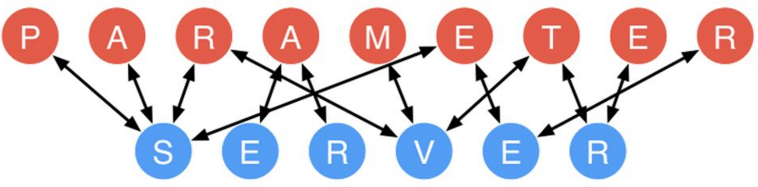
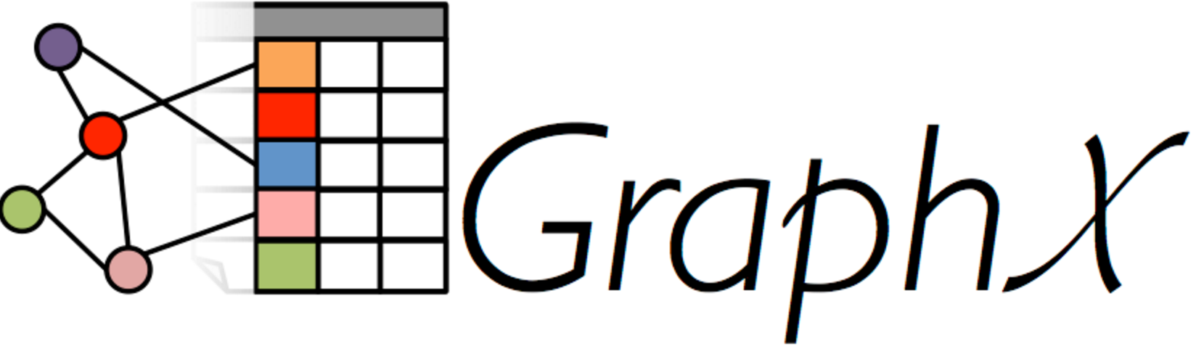
Key-Value Store in Data Centers
Web Cache
Shared Data Structure
Key
Value
Key
Value
User ID
Recent Tweets
Graph node
List of edges
SQL
Query result
Feature
Weight
Session
Browser cookies
Shard
Sequence number
More demanding workload
Notes:
In recent years, key-value store goes beyond object caching and becomes an infrastructure service to store shared data structure in a distributed system.
Examples include parameter servers in machine learning, graph computing engine and sequencers for distributed transactions, as the Eris paper in this session just said.
Shared data structure stores demands more performance compared to web cache.

Slide 41
Key-Value Store in Data Centers
Shared Data Structure
Design Goals
High throughput
Low tail latency
Write intensive
Vector operations
____
Atomic operations
Key
Value
Graph node
List of edges
Feature
Weight
Shard
Sequence number
More demanding workload
Notes:
These shared data structure stores have enormous throughput requirement, for example a graph computation application may need billions of key-value operations per iteration.
Second, it requires low tail latency because the latency of an application is typically determined by the slowest one.
Third, the workload is no longer read intensive, so both reads and writes need to be efficient.
Finally, we should have built in support for vector operations and atomic operations.

Slide 42
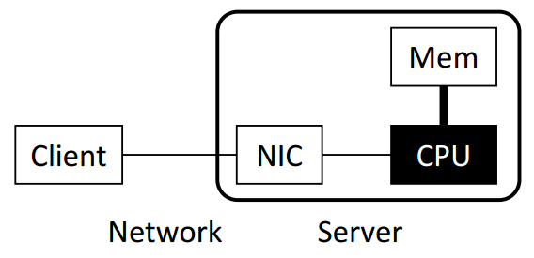
Key-Value Store Architectures
Software (Kernel TCP/IP)
Bottleneck: Network stack in OS
(~300 Kops per core)
Notes:
Key-value store is a holistic exercise of systems, including networking, computation and memory accesses.
For traditional key-value stores such as memcached and redis, the bottleneck is network stack in operating system. We all know that TCP/IP stack are slow.

Slide 43
Key-Value Store Architectures
Software (Kernel TCP/IP)
Bottleneck: Network stack in OS
(~300 Kops per core)
Software
(Kernel Bypass)
e.g. DPDK, mtcp, libvma, two-sided RDMA
Bottlenecks: CPU random memory access
and KV operation computation
(~5 Mops per core)
Notes:
Next, researchers use kernel-bypass networking to mitigate the network stack overhead.
One way is to build a lightweight network stack in user-mode.
Another way is to leverage two-sided RDMA to offload the networking stack into NIC hardware.
However, the throughput bottleneck is now CPU random access and key-value operation computation.

Slide 44
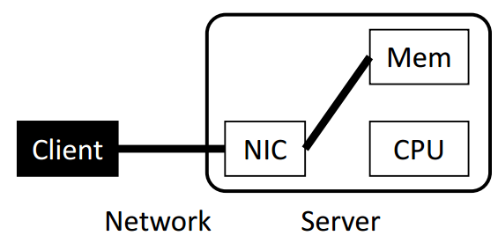
Key-Value Store Architectures
Software (Kernel TCP/IP)
Bottleneck: Network stack in OS
(~300 Kops per core)
Software
(Kernel Bypass)
e.g. DPDK, mtcp, libvma, two-sided RDMA
Bottlenecks: CPU random memory access
and KV operation computation
(~5 Mops per core)
One-sided RDMA
Communication overhead: multiple round-
trips per KV operation (fetch index, data)
Synchronization overhead: write operations
Notes:
Another key-value store architecture is to bypass the server CPU entirely using one-sided RDMA.
The KV processing is offloaded to clients, and they access the key-value store via remote memory access.
However, in this design, there is significant communication overhead due to multiple round-trips per KV operation.
Furthermore, when clients need to write on a same key-value pair, they need synchronization to ensure consistency.

Slide 45
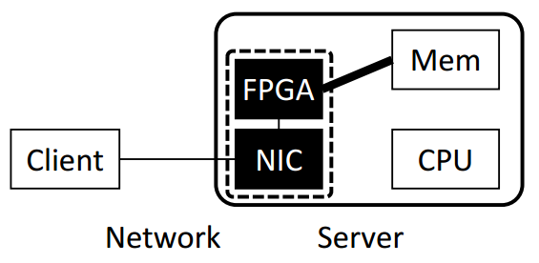
Key-Value Store Architectures
Software
(Kernel TCP/IP)
Software
(Kernel Bypass)
KV-Direct FPGA + NIC
Offload KV processing on CPU
to Programmable NIC
One-sided RDMA
Notes:
We propose KV-Direct to offload KV processing on CPU to programmable NIC.
The name of KV-Direct means that the NIC directly fetches data and applies updates in the host memory to serve KV requests, completely bypassing server CPU.

Slide 46
KV-Direct Architecture
Network Decoder
Request Scheduler
NIC
Network Encoder
Hash Table
Slab Allocator
Load Dispatch
On-board DRAM
PCIe
(host mem)
Notes:
Now we look at the architecture of KV-Direct.
key-value operations are received from the NIC and decoded in the network decoder,
Then the request scheduler issues independent key-value operations to the hash table,
Small key-value pairs are stored inline in the hash table, while larger key-value pairs are stored in dynamically allocated memory, which requires a slab memory allocator.
The memory accesses are dispatched to either on-board DRAM, or the PCIe bus to access host memory.
When the memory lookup result comes back, finally we encode the KV operation results and send to the client.

Slide 47
Performance Challenges
40 GbE
Reconfigurable NIC
NIC
ToR switch
On-board DRAM (4 GB)
FPGA
Header overhead and limited parallelism:
Be frugal on
memory accesses
PCIe Gen3
x16 DMA
13 GB/s
120 Mops
Host DRAM (256 GB)
CPU
Notes:
First, our PCIe interface between FPGA and host memory has limited throughput.
There is something worse. PCIe transport layer packets has header overhead, and the PCIe IP core in our FPGA has limited parallelism, which limits our PCIe throughput to 120 million operations per second.
So we need to be frugal on memory accesses.

Slide 48
Performance Challenges
40 GbE
Reconfigurable NIC
NIC
ToR switch
On-board DRAM (4 GB)
FPGA
Atomic operations have dependency:
PCIe latency hiding
PCIe Gen3
x16 DMA
1us delay
120 Mops
Host DRAM (256 GB)
CPU
Notes:
Second, the PCIe bus has delay of nearly 1 microsecond, due to additional delay in the PCIe IP core in our FPGA.
When atomic operations operate on the same key, they depend on the result of each other and needs to executed one by one.
Therefore, we need to hide the PCIe latency, otherwise the throughput will degrade to 1 million operations per second.

Slide 49
Performance Challenges
40 GbE
Reconfigurable NIC
NIC
ToR switch
0.2us delay
100 Mops
On-board DRAM (4 GB)
FPGA
Load dispatch
PCIe Gen3
x16 DMA
1us delay
120 Mops
Host DRAM (256 GB)
CPU
Notes:
Third, we hope to leverage both the throughput of on-board DRAM and host DRAM, so we need an efficient load dispatch mechanism.

Slide 50
Performance Challenges
60 Mpps
40 GbE
Reconfigurable NIC
NIC
ToR switch
0.2us delay
100 Mops
Client-side batching
Vector-type operations
On-board DRAM (4 GB)
FPGA
PCIe Gen3
x16 DMA
1us delay
120 Mops
Host DRAM (256 GB)
CPU
Notes:
Finally, because network packet headers also have significant overhead, we leverage client-side batching and support vector-type operations to reduce network overhead.

Slide 51
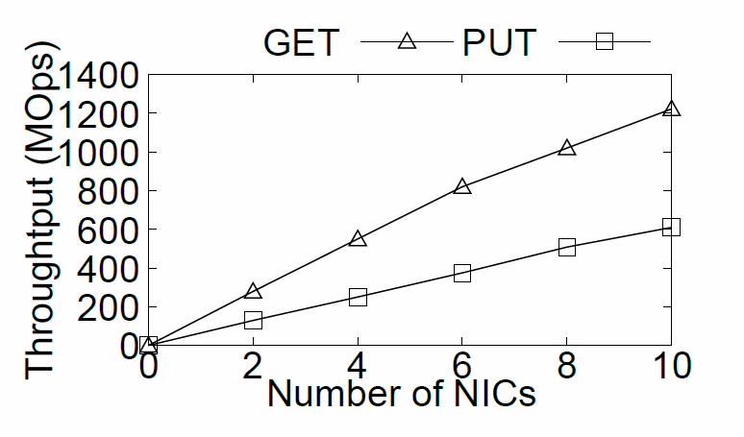
Scalability with Multiple NICs
Notes:
Because a single KV-Direct NIC has not saturated the bandwidth of host DRAM, we can leverage multiple programmable NICs to scale up the KV-Direct system. As we can see in the figure, the throughput increases almost linearly with number of NICs.

Slide 52
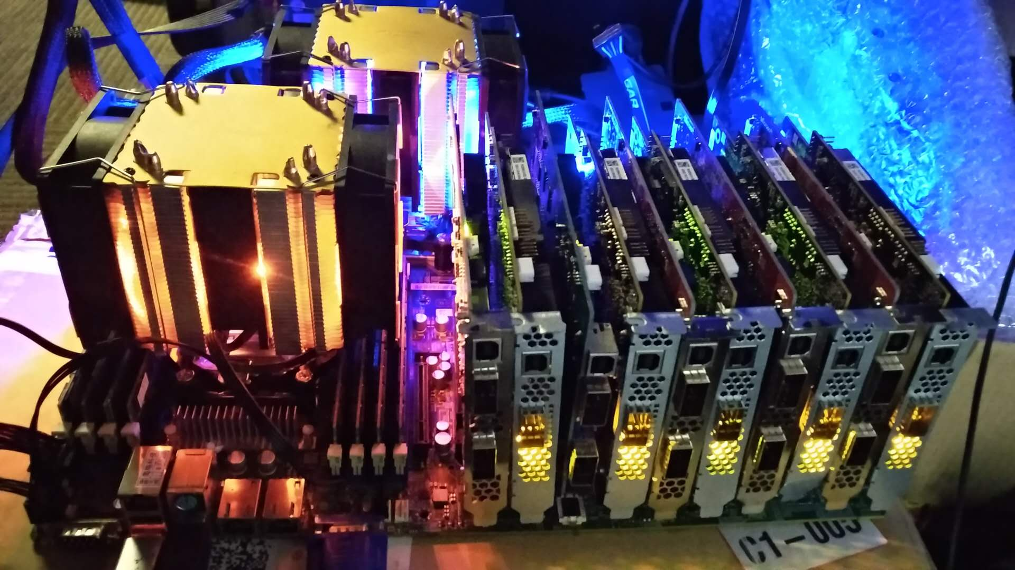
Scalability with Multiple NICs
1.22 billion KV op/s
357 watts power
Notes:
This photo is our test server with 10 programmable NICs, two Xeon E5 processors and 128 Gigabytes of memory.
Each programmable NIC is connected to the motherboard via 8 lanes of PCIe Gen3, so the 10 NICs saturate the 80 PCIe lanes from two Xeon E5 processors.
(click) With 10 programmable NICs, KV-Direct achieves 1.2 billion key-value operations per second with less than 400 watts of power consumption, setting a new milestone for general purpose key-value stores.

Slide 53
KVS Performance Comparison
 | Tput (Mops) (GET / PUT) | Power (Kops/W) | Comment | Latency (us) (GET / PUT)
Memcached | 1.5 / 1.5 | 5 / 5 | TCP/IP | 50 / 50
MemC3 | 4.3 / 4.3 | 14 / 14 | TCP/IP | 50 / 50
RAMCloud | 6 / 1 | 20 / 3.3 | Kernel bypass | 5 / 14
MICA (12 NICs) | 137 / 135 | 342 / 337 | Kernel bypass | 81 / 81
FARM | 6 / 3 | 30 (261) / 15 | One-side RDMA | 4.5 / 10
DrTM-KV | 115 / 14 | 500 (3972) / 60 | One-side RDMA | 3.4 / 6.3
HERD | 35 / 25 | 490 / 300 | Two-side RDMA | 4 / 4
FPGA-Xilinx | 14 / 14 | 106 / 106 | FPGA | 3.5 / 4.5
Mega-KV | 166 / 80 | 330 / 160 | GPU | 280 / 280
KV-Direct (1 NIC) | 180 / 114 | 1487 (5454) / 942 (3454) | Programmable NIC | 4.3 / 5.4
KV-Direct (10 NICs) | 1220 / 610 | 3417 (4518) / 1708 (2259) | Programmable NIC | 4.3 / 5.4
* Number in parenthesis indicates power efficiency based on power consumption of NIC only, for server-bypass systems.
Notes:
KV-Direct achieves high throughput and power efficiency compared to existing work.
In the table we show several existing systems, including traditional TCP IP, kernel-bypass networking, RDMA, FPGA and GPU.

Slide 54
KVS Performance Comparison
 | Tput (Mops) (GET / PUT) | Power (Kops/W) | Comment | Latency (us) (GET / PUT)
Memcached | 1.5 / 1.5 | 5 / 5 | TCP/IP | 50 / 50
MemC3 | 4.3 / 4.3 | 14 / 14 | TCP/IP | 50 / 50
RAMCloud | 6 / 1 | 20 / 3.3 | Kernel bypass | 5 / 14
MICA (12 NICs) | 137 / 135 | 342 / 337 | Kernel bypass | 81 / 81
FARM | 6 / 3 | 30 (261) / 15 | One-side RDMA | 4.5 / 10
DrTM-KV | 115 / 14 | 500 (3972) / 60 | One-side RDMA | 3.4 / 6.3
HERD | 35 / 25 | 490 / 300 | Two-side RDMA | 4 / 4
FPGA-Xilinx | 14 / 14 | 106 / 106 | FPGA | 3.5 / 4.5
Mega-KV | 166 / 80 | 330 / 160 | GPU | 280 / 280
KV-Direct (1 NIC) | 180 / 114 | 1487 (5454) / 942 (3454) | Programmable NIC | 4.3 / 5.4
KV-Direct (10 NICs) | 1220 / 610 | 3417 (4518) / 1708 (2259) | Programmable NIC | 4.3 / 5.4
* Number in parenthesis indicates power efficiency based on power consumption of NIC only, for server-bypass systems.
Notes:
The throughput of KV-Direct is equivalent to 20 to 30 CPU cores.
The MICA system uses 12 NICs, but we achieve the throughput with only a single NIC.
Although the GET throughput of DrTM is high, the PUT throughput is low, this is because it uses one-sided RDMA and the clients need synchronization to keep consistency on write operations.
The Mega-KV system uses GPU, although the throughput of GPU memory is high, its capacity is much smaller than the host memory.

Slide 55
KVS Performance Comparison
 | Tput (Mops) (GET / PUT) | Power (Kops/W) | Comment | Latency (us) (GET / PUT)
Memcached | 1.5 / 1.5 | 5 / 5 | TCP/IP | 50 / 50
MemC3 | 4.3 / 4.3 | 14 / 14 | TCP/IP | 50 / 50
RAMCloud | 6 / 1 | 20 / 3.3 | Kernel bypass | 5 / 14
MICA (12 NICs) | 137 / 135 | 342 / 337 | Kernel bypass | 81 / 81
FARM | 6 / 3 | 30 (261) / 15 | One-side RDMA | 4.5 / 10
DrTM-KV | 115 / 14 | 500 (3972) / 60 | One-side RDMA | 3.4 / 6.3
HERD | 35 / 25 | 490 / 300 | Two-side RDMA | 4 / 4
FPGA-Xilinx | 14 / 14 | 106 / 106 | FPGA | 3.5 / 4.5
Mega-KV | 166 / 80 | 330 / 160 | GPU | 280 / 280
KV-Direct (1 NIC) | 180 / 114 | 1487 (5454) / 942 (3454) | Programmable NIC | 4.3 / 5.4
KV-Direct (10 NICs) | 1220 / 610 | 3417 (4518) / 1708 (2259) | Programmable NIC | 4.3 / 5.4
* Number in parenthesis indicates power efficiency based on power consumption of NIC only, for server-bypass systems.
Notes:
On the power efficiency part, KV-Direct is 10x power efficient than existing work with pure CPU, one-sided RDMA, two-sided RDMA or GPU. Number in parenthesis indicates power efficiency based on power consumption of NIC only, for server-bypass systems. This methodology is justified because other workload can still run on CPU with little performance impact.
(click) Finally, the latency of KV-Direct is on-par with the best of other systems.

Slide 56

Conclusion
Leverage the SmartNIC to access remote data structures in host memory without involving CPU
Key-value store is only an example
DRAM
DRAM
CPU
CPU
QPI
Gen3 x8
Gen3 2x8
NIC
DRAM
1
FPGA
2
QSFP
QSFP
QSFP
40Gb/s
40Gb/s
ToR

Slide 57
3. Acceleration of OS Communication Primitives
Compute Node
Network Node
Hypervisor
Programmable
NIC
VNF Data Plane
VNF Control Plane
VM1
VM2
VM3
App
App
App
OS (Socket)
OS (Socket)
OS (Socket)
Storage Node
vNIC1
vNIC2
vNIC3
Programmable
NIC
Data Structure Control Plane
Data Structure Data Plane
Programmable
NIC
Virt Disk
Mem / Flash
Virt Net
DDR / Flash
Communication Protocol
Data Center Network

Slide 58
SocksDirect: Datacenter Sockets can be Fast and Compatible
SIGCOMM ‘19
Bojie Li*^{1,2} Tianyi Cui*³ Zibo Wang^{1,2} Wei Bai¹ Lintao Zhang¹
¹Microsoft Research ²USTC ³University of Washington
* Co-first authors

Slide 59
The Socket Communication Primitive
Server
Client
socket()
bind()
listen()
accept()
recv()
send()
close()
socket()
connect()
send()
recv()
close()
Notes:
As we all know, most applications use the socket primitive for inter-process communication, both within a same server and among different servers.

Slide 60
Socket: a Performance Bottleneck
Socket syscall time >> user application time
Socket latency >> hardware transport latency
Notes:
Traditionally, sockets are implemented in the OS kernel. We all know that kernel socket is very slow. To show this point, we profile several popular applications in data centers. We can see that 70% to 90% of CPU time is used in OS kernel, which means it is handling the socket system calls. If we could eliminate the overhead of OS kernel and all CPU time can be utilized by the user space application, the application throughput will improve by several times.
Next we look at the latency, and the problem is more severe than throughput. For communication between two directly connected servers, socket latency is 17x of RDMA. For intra-host communication, socket latency is 40x of shared memory queue. In this work, we try to answer one question: is this socket overhead an intrinsic property of the socket abstraction, or we can do something to eliminate the socket overhead?

Slide 61
High Performance Socket Systems
Kernel Optimization
User-space TCP/IP
Offload to RDMA NIC
User App
User App
User App
User App
User App
User App
Kernel VFS
User-space VFS
User-space VFS
User-space VFS
User-space VFS
Kernel TCP/IP
User-space TCP/IP
User-space TCP/IP
NIC RDMA API
Hardware-based Transport
NIC packet API
NIC packet API
TCP/IP
Host 1
TCP/IP
Host 1
RDMA
Host 1
Host 2
Host 2
Host 2
NIC packet API
NIC packet API
NIC RDMA API
Kernel
User-space Stack
User-space VFS
User App
User App
User App
FastSocket, Megapipe, StackMap…
IX, Arrakis, SandStorm, mTCP,
LibVMA, OpenOnload…
Rsocket, SDP, FreeFlow…
Notes:
There have been extensive research to improve the performance of socket systems.
The first category is to optimize the kernel. A socket stack basically divides into three layers. The first layer is the virtual file system, VFS, because each socket connection is regarded as a file in Linux, and a file descriptor is mapped for the socket. The second layer is the kernel TCP/IP stack that provides the transport function. The third layer is the hardware interface layer. Linux kernel uses a packet API.
The second category is to implement the VFS abstraction and TCP/IP transport in the user space. It not only move the kernel functions into user space, but also greatly simplify the functions, for example, use polling to avoid the interrupt and process scheduling overheads.
The third category is to offload the transport to the NIC. Here we recall some history of hardware-based transports. TCP offload is not a new thing. In 1990s, there has been Ethernet cards that

Slide 62
SocksDirect Design Goals
Compatibility
Drop-in replacement, no application modification
Isolation
Security isolation among containers and applications
Enforce access control policies
High Performance
High throughput
Low latency
Scalable with number of CPU cores

Slide 63
SocksDirect: Fast and Compatible Socket in User Space
Monitor Process
ACL rules
Process 1
Process 2
Event queue
Event queue
Data
Shared Buffer
Data
Application
send
recv
Application
connect
accept
Request queue
Request queue
User Mode
Kernel Mode
Monitor: user-space daemon process to coordinate global resources and enforce ACL rules.
Processes as a shared-nothing distributed system: use message passing over shared-memory queues.

Slide 64
SocksDirect Supports Different Transports for Data
User App
User App
libsd
Mem Queue
Monitor
Mem Queue
libsd
Host 1
Mem Queue
TCP/IP
NIC RDMA API
NIC Packet API
RDMA
TCP/IP
NIC RDMA API
Host 2
libsd
Host 3
No SocksDirect
TCP/IP
User App
User App
Monitor

Slide 65
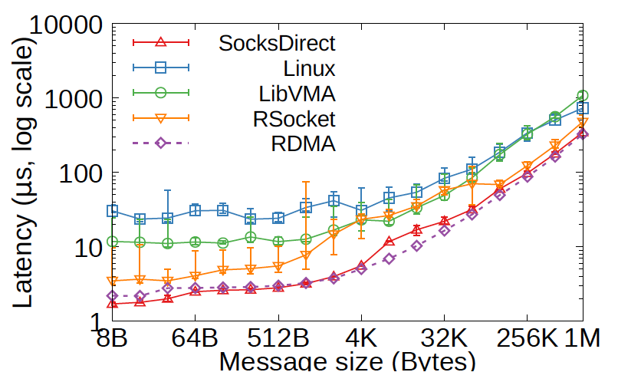
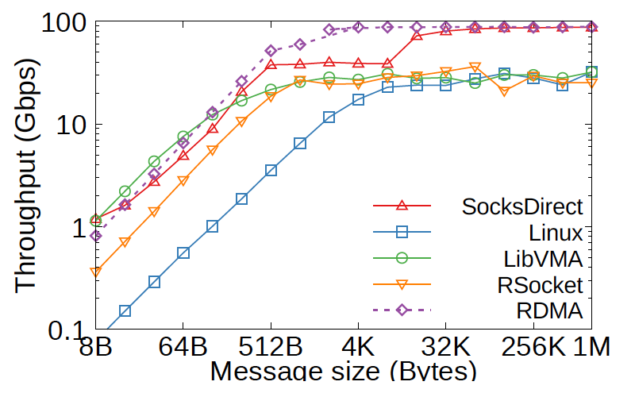
Microbenchmarks
Latency
Throughput
Notes:
Intra-host: 8B latency close to shared memory queue, 4x lower than Rsocket and LibVMA because they use NIC to forward intra-host packets. 35x lower than Linux.
Inter-host: 8B latency even lower than two-sided RDMA send and receive, because we use one-sided RDMA write. Half of Rsocket, performance gain due to buffer management. 7x lower than LibVMA because it needs batching. Latency 17x lower than Linux.

Slide 66
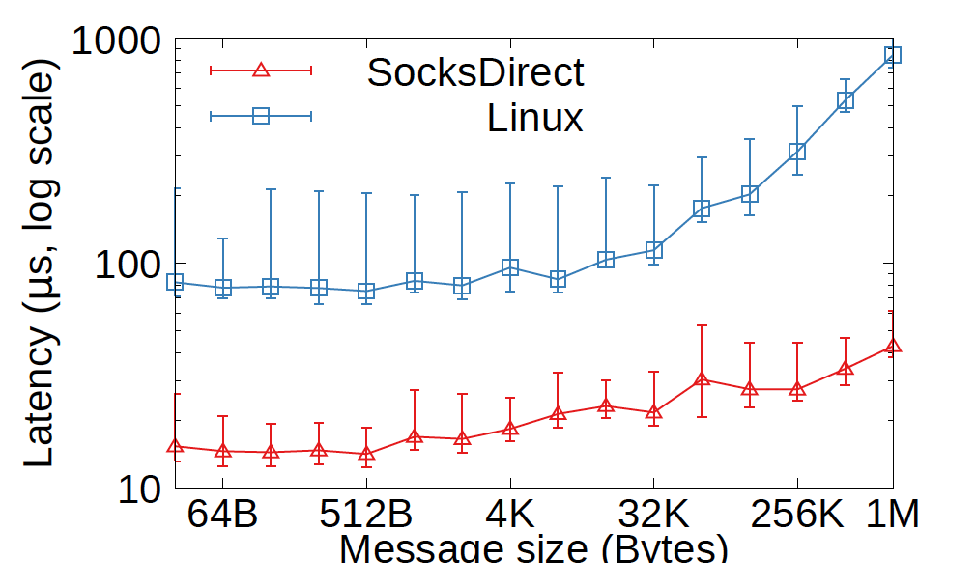
Application Performance
Nginx HTTP server request latency
Notes:
Nginx HTTP server between two hosts: small HTTP messages, 5x lower than Linux. For large message, 13x lower than Linux due to zero copy.

Slide 67
Cloud Acceleration based on Programmable NIC
Compute Node
Network Node
Hypervisor
Programmable
NIC
VNF Data Plane
VNF Control Plane
VM1
VM2
VM3
App
App
App
OS (Socket)
OS (Socket)
OS (Socket)
Storage Node
vNIC1
vNIC2
vNIC3
Programmable
NIC
Data Structure Control Plane
Data Structure Data Plane
Programmable
NIC
Virt Disk
Mem / Flash
Virt Net
DDR / Flash
Communication Protocol
Data Center Network

Slide 68
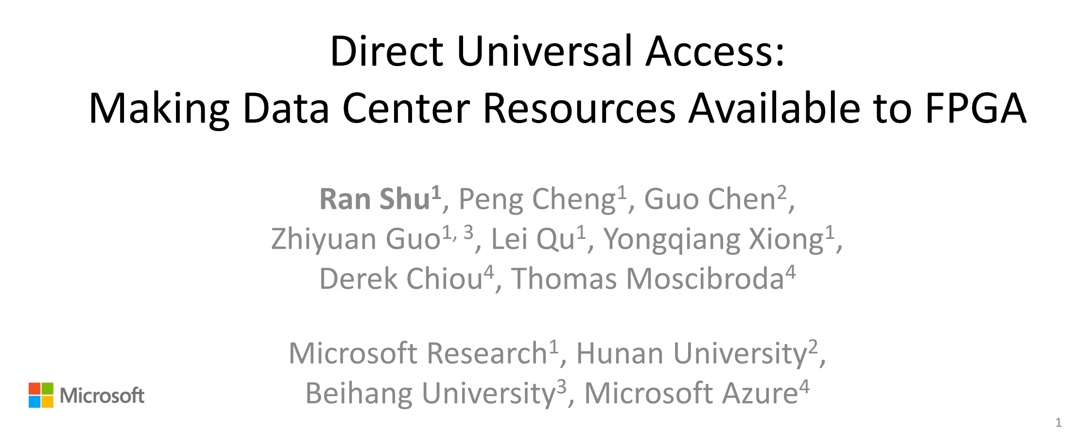
NSDI ‘19

Slide 69
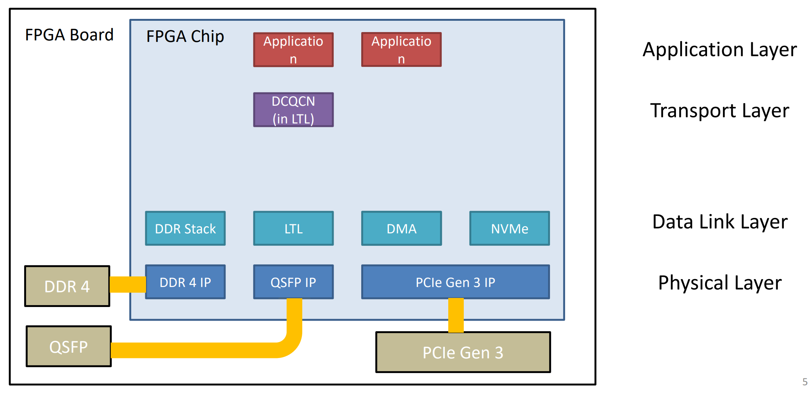
Current FPGA communication architecture

Slide 70
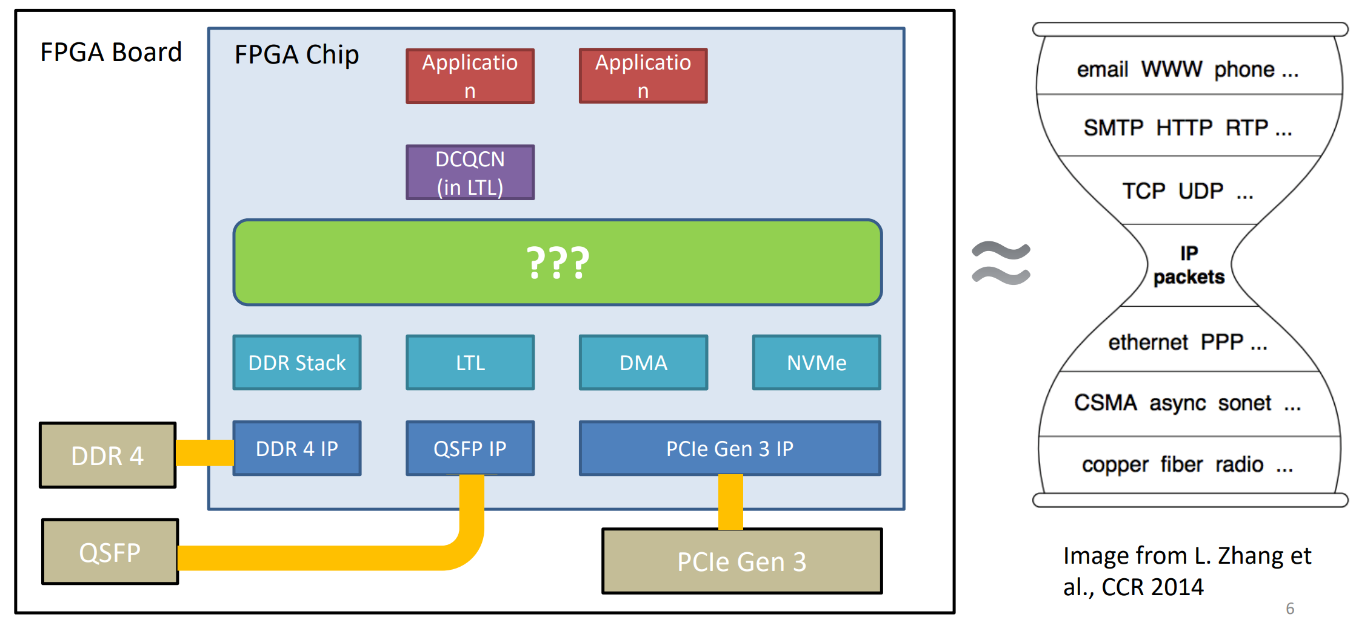
Current FPGA communication architecture

Slide 71
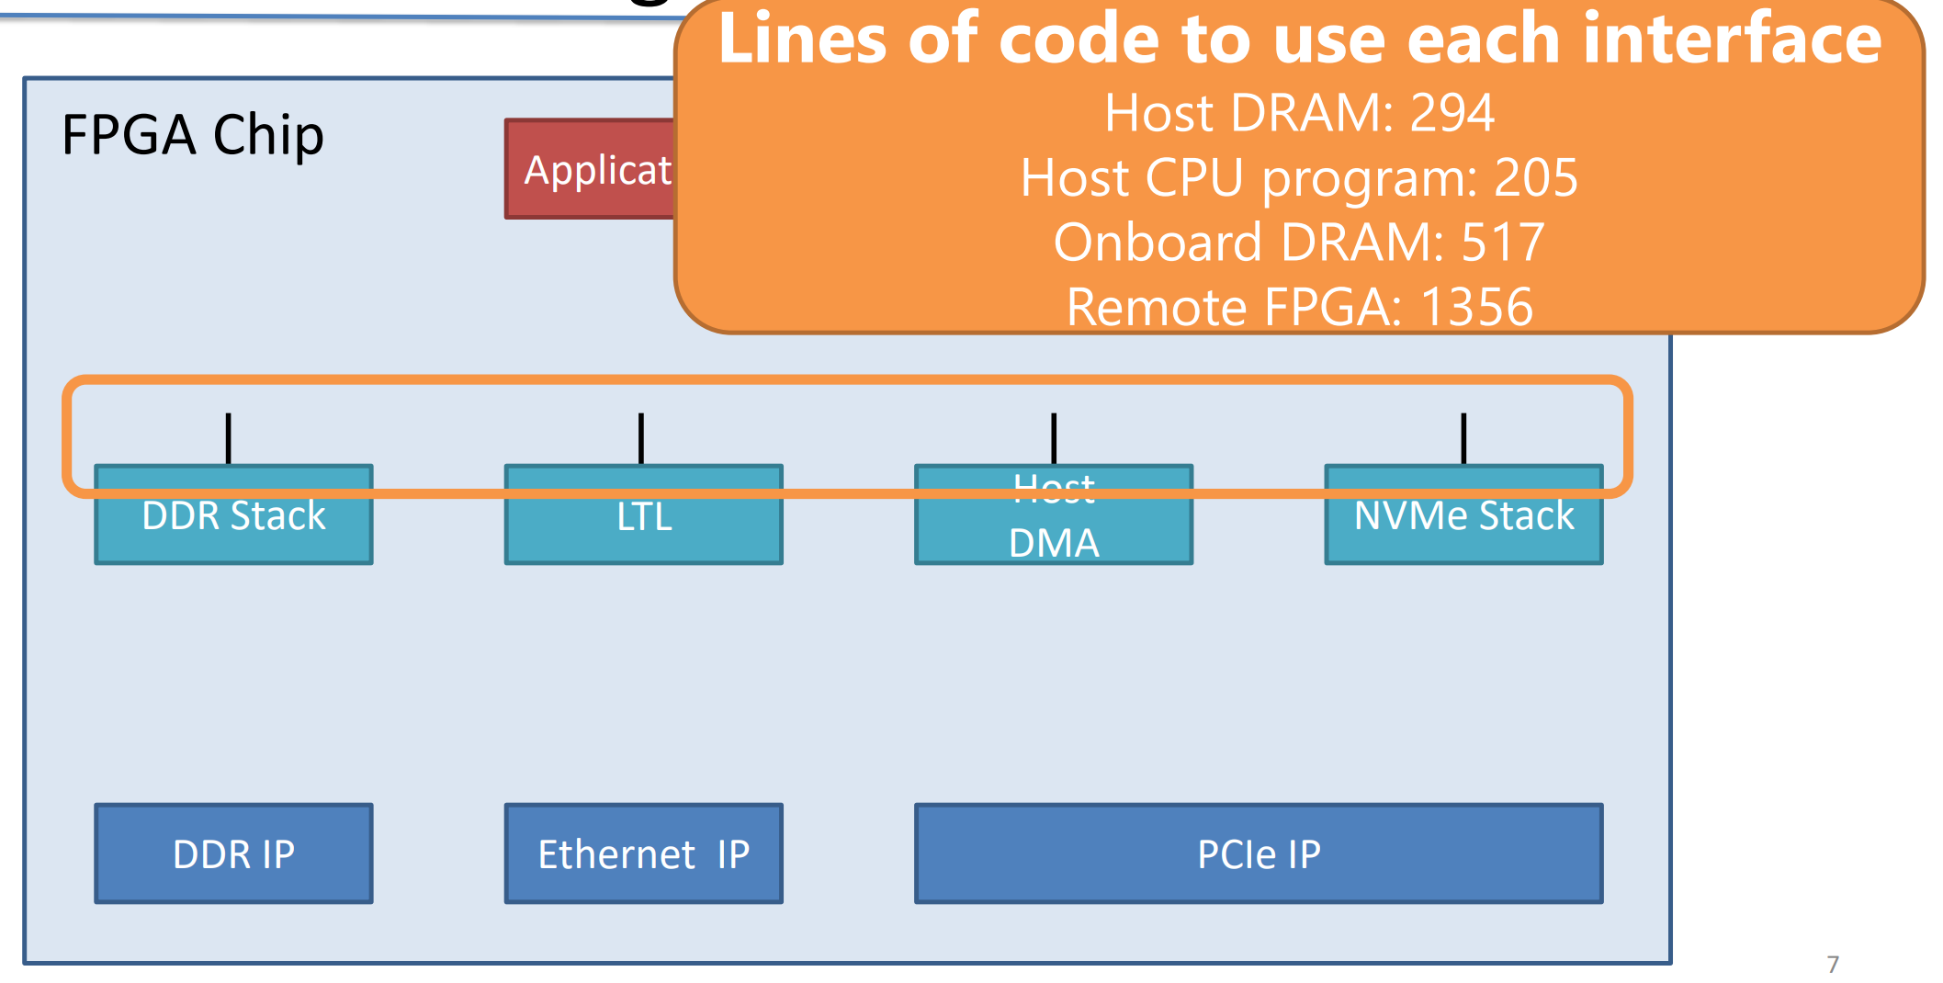
Problem #1: Programming Interface

Slide 72
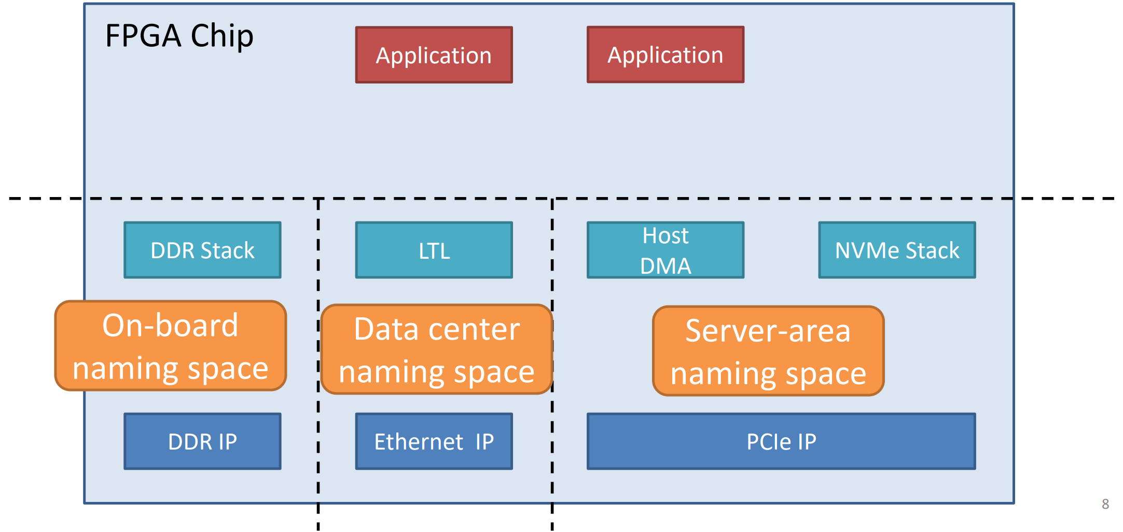
Problem #2: Accessibility

Slide 73
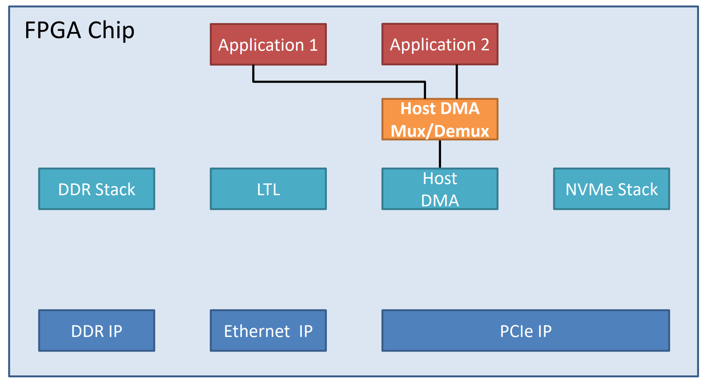
Problem #3: Multiplexing

Slide 74
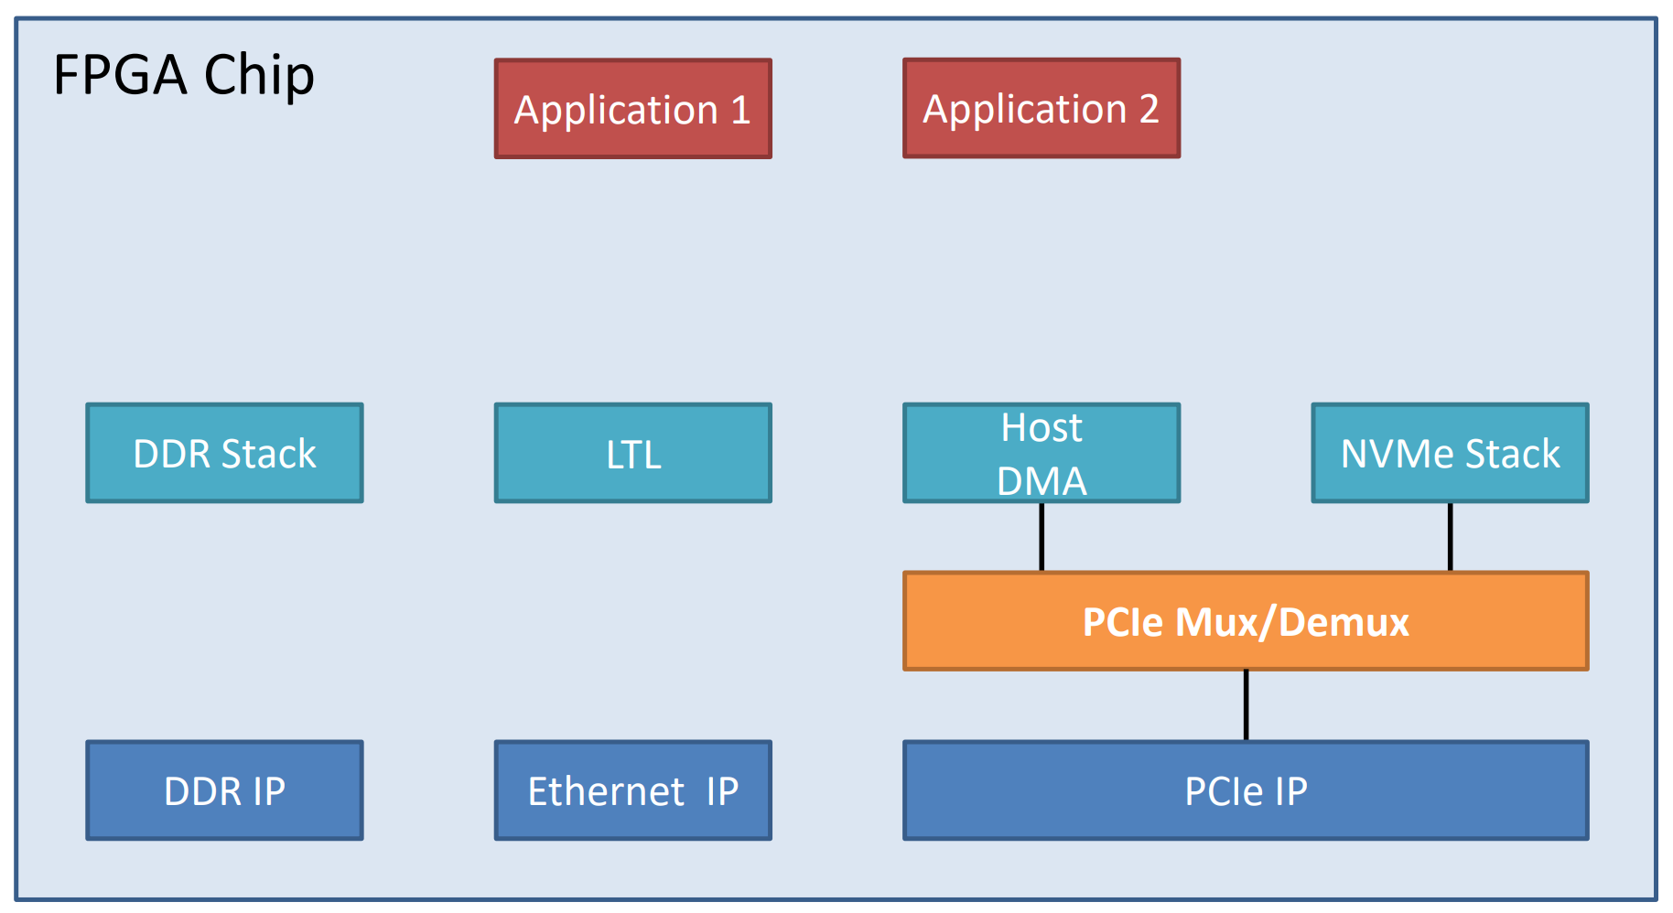
Problem #3: Multiplexing

Slide 75
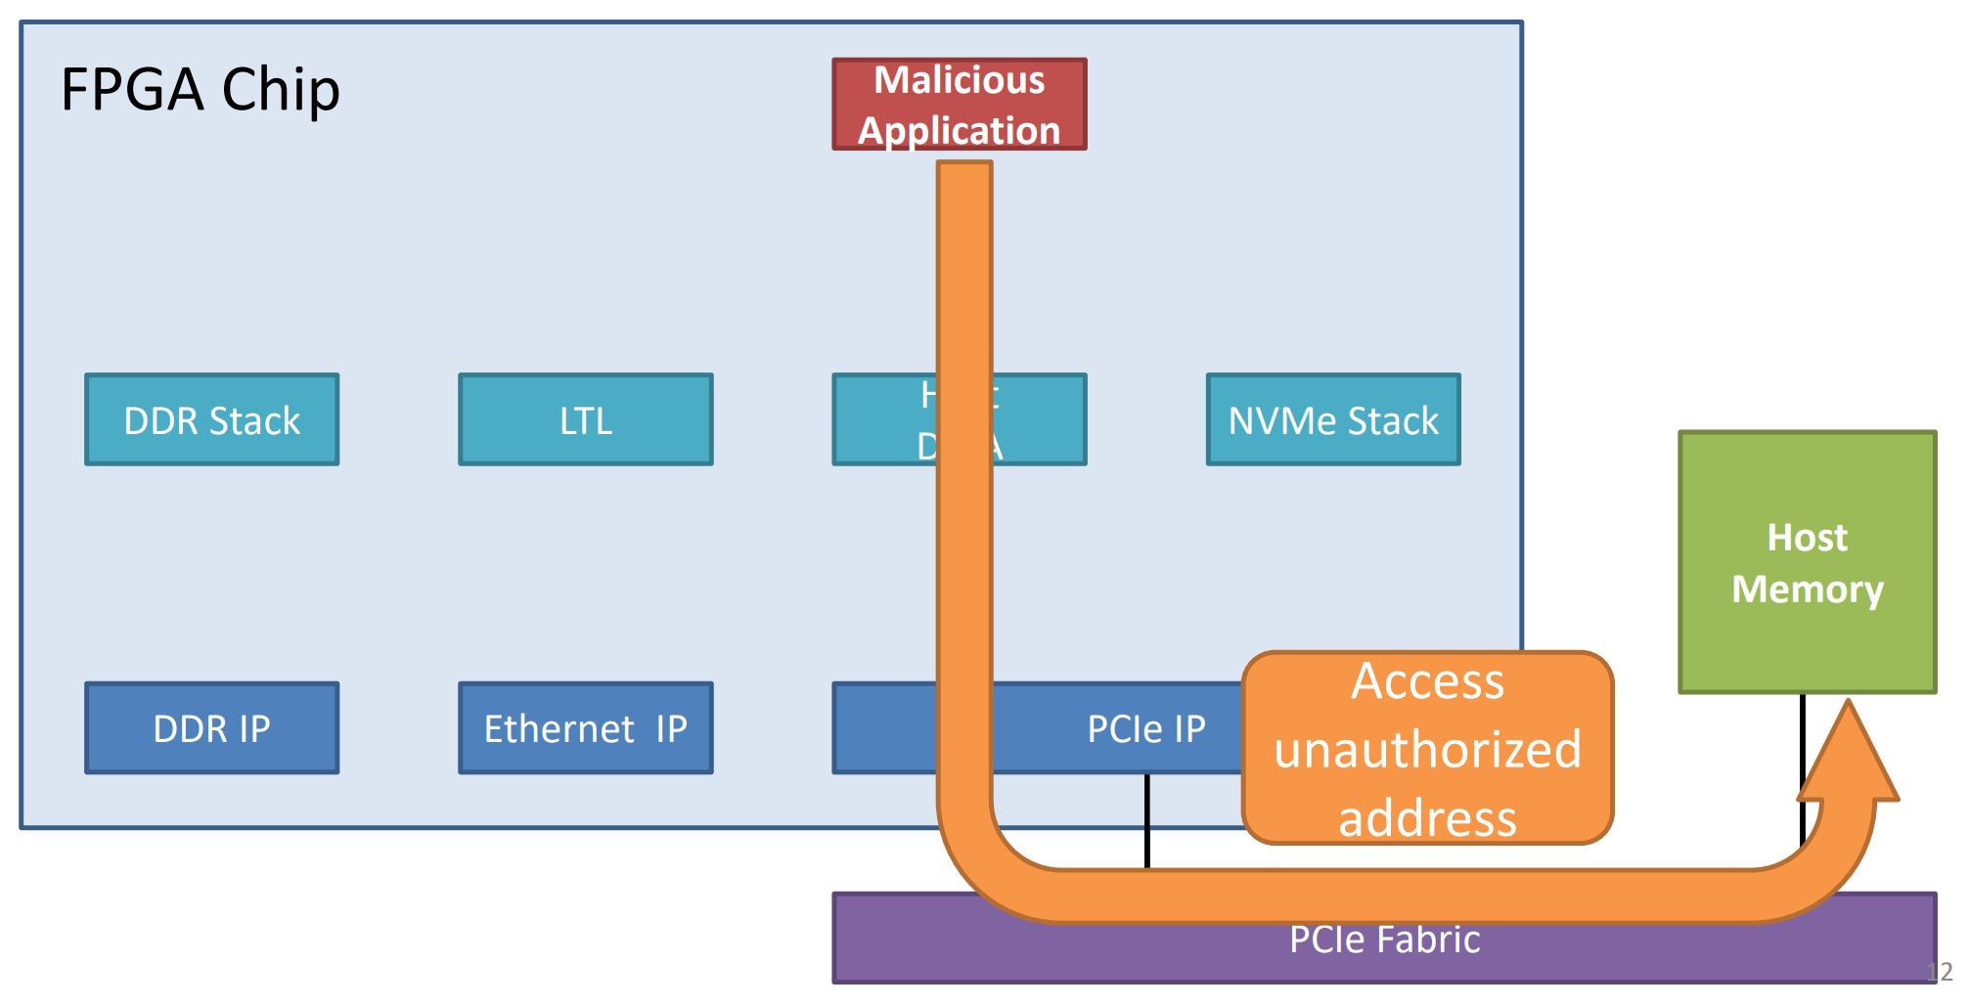
Problem #4: Security

Slide 76
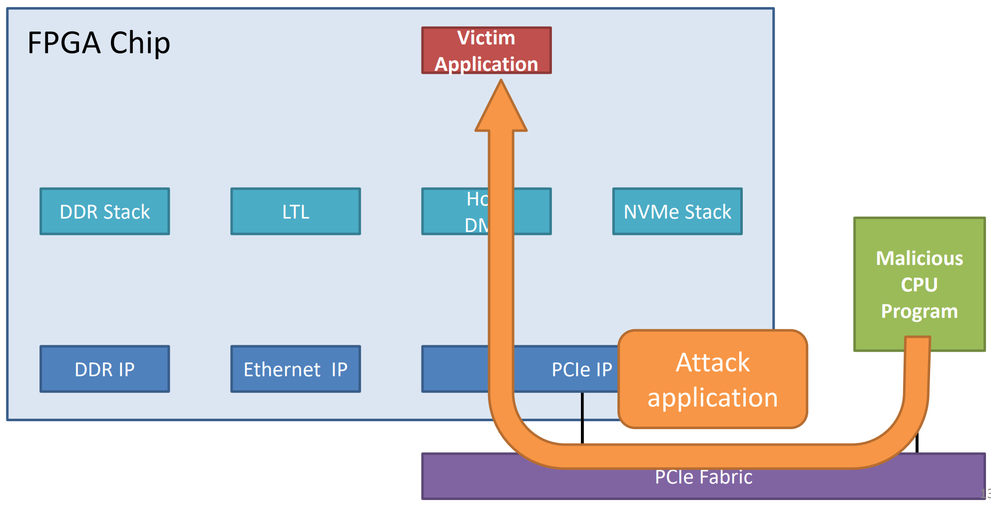
Problem #4: Security

Slide 77
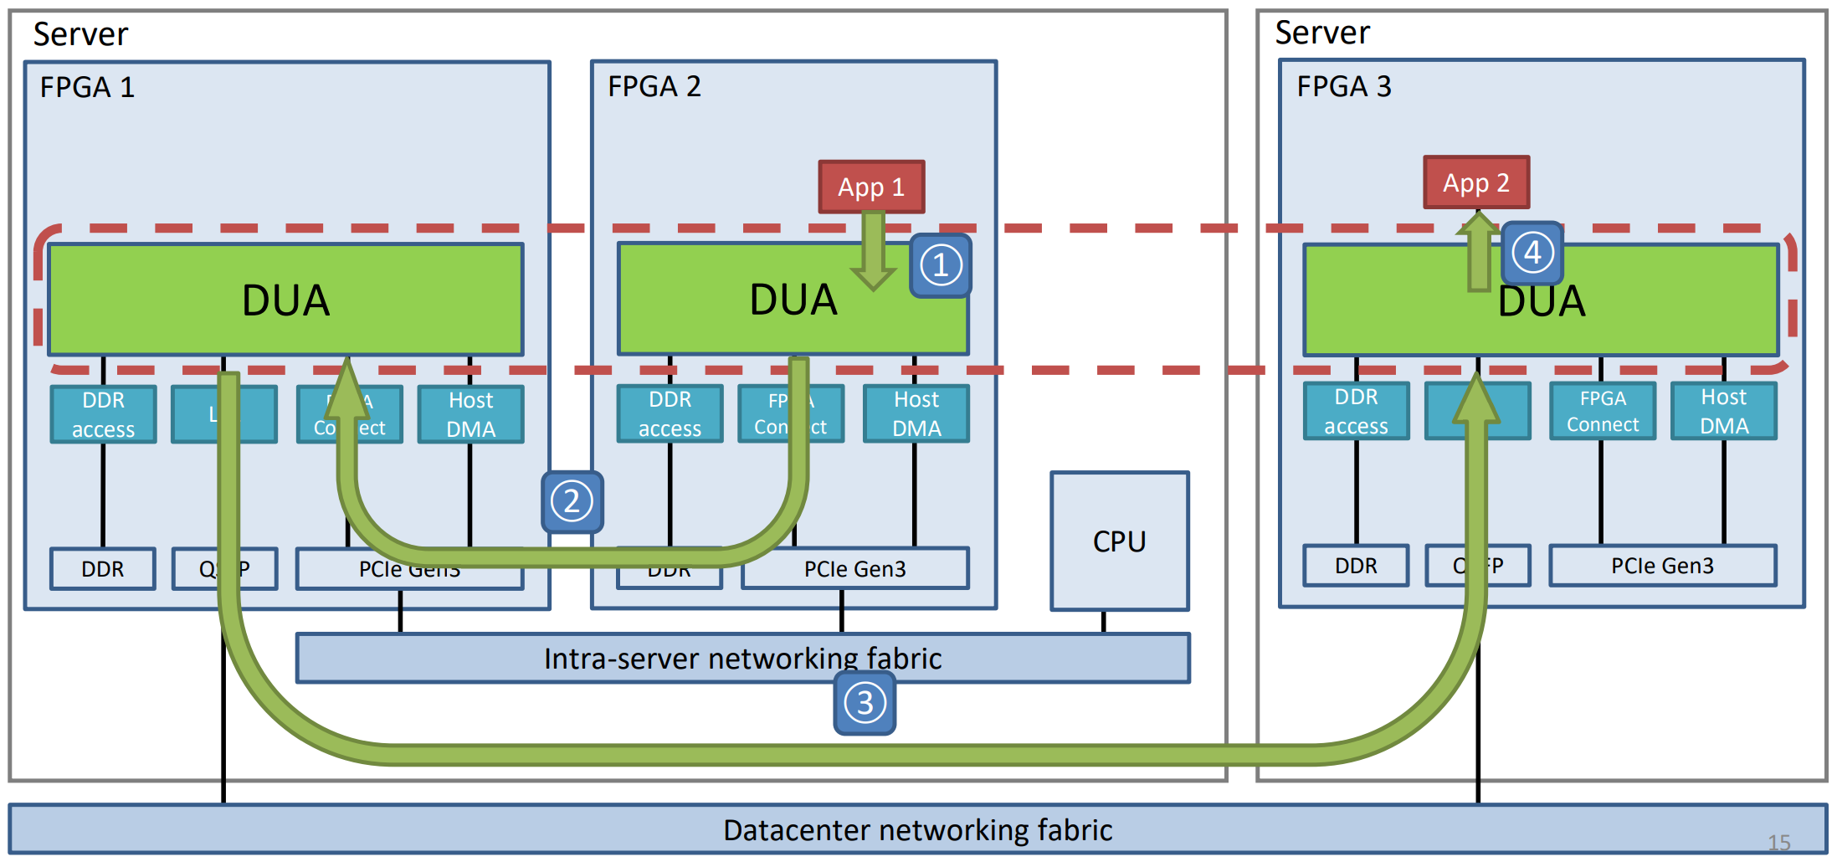
Direct Universal Access

Slide 78
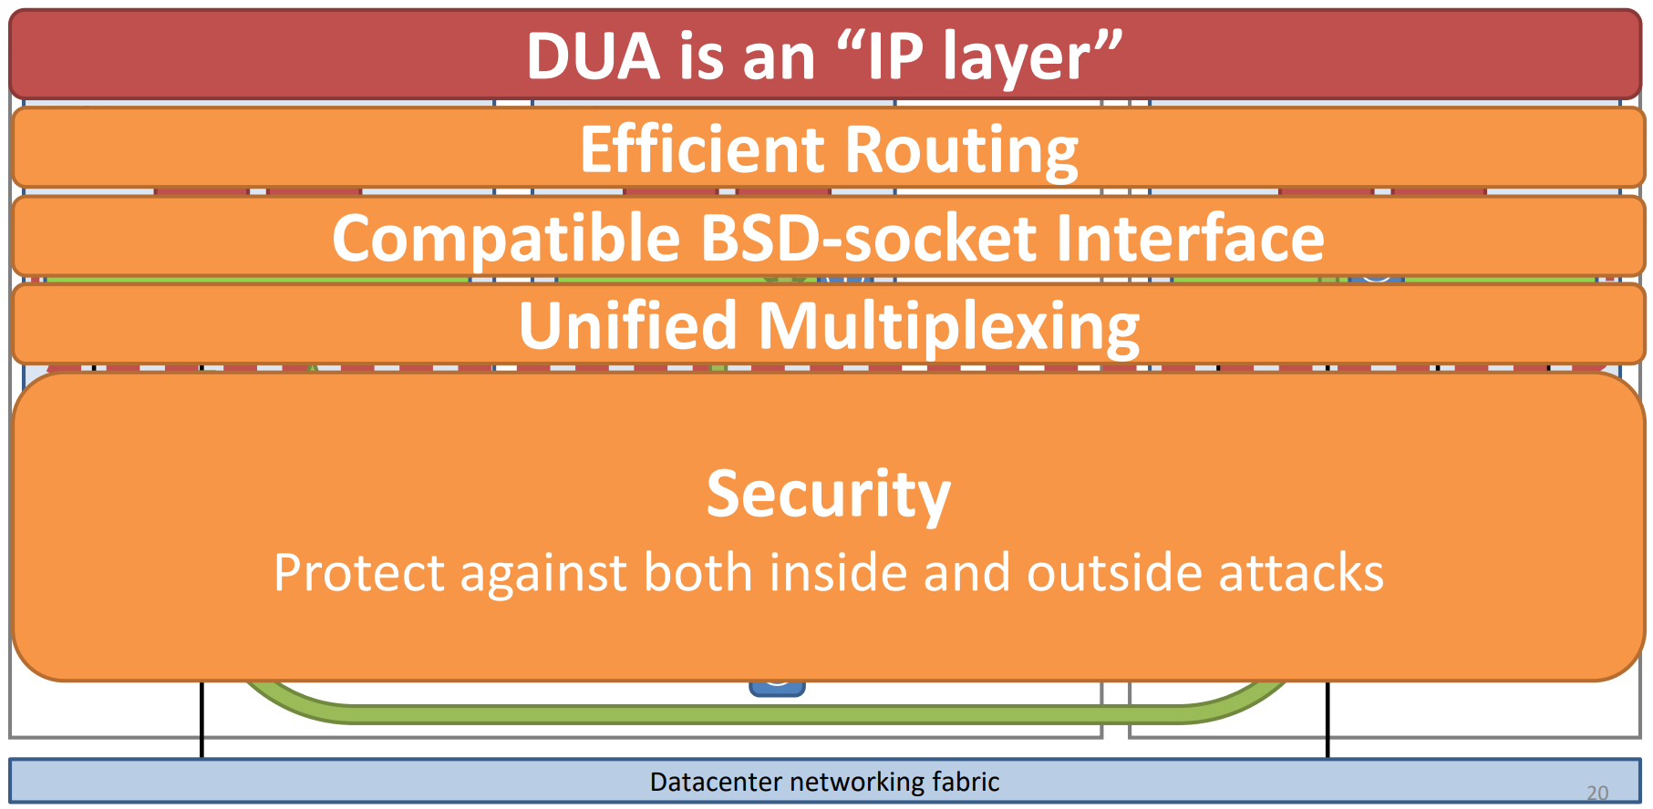
Direct Universal Access

Slide 79
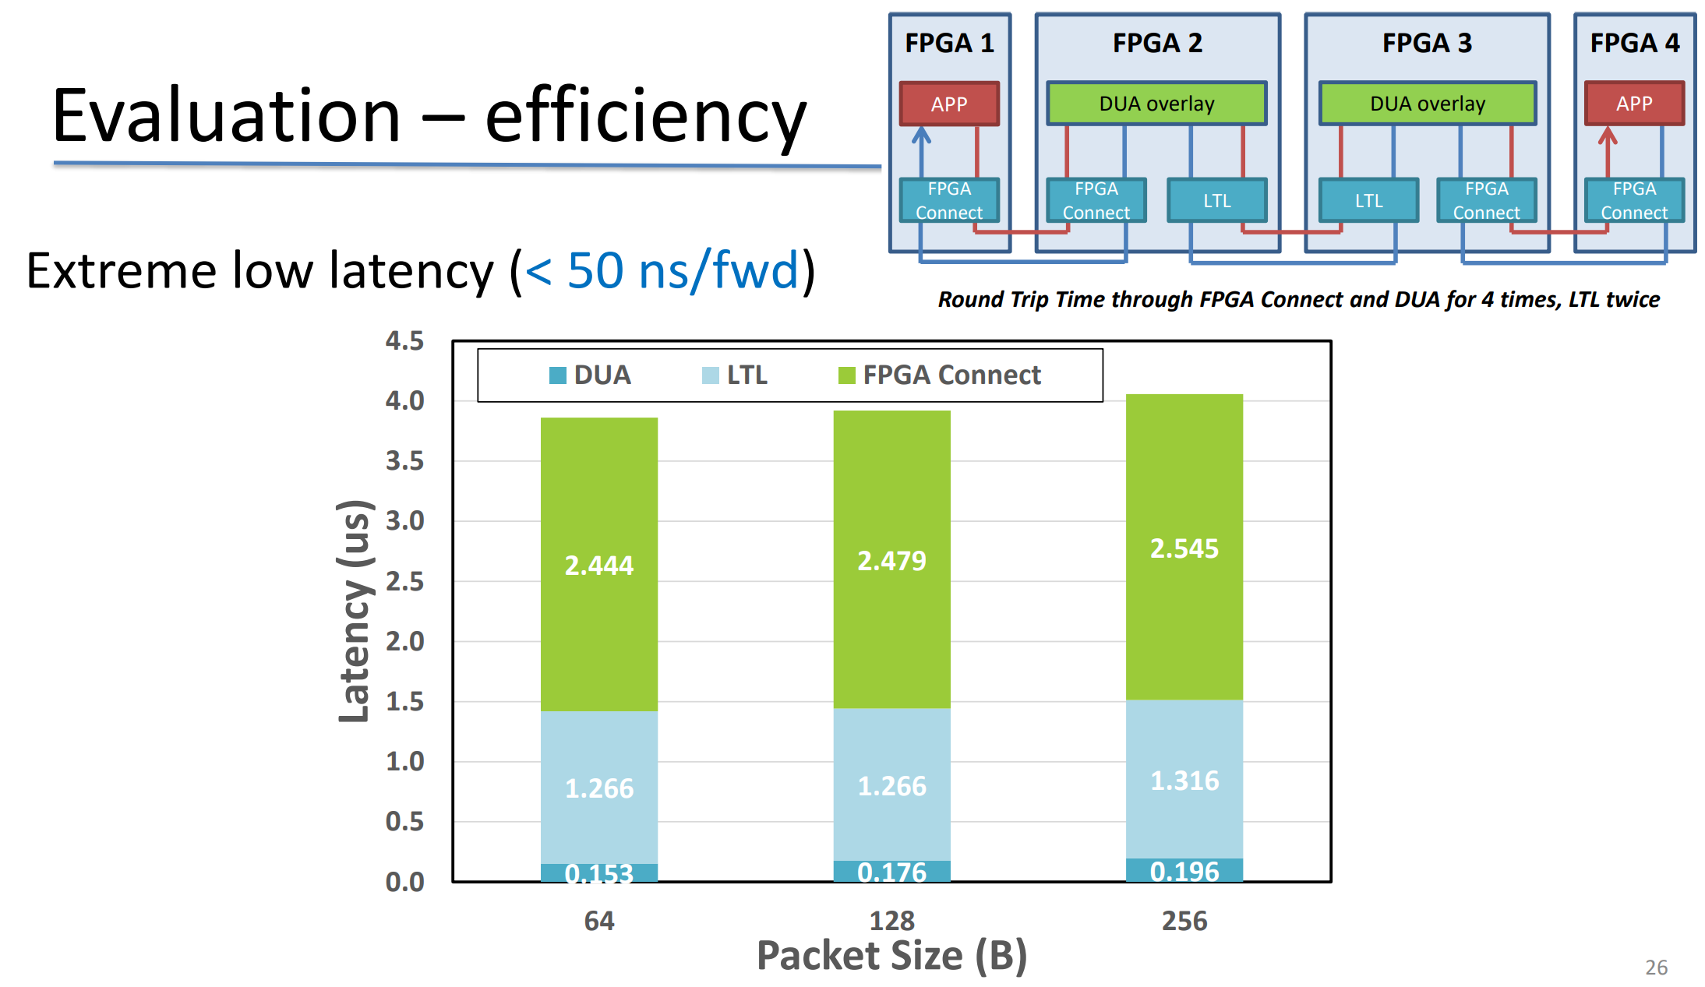

Slide 80
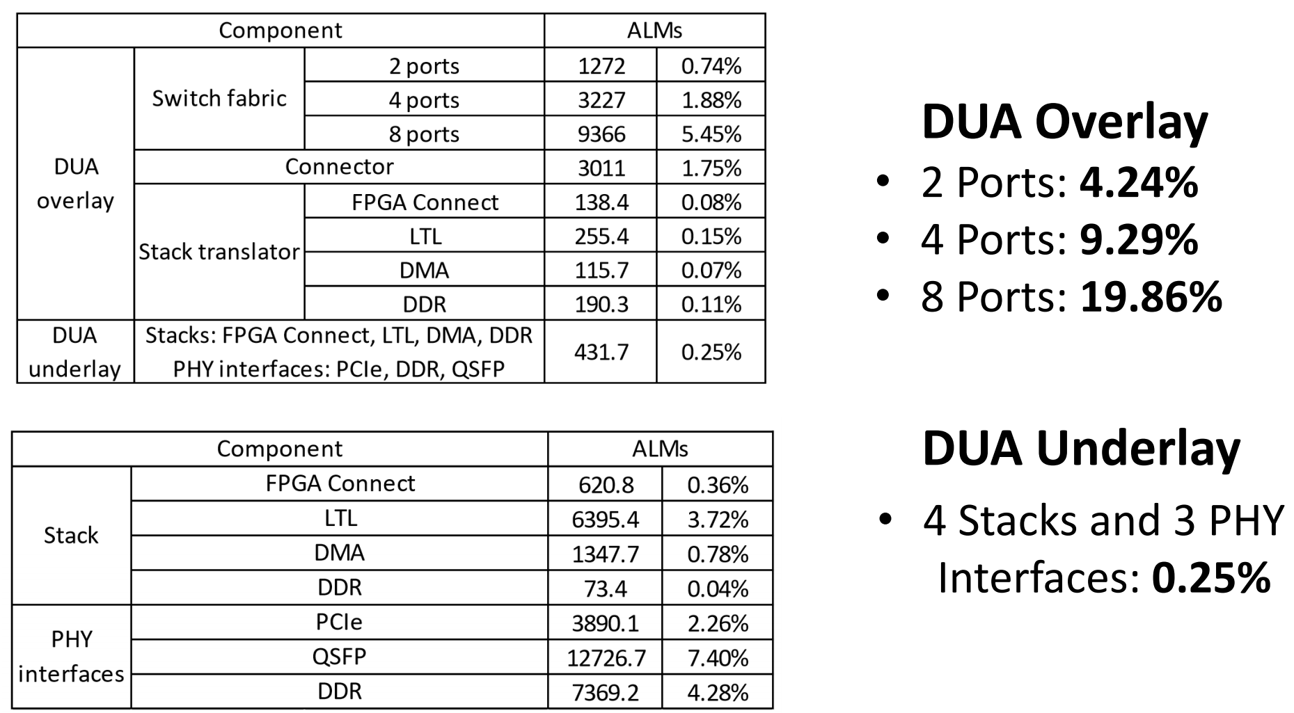
Evaluation: Logic Overhead

Slide 81
Outline
Why SmartNICs
SmartNIC applications
  ClickNP: highly flexible and high performance network processing with FPGA
  KV-Direct: a high-performance in-memory key-value store with FPGA
  SocksDirect: high performance socket communication
  DUA: making data center resources available to FPGA
The future of SmartNIC architecture

Slide 82
Tight Integration with host CPU
SoC
Core 1
Core 2
Core 3
Core 1
Core 2
Core 3
PCIe RC
Mem controller
NIC
Mem controller
PCIe
DDR
DDR
NIC
Recall: In KV-Direct, when accessing data structures in host memory, why do we need to be frugal on memory accesses? Why do we need to hide the PCIe latency?

Slide 83
Disaggregated Pool of Tiered Memory
Towards memory disaggregation in a cluster
  Motivation 1: 40% hardware cost of cloud servers is DDR. VM memory usage is highly unbalanced, and 40% provisioned memory capacity is unused. Borrowing memory from other nodes in the cluster can expand memory capacity.
  Motivation 2: Big data and database applications require PB-scale storage, which needs to store large data structures in a cluster.
Towards disaggregated pool of tiered memory
  DDR/Optane/Flash are different classes of storage with different capacity, price, and persistence.
  DDR should be a performance layer holding the hot data.

Slide 84
Disaggregated Pool of Tiered Memory
Host 1
Host 2
Host 3
CPU
CPU
CPU
DDR
DDR
DDR
DDR latency = 0.1 us
Flash
Flash
Flash
Flash latency = 30 us
Network RTT = 3 us
Problem: latency of remote memory and Flash storage is much higher than local DDR access!

Slide 85
Heterogenous Data Access Methods
Compute at Client
Compute at Server
(Home Node of Data)
Memory-mapped Load/Store
(CXL, Gen-Z, etc.)
In-Network Computation
SmartNIC Offloading
RPC on CPU
Asynchronous Read/Write
(one-sided RDMA)
Load/Store: low overhead per operation, but synchronous; may have cache and buffer
Read/Write: high overhead per operation, but each op can transfer a large block, and many ops can work in parallel
Switch: high throughput but low programmability and buffer size
SmartNIC: high parallelism but high PCIe latency and low buffer size
RPC on CPU: close to memory, easy to program but high cost
How to choose among the data access methods?
Can we have a unified programming framework?
Notes:
Now we have heterogenous methods to access a piece of remote data in data center networks. Traditionally, the only way to access remote data is by executing RPC on the remote CPU. Then we have RDMA technology to directly copy the data to local buffer and do computation. If the data structure is complicated, we may need multiple network round-trips to RDMA the data. But because it removes the cost to invoke an RPC on the remote CPU, which is mainly the TCP/IP and RPC protocol stack, the overall performance may be still higher. Next we have smartNIC offloading and in-network computation. SmartNIC is high parallelism but its main drawback is high PCIe latency and low on-chip buffer size. Network switches also have low buffer size but high throughput. In the next a few years we will have memory-mapped load/store over network, which has lower per-operation overhead compared to reads and writes, but each operation only accesses a cache line of data. In summary, we have a wide spectrum of data access methods, and we need some way to choose among them.

Slide 86
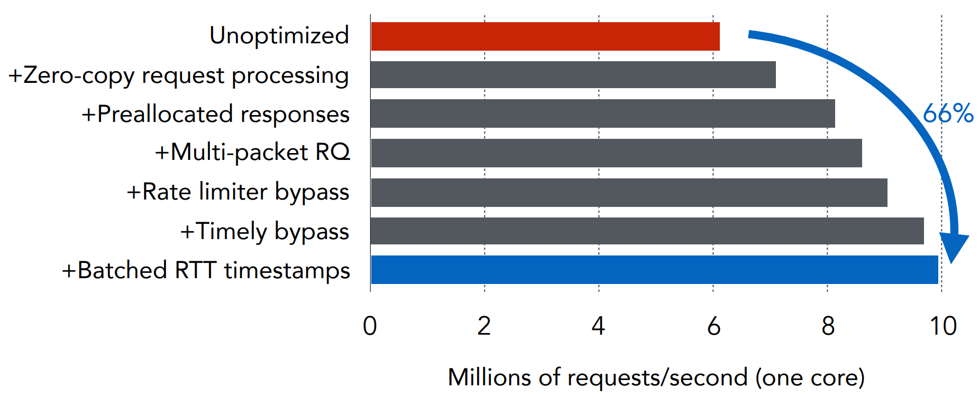
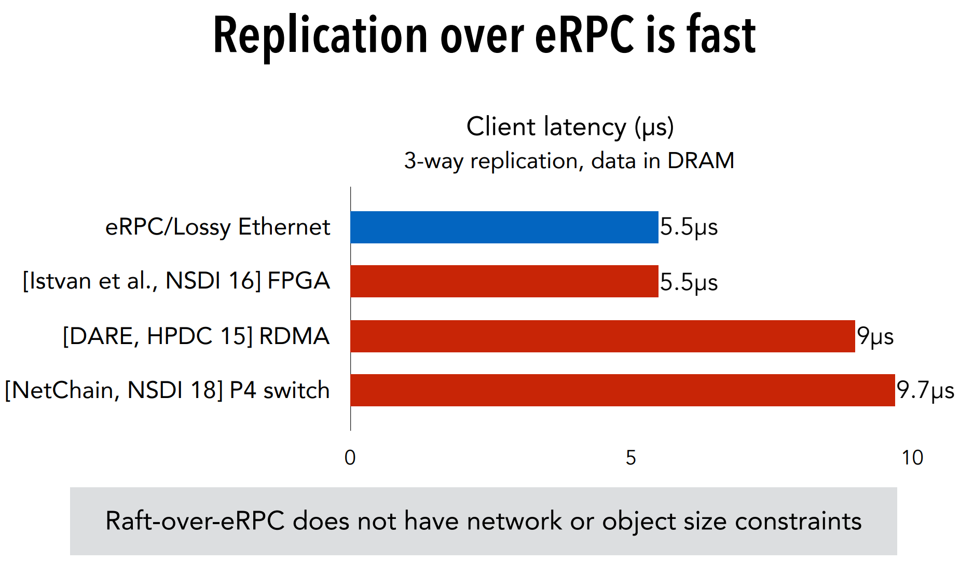
RPC at Server CPU
DPDK, ZygOS, Shinjuku, Shenango, eRPC…
Source: Datacenter RPCs can be General and Fast, NSDI’19

Slide 87
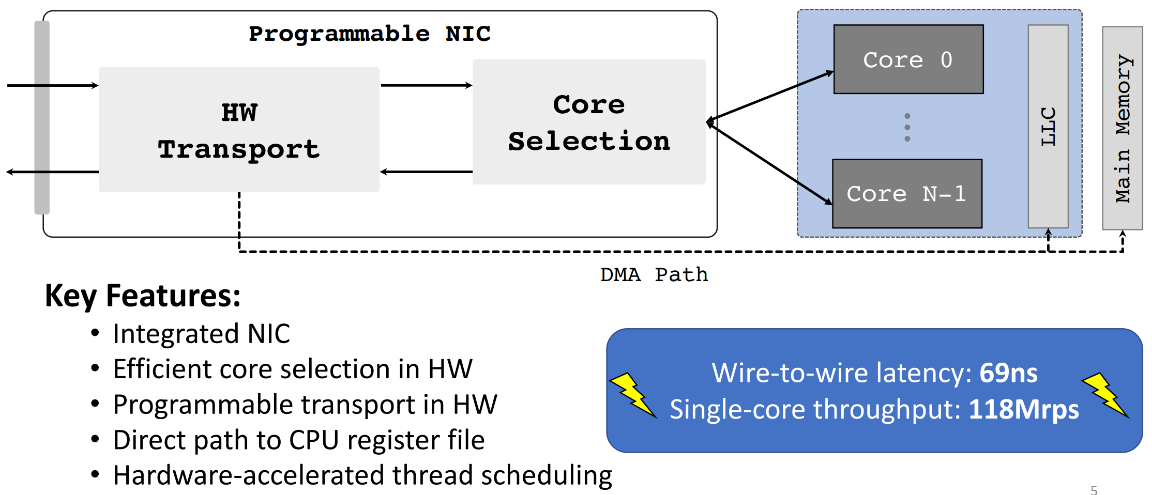
Hardware-accelerated RPC at Server
RPCvalet, NeBuLa (Scale-Out NUMA), NanoPU…
Source: The nanoPU: A Nanosecond Network Stack for Datacenters, OSDI’21

Slide 88
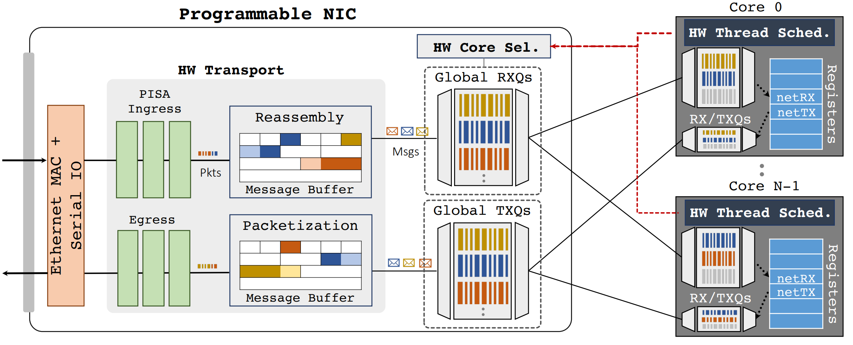
Hardware-accelerated RPC at Server
RPCvalet, NeBuLa (Scale-Out NUMA), NanoPU…
Source: The nanoPU: A Nanosecond Network Stack for Datacenters, OSDI’21

Slide 89
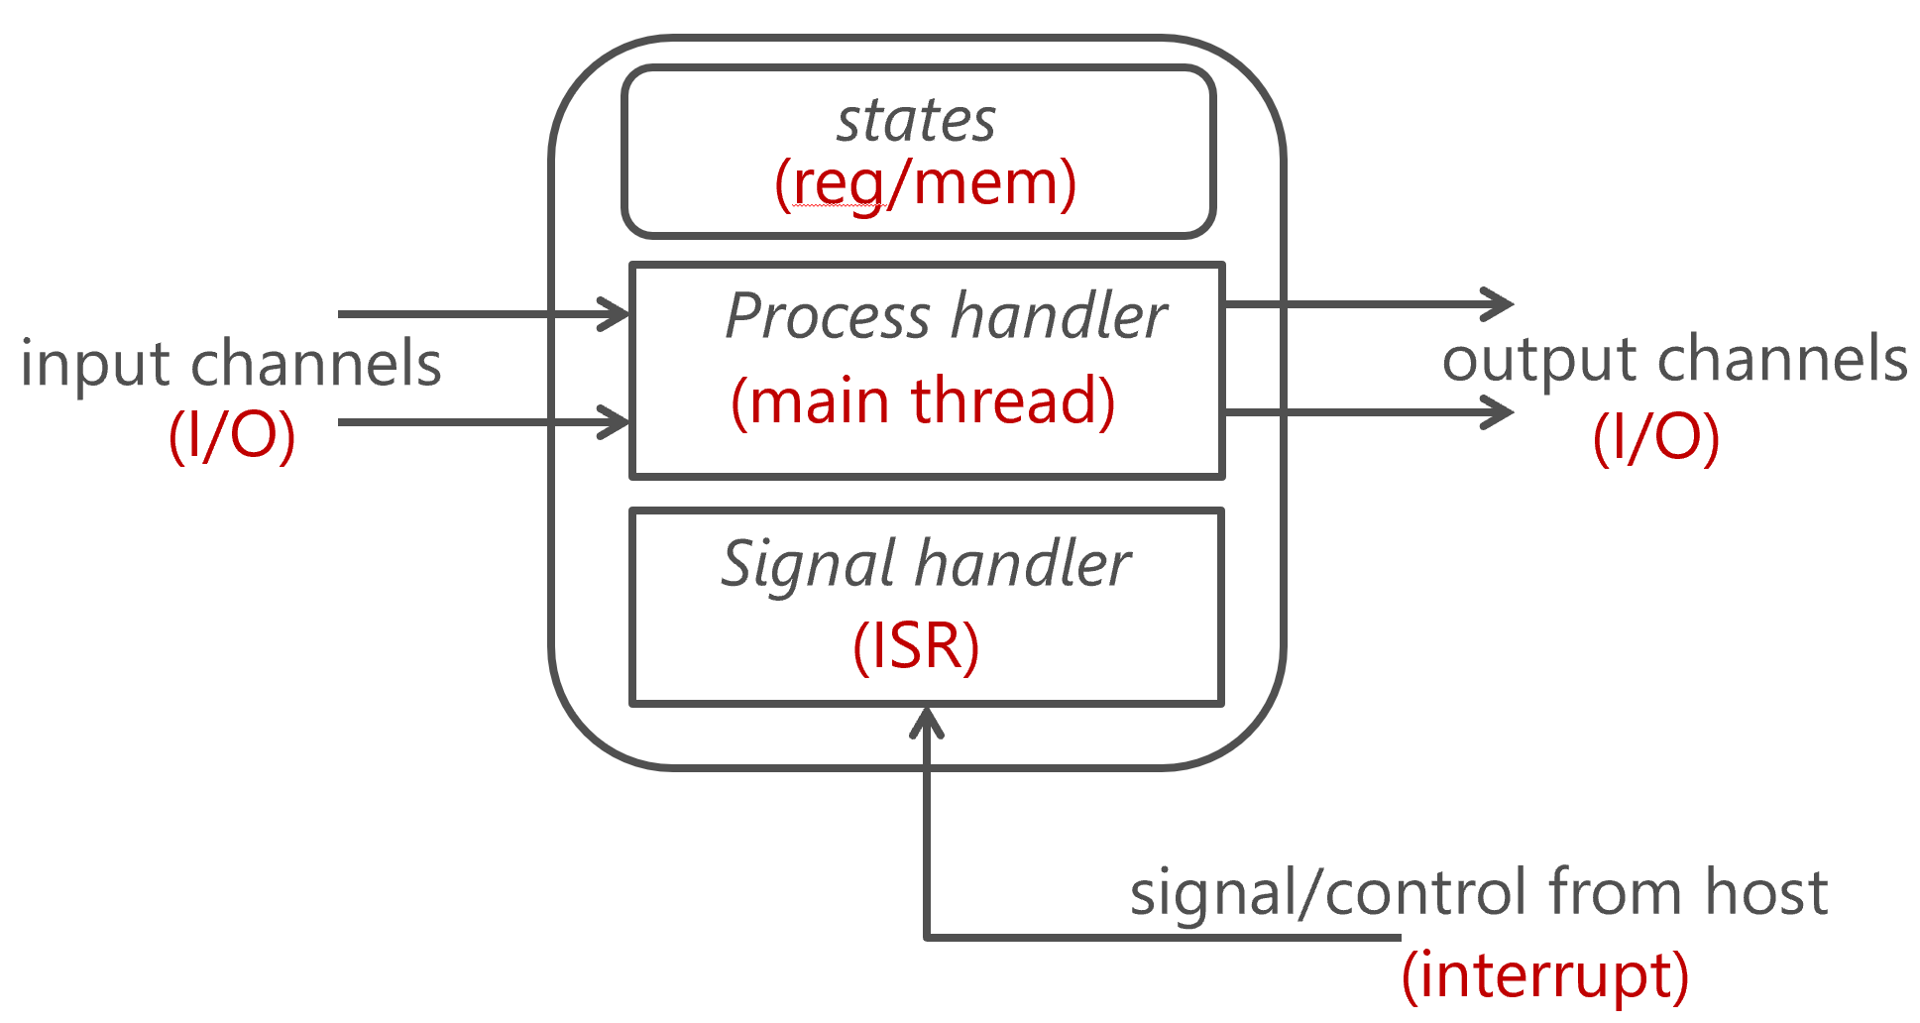
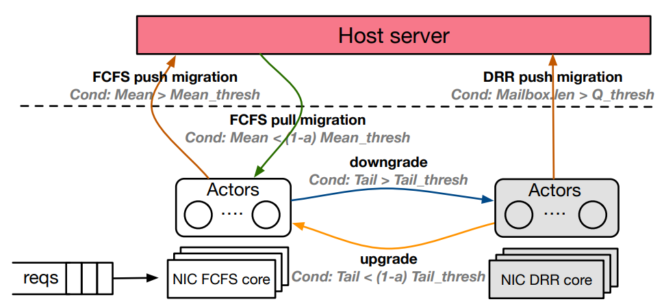
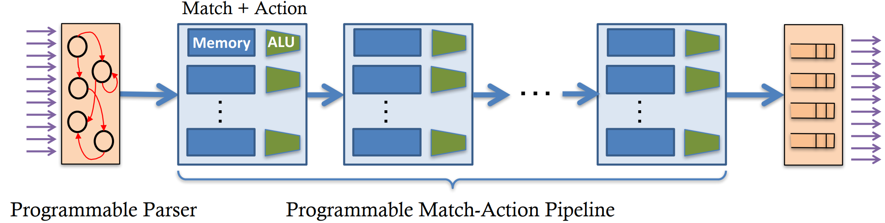
SmartNIC Offloading at Server
Actor Programming Model
  Each actor has local state and communicates with explicit messages
ClickNP
iPipe
Source: Offloading Distributed Applications onto SmartNICs using iPipe, SIGCOMM’19
RMT: Reconfigurable Match-action Table

Slide 90
SmartNIC Offloading at Client
Traditional CPU cores have limited capability of hiding memory latency, especially when accessing remote memory and Flash storage with 3us+ latency. The CPU core is stuck waiting without scheduling other tasks.
The solution: hardware multithreading.
Adding hardware multithreading to the main CPU is too complicated, so we consider building such a co-processor in SmartNICs.
The host CPU should offload tasks with a lot of remote memory accesses which cannot be simply offloaded to the remote side.
The co-processor should have multiple hardware threads to hide load/store latency. When a hardware thread executes a slow load (remote or slow storage media), the thread should be paused and the hardware scheduler finds another ready thread to execute.

Slide 91
Improving Data Locality
In a disaggregated pool of tiered memory:
  When using remote memory to expand local memory, hot data should be in local memory.
  Hot data in the cluster should be in DDR rather than slow storage media.
Open question: how to do data hotness measurement and migration?
Can we cache hot data at clients?
  How to maintain cache coherence among clients and server?

Slide 92
Conclusion
Infrastructure services in data centers mainly use software processing on general processors, whose performance lags behind networking, storage and customized computing hardware.
To provide high performance and flexibility, recent years witnessed large scale deployment of programmable NICs (SmartNICs) in data centers.
We use SmartNICs to offload network functions, remote data structures, and OS communication primitives.
Future SmartNICs will be tightly integrated with host CPU, support programmable offloading, and build the data plane for disaggregated pool of tiered memory.

Slide 93
Thanks!
Q&A

