Slide 1
Network Intelligence: NIC, switch or xPU?
Bojie Li
Co-Founder, Logenic AI
Sep 16, 2023

Slide 2
Contents
Trend 1: Intelligent Network Devices
SmartNIC: FPGA, ASIC, NP and DPU
Programmable Switch
Trend 2: Fast Interconnect
NVLink and CXL: Direct P2P with Memory Semantics
Convergence of AI and Cloud Networking

Slide 3
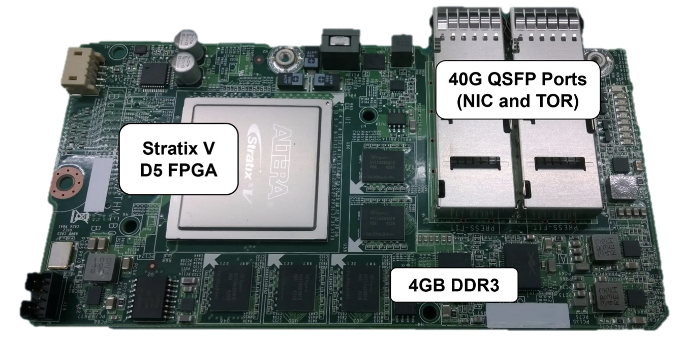
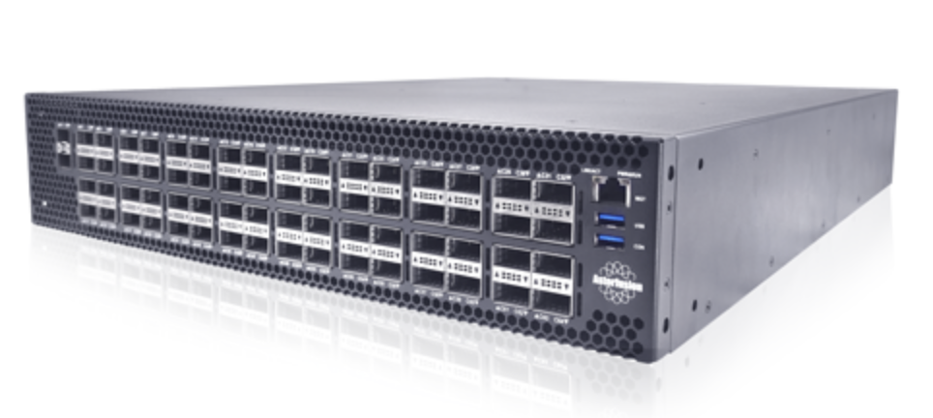
Trend 1: Intelligent Network Devices
SmartNICs
(Microsoft)
Programmable Switches
(Barefoot Tofino)

Slide 4
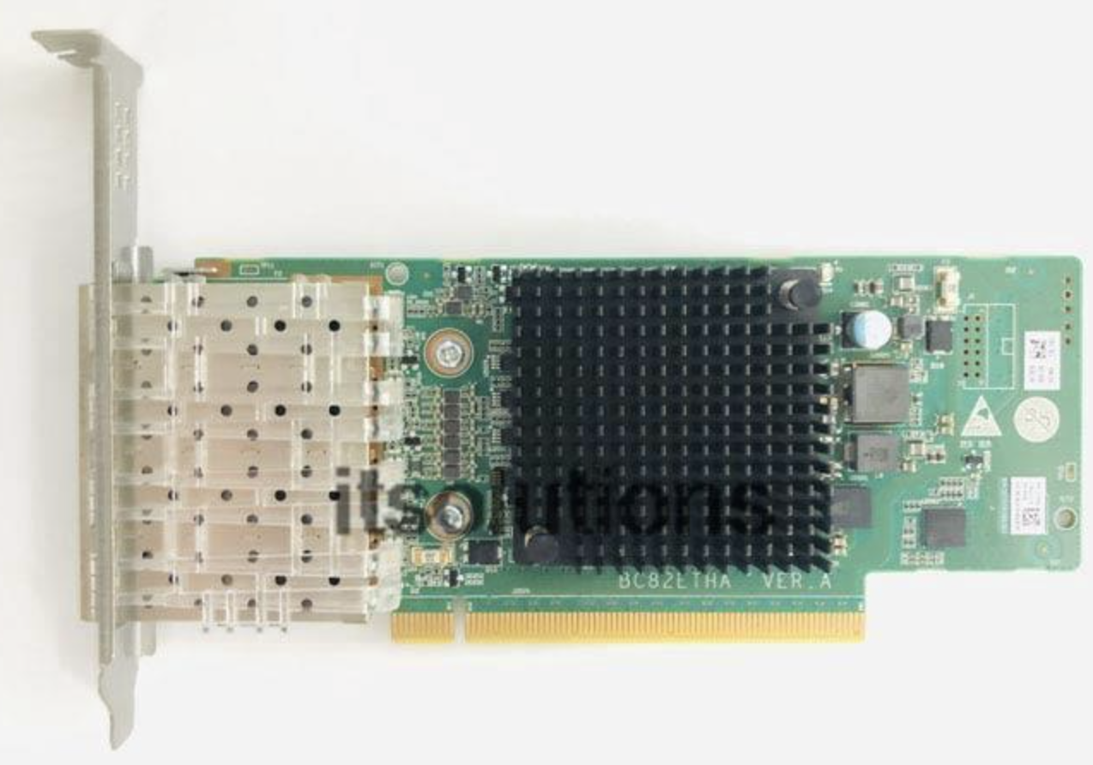
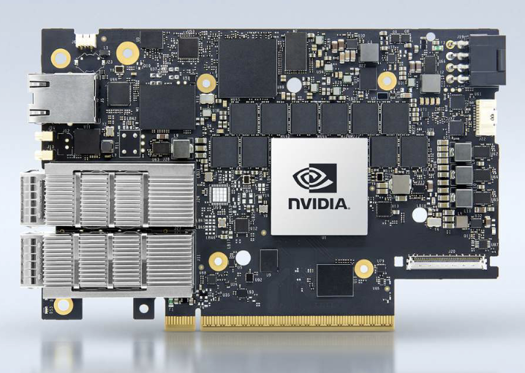
Types of SmartNICs
FPGA/ASIC On-Path SmartNICs
(Microsoft Catapult)
NP-based On-Path SmartNICs (Huawei Hi1822)
Off-Path SmartNICs (DPU)
(Mellanox BlueField)
Host CPU
PCIe
RDMA NIC
Host CPU
Host CPU
Ethernet
PCIe
Hi1822 NIC
BlueField NIC
FPGA
Ethernet
MIPS Cores
PCIe Switch
ToR Switch
Hardware Engine
RDMA NIC
ARM Cores
ToR Switch
ToR Switch

Slide 5
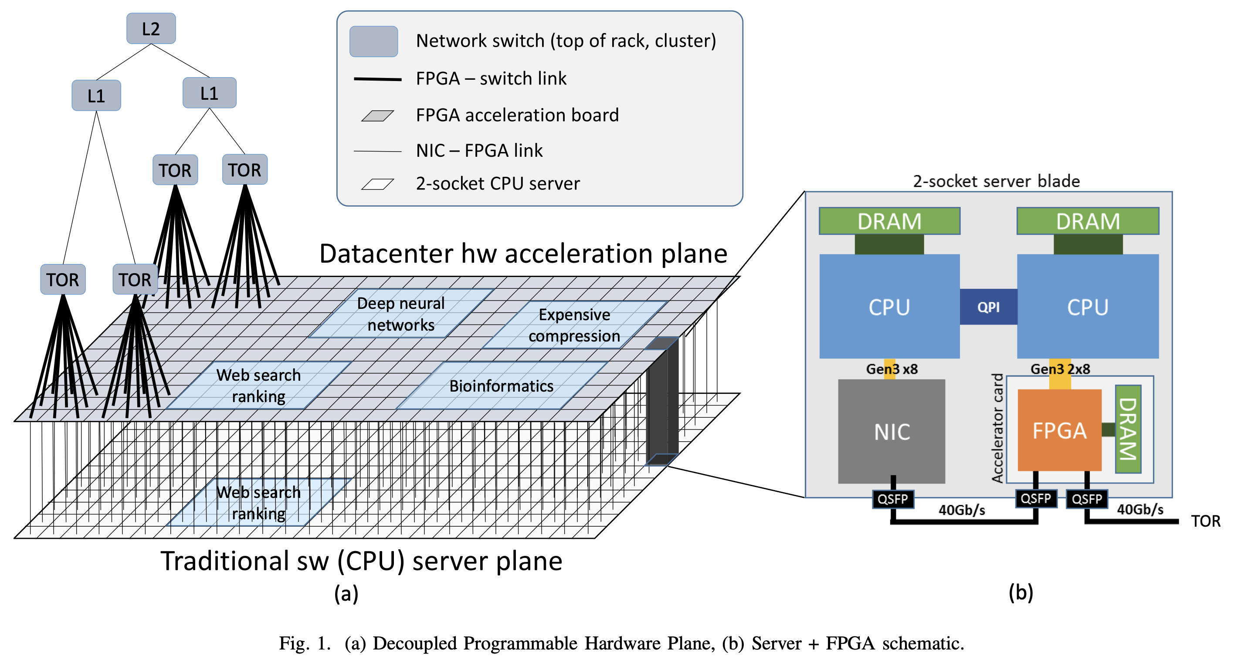
FPGA-based On-Path SmartNICs
Since 2016, every new server in Azure has deployed an FPGA-based SmartNIC
Network virtualization
Storage virtualization
Bing ranking acceleration
Compression acceleration
Encryption acceleration
A Cloud-Scale Acceleration Architecture, ISCA ’16 (Microsoft)

Slide 6
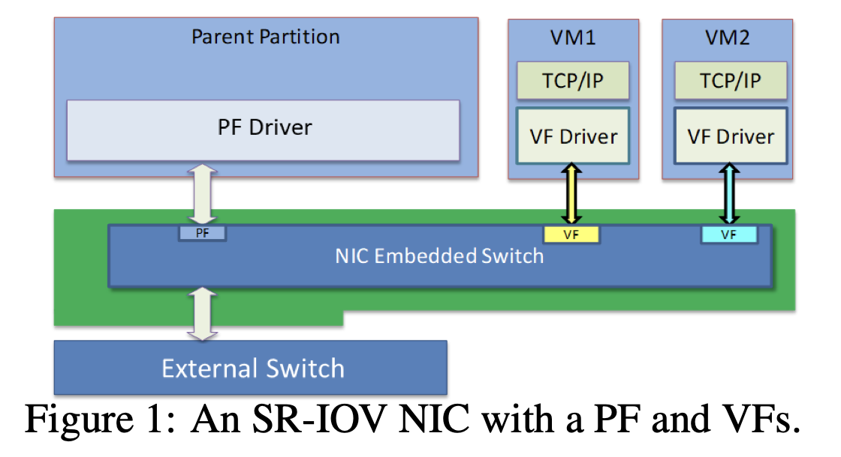
SmartNICs in the Public Cloud
Network Virtualization consumes CPUs, e.g., 5 physical cores per host.
Each physical core sells for $0.1 per hour.
Max potential value $900 per year.
$4500 over the lifetime of a server.
How much does an FPGA-based SmartNIC cost?
Less than $1000 when purchased in large bulk.
Azure Accelerated Networking: SmartNICs in the Public Cloud, NSDI ’18 (Microsoft)

Slide 7
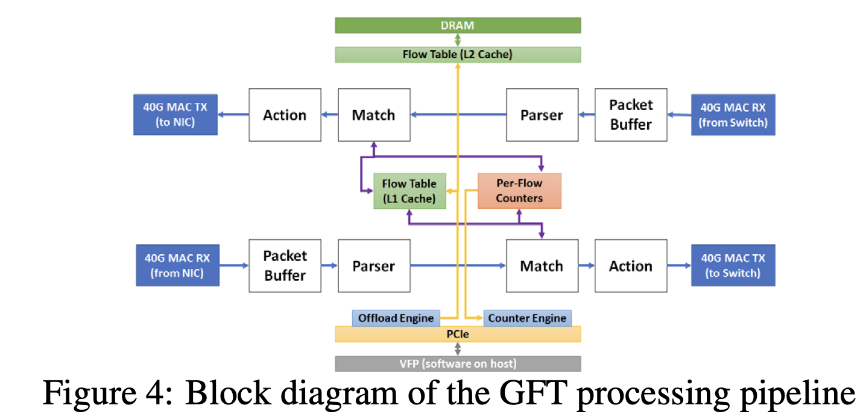
SmartNICs in the Public Cloud
Azure Accelerated Networking: SmartNICs in the Public Cloud, NSDI ’18 (Microsoft)

Slide 8
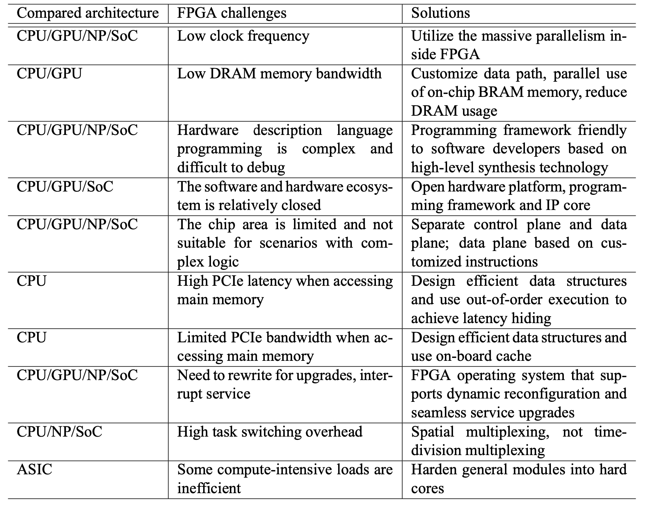
Challenges of FPGA-based SmartNICs

Slide 9
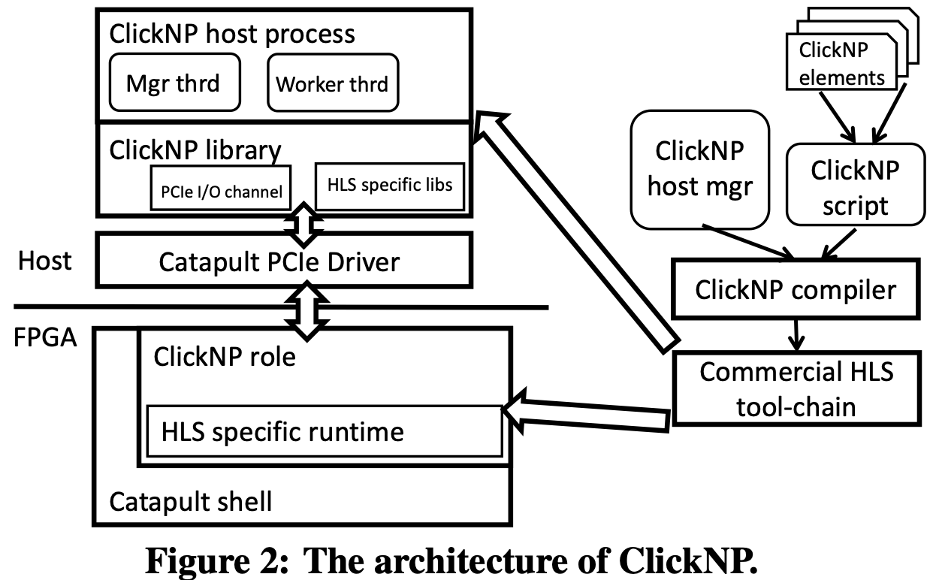
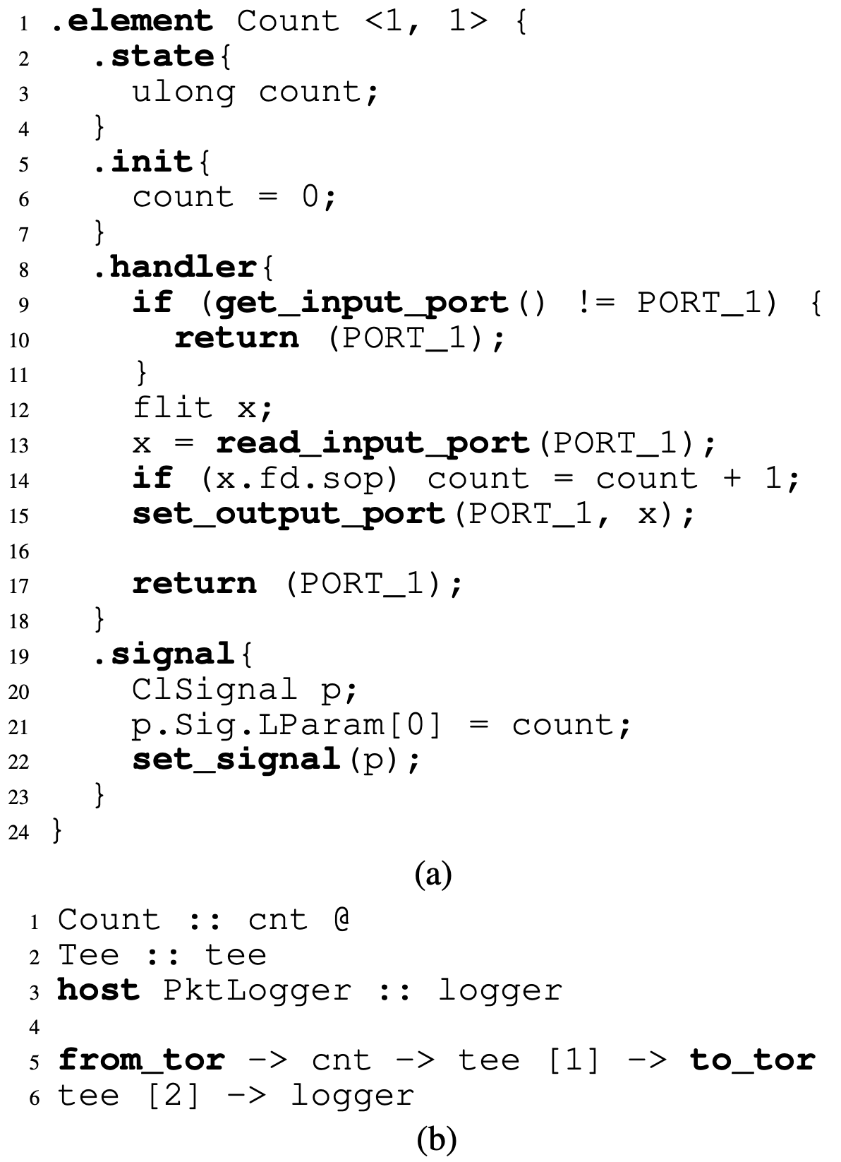
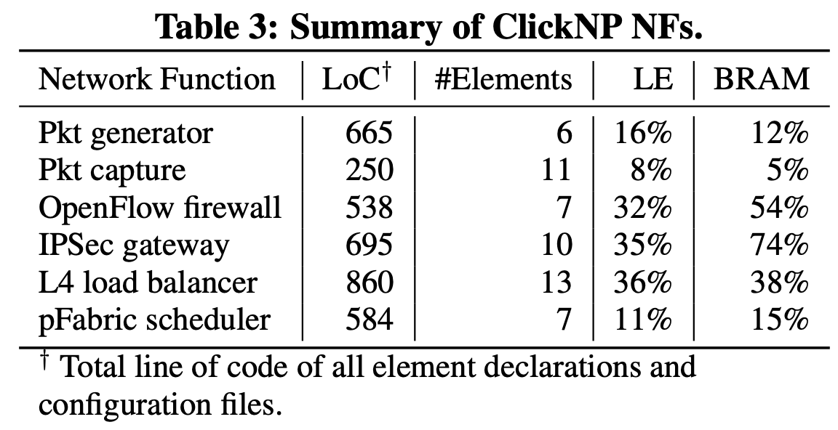
FPGA Programming Made Simple
ClickNP: Highly Flexible and High Performance Network Processing with Reconfigurable Hardware, SIGCOMM ‘16

Slide 10
When to Use FPGA – the 10/100/1000 Rule
10 – 10 years of workload lifetime
If the workload is shifting too fast, FPGA is not as agile as CPUs
100 – 100 lines of C++ code
If the workload is too complicated, an FPGA implementation consumes too much area
1000 – 1000 servers
If the workload is too lightweight, the FPGA development cost is hard to amortize

Slide 11
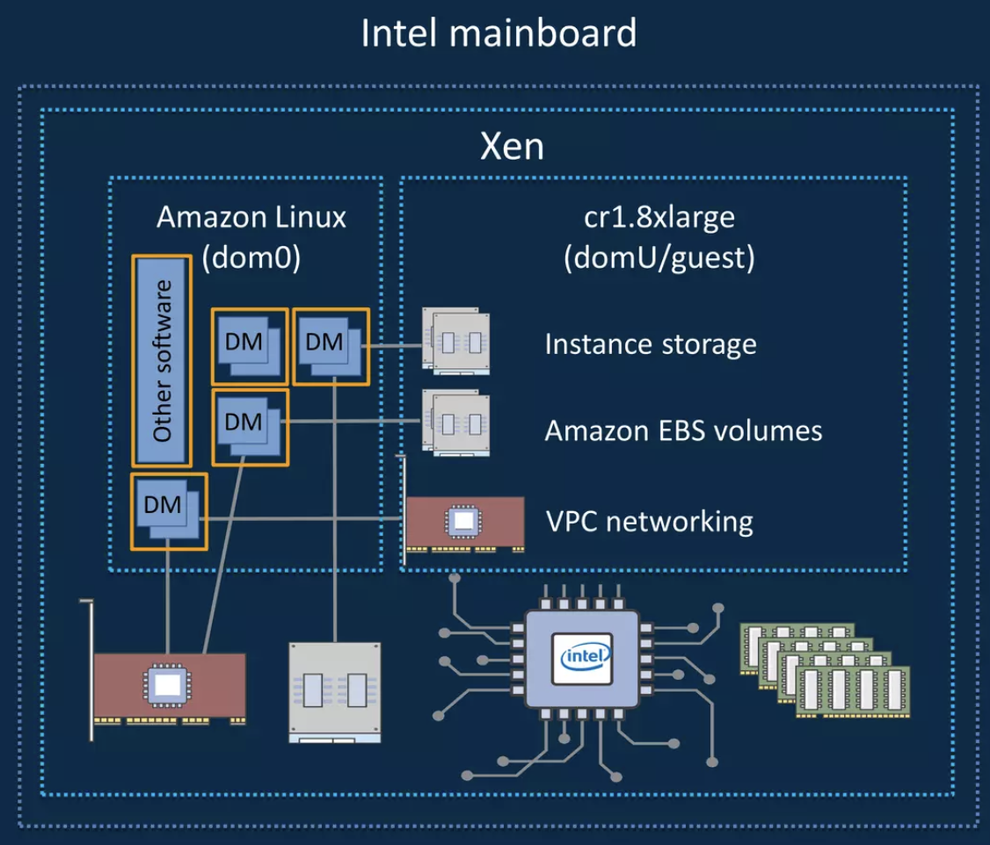
ASIC-based On-Path SmartNICs: AWS Nitro
Traditional: Hypervisor (dom0) consumes several cores
Network virtualization (VPC)
Storage virtualization
Local instance storage
Network-attached EBS volumes
Management
Security benefits of the Nitro architecture - SEP401-R - AWS re:Inforce 2019

Slide 12
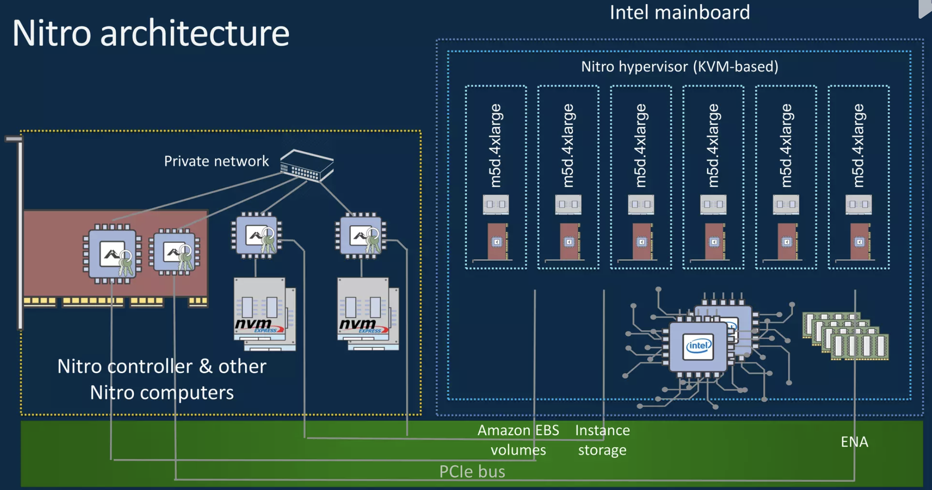
AWS Nitro Removes Hypervisor CPU Cost
Security benefits of the Nitro architecture - SEP401-R - AWS re:Inforce 2019

Slide 13
AWS Nitro Enables Bare-Metal Instance
Security benefits of the Nitro architecture - SEP401-R - AWS re:Inforce 2019

Slide 14
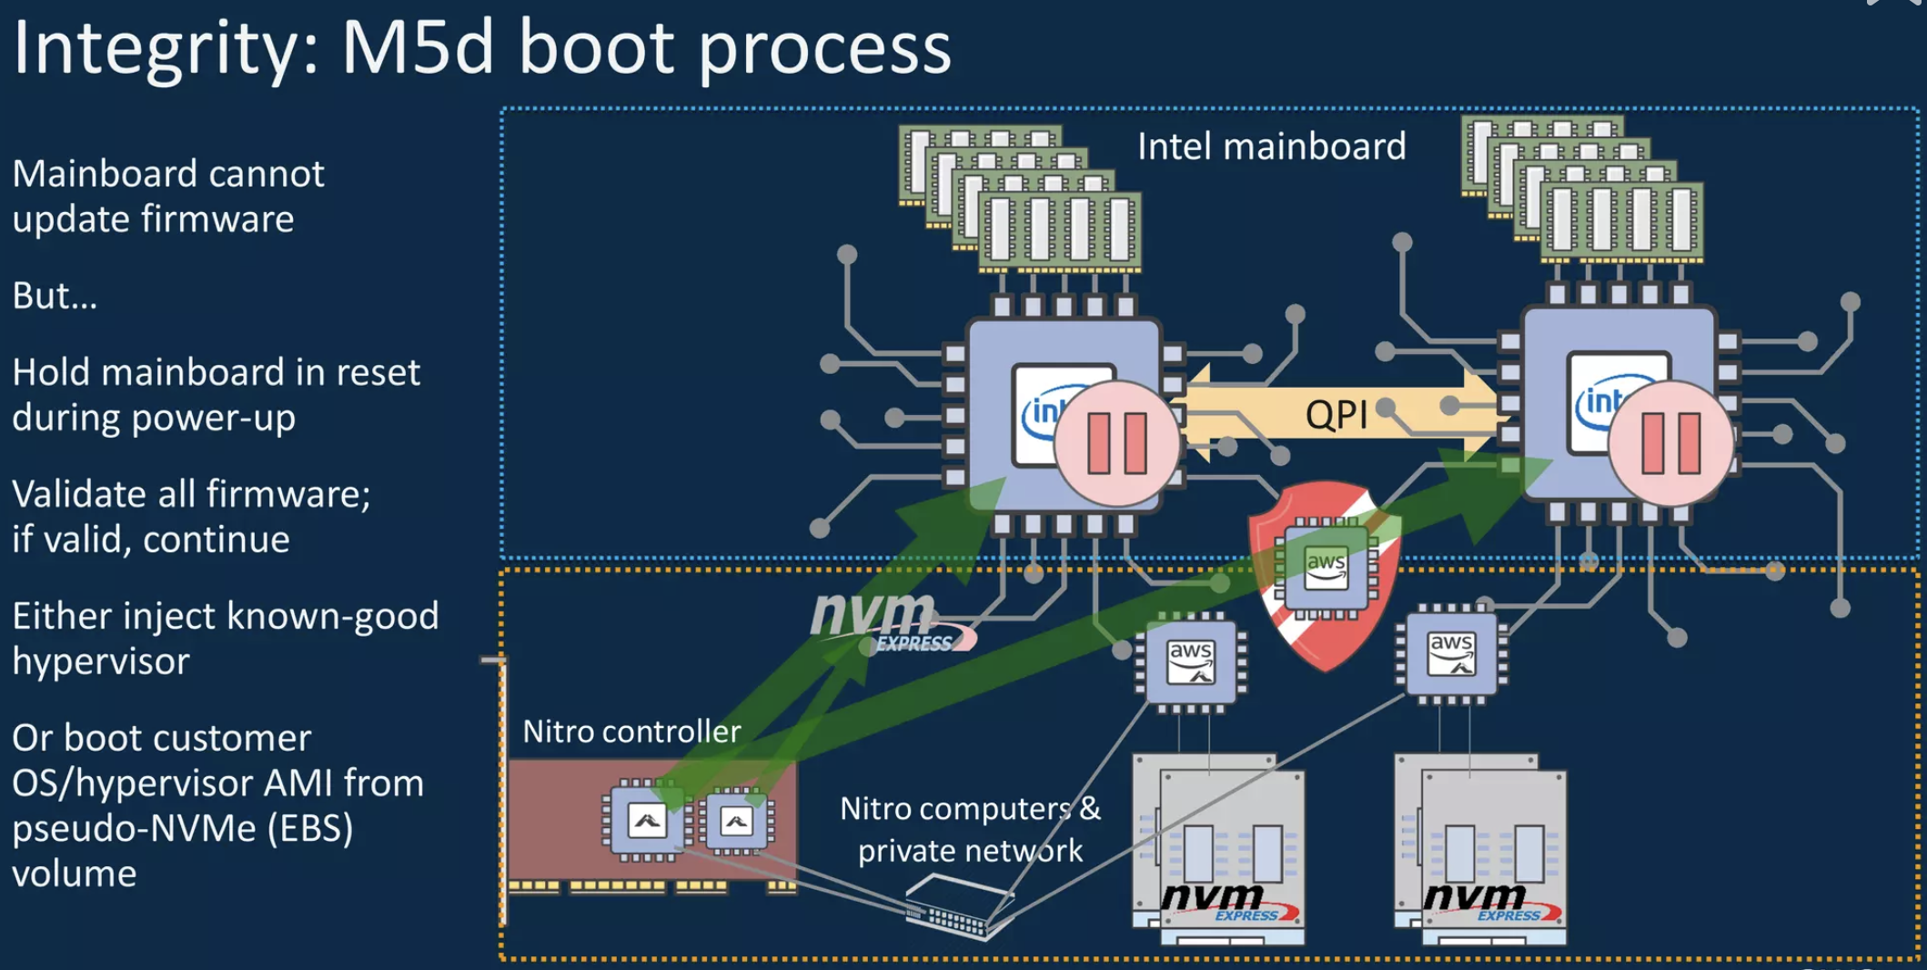
AWS Nitro Provides Security Benefits
Security benefits of the Nitro architecture - SEP401-R - AWS re:Inforce 2019

Slide 15
AWS Nitro Provides Security Benefits
Security benefits of the Nitro architecture - SEP401-R - AWS re:Inforce 2019

Slide 16
AWS Nitro Provides Security Benefits
Security benefits of the Nitro architecture - SEP401-R - AWS re:Inforce 2019

Slide 17
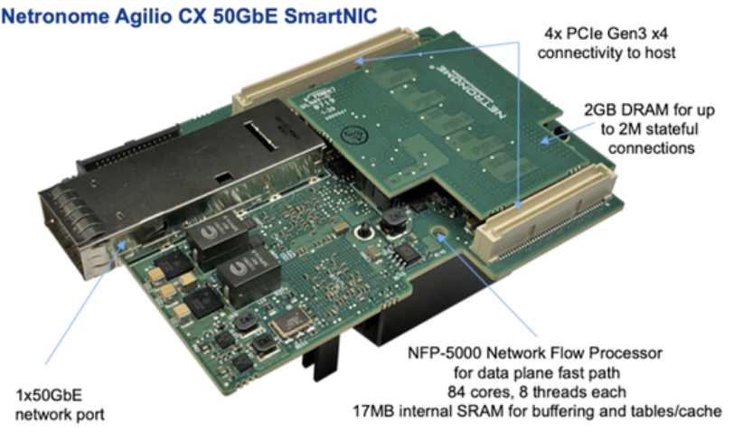
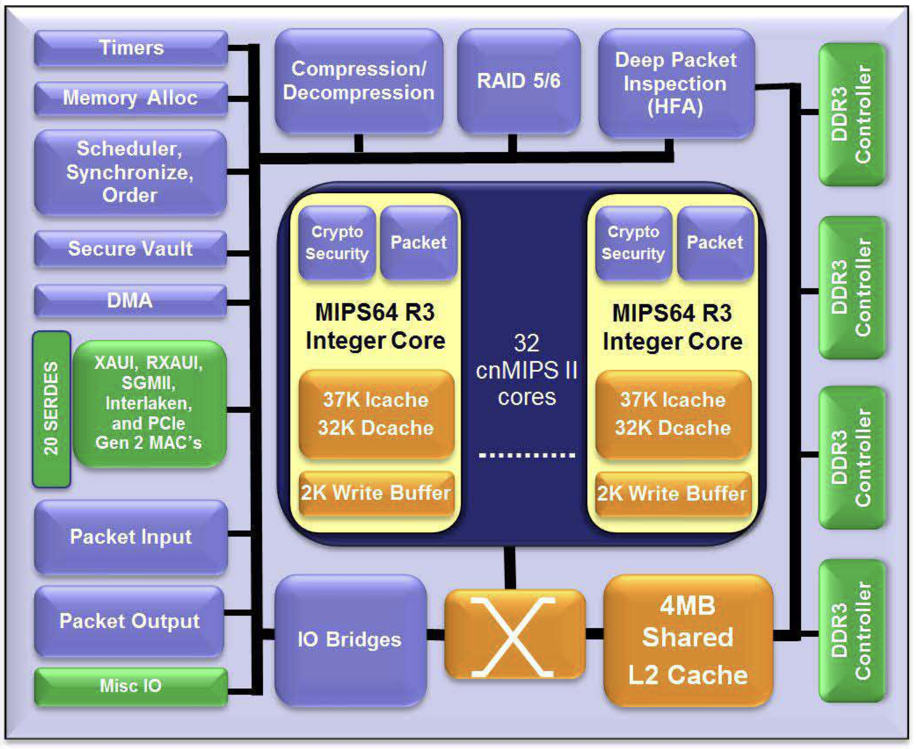
NP-based On-Path SmartNICs
Data and command from CPU
Connection State Store
Hardware Accelerators
Output Queue
Network Output
DMA Input
Transaction State
On-chip Network
Egress Packets
Packet Processing Cores (Match-Action Table)
Request data and transaction state
Flow Processing Cores
Response Data
Packet Processing Cores (Match-Action Table)
Request Scheduler
Request Data
Send data to CPU
Ingress Packets
Request complete or wait for DMA/next packet;
Update transaction state
DMA Output
Network Input
Netronome Agilio CX SmartNIC
Cavium OCTEON II 68xx
Huawei Hi1822 SmartNIC

Slide 18
NP-based SmartNICs: Hard to Program
Need to read 1000+ pages of documents
10+ data structure and 10+ packet processing accelerators on chip
An NP-based RDMA implementation has 10K+ lines of C code
Limited instruction cache: cache thrashing if not optimized
Need to carefully arrange the hot paths to make sure it fits in the cache
Need to pipeline accesses to DMA and data structures on chip
A classical latency hiding problem: the trade-off between polling and context switch
When the flow processing cores waits for data structure access and locks, if it switches context to other QP contexts, loading the context takes time
Typical latencies: on-chip data structure access < context switch < DMA

Slide 19
SoC-based Off-Path SmartNICs (aka. DPU)
Host DRAM
Host CPU
SmartNIC
PCIe Switch
RDMA NIC (Connect-X)
NIC DRAM
Multi-core General Processors
Data Center Network
Mellanox BlueField

Slide 20
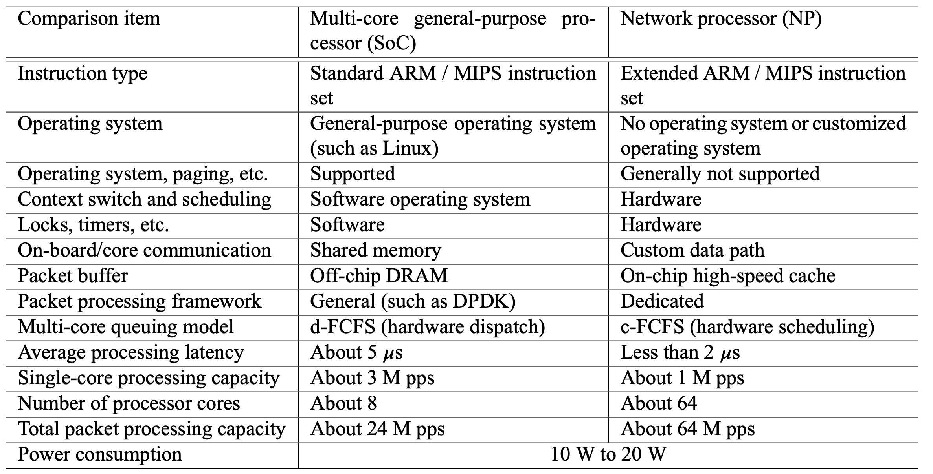
Off-Path vs. NP-based On-Path SmartNICs

Slide 21
DPU is Not Yet Another CPU
NVIDIA DATA CENTER PROCESSING UNIT (DPU) ARCHITECTURE, HotChips 2021

Slide 22
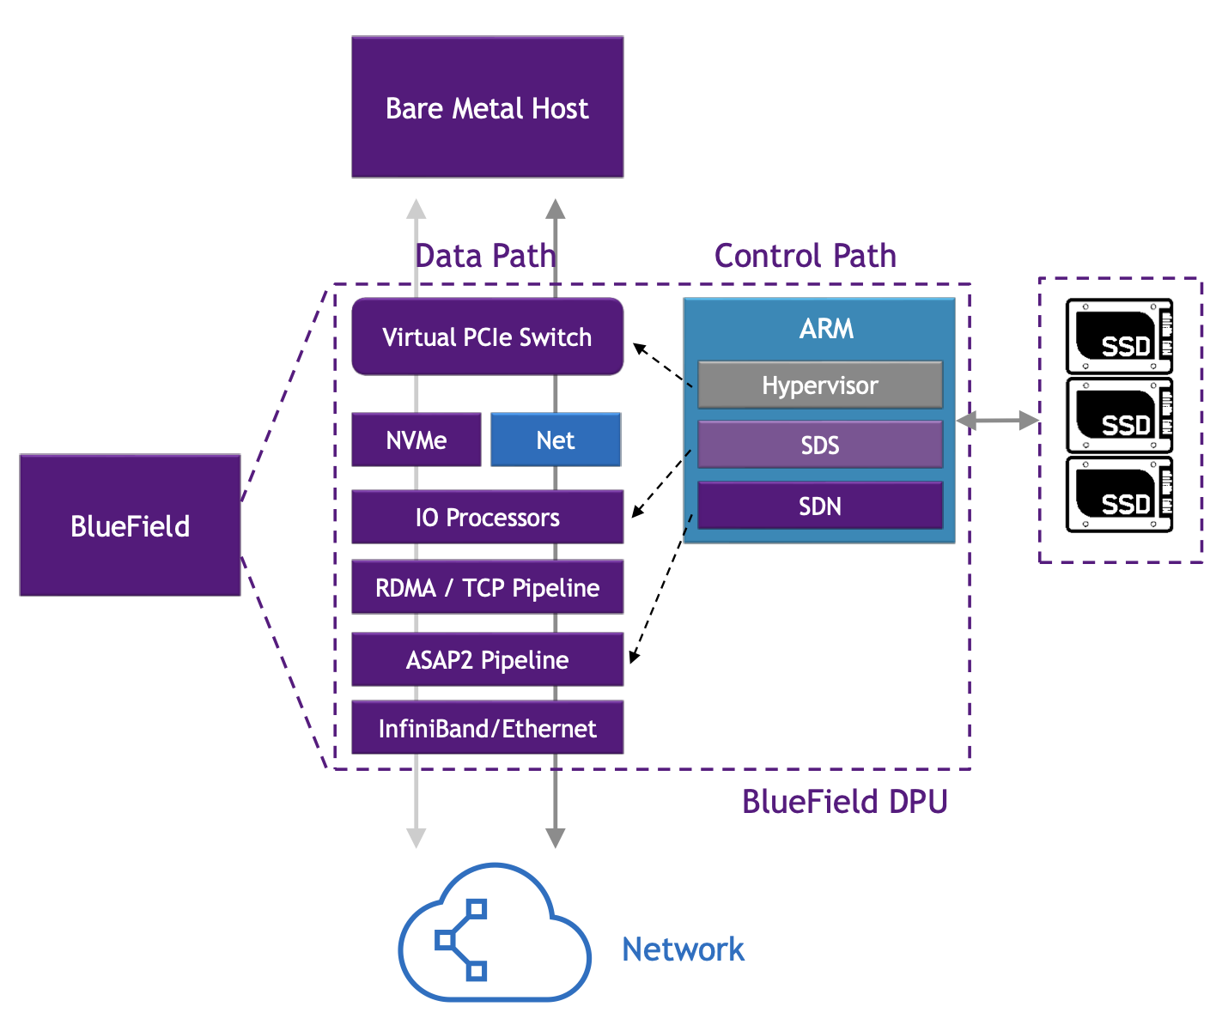
DPU Must Include Hardware Acceleration
DPU: A convergence of Off-Path and NP-based On-Path SmartNICs
NVIDIA DATA CENTER PROCESSING UNIT (DPU) ARCHITECTURE, HotChips 2021

Slide 23
How to Choose SmartNICs?
ASIC and FPGA are similar.
FPGA is more programmable.
ASIC is cheaper in extremely large scale (1M+ hosts).
Suitable for large cloud providers.
NP-based SmartNICs and DPUs are similar.
Only offloading tasks to generic processors does not work.
Hardware acceleration adds complexity to programming, but essential for performance.
Suitable for small-to-medium scale deployments.

Slide 24
Contents
Trend 1: Intelligent Network Devices
SmartNIC: FPGA, ASIC, NP and DPU
Programmable Switch
Trend 2: Fast Interconnect
NVLink and CXL: Direct P2P with Memory Semantics
Convergence of AI and Cloud Networking

Slide 25
Programmable Switch: P4
 | Server | Switch
Example | [NetBricks, OSDI ’16] | Barefoot Tofino
Packets per second | ~30 million | > 1 billion
Bandwidth | 10-100 Gbps | 6.5 Tbps
Processing delay | 10-100 us | < 1 us
Visibility | Narrow | Wide
Memory capacity | Large | Small
Programmability | High | Low

Slide 26
Use Case 1: NIC + Switch Congestion Control
HPCC: High Precision Congestion Control, SIGCOMM ‘19
Towards Compute-Native Networking, APNet ‘21

Slide 27
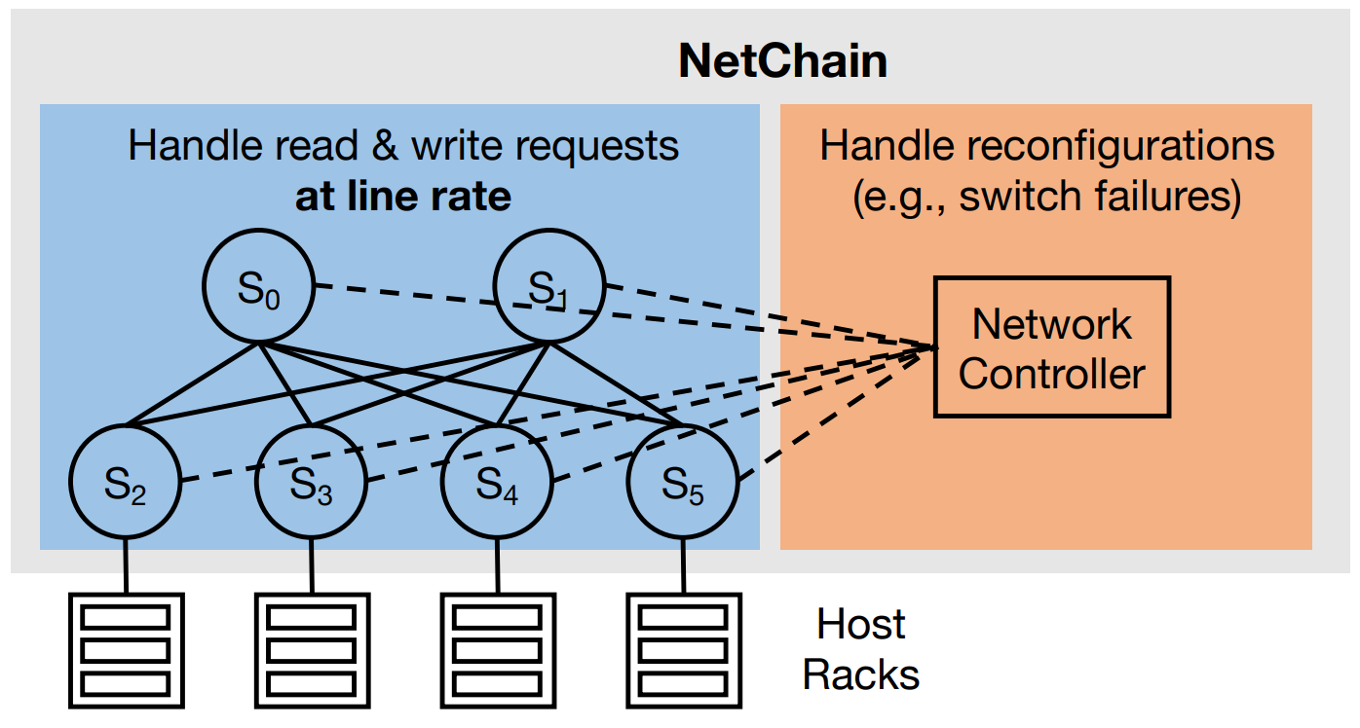
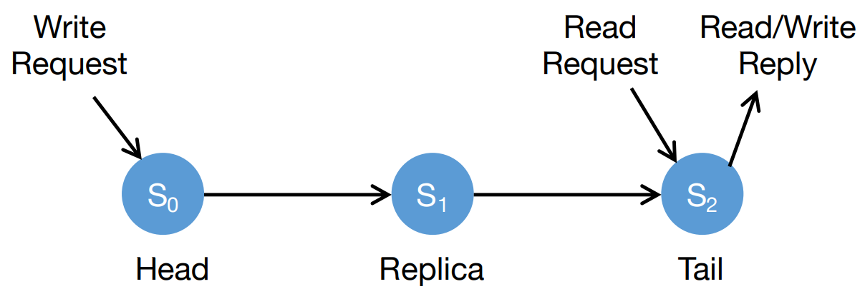
Use Case 2: Sub-RTT Coordination on Switches
High throughput
Low latency
Strong consistency
Fault tolerance
Directly from high-performance switches
Chain replication in the network
NetChain: Scale-Free Sub-RTT Coordination, NSDI ‘18

Slide 28
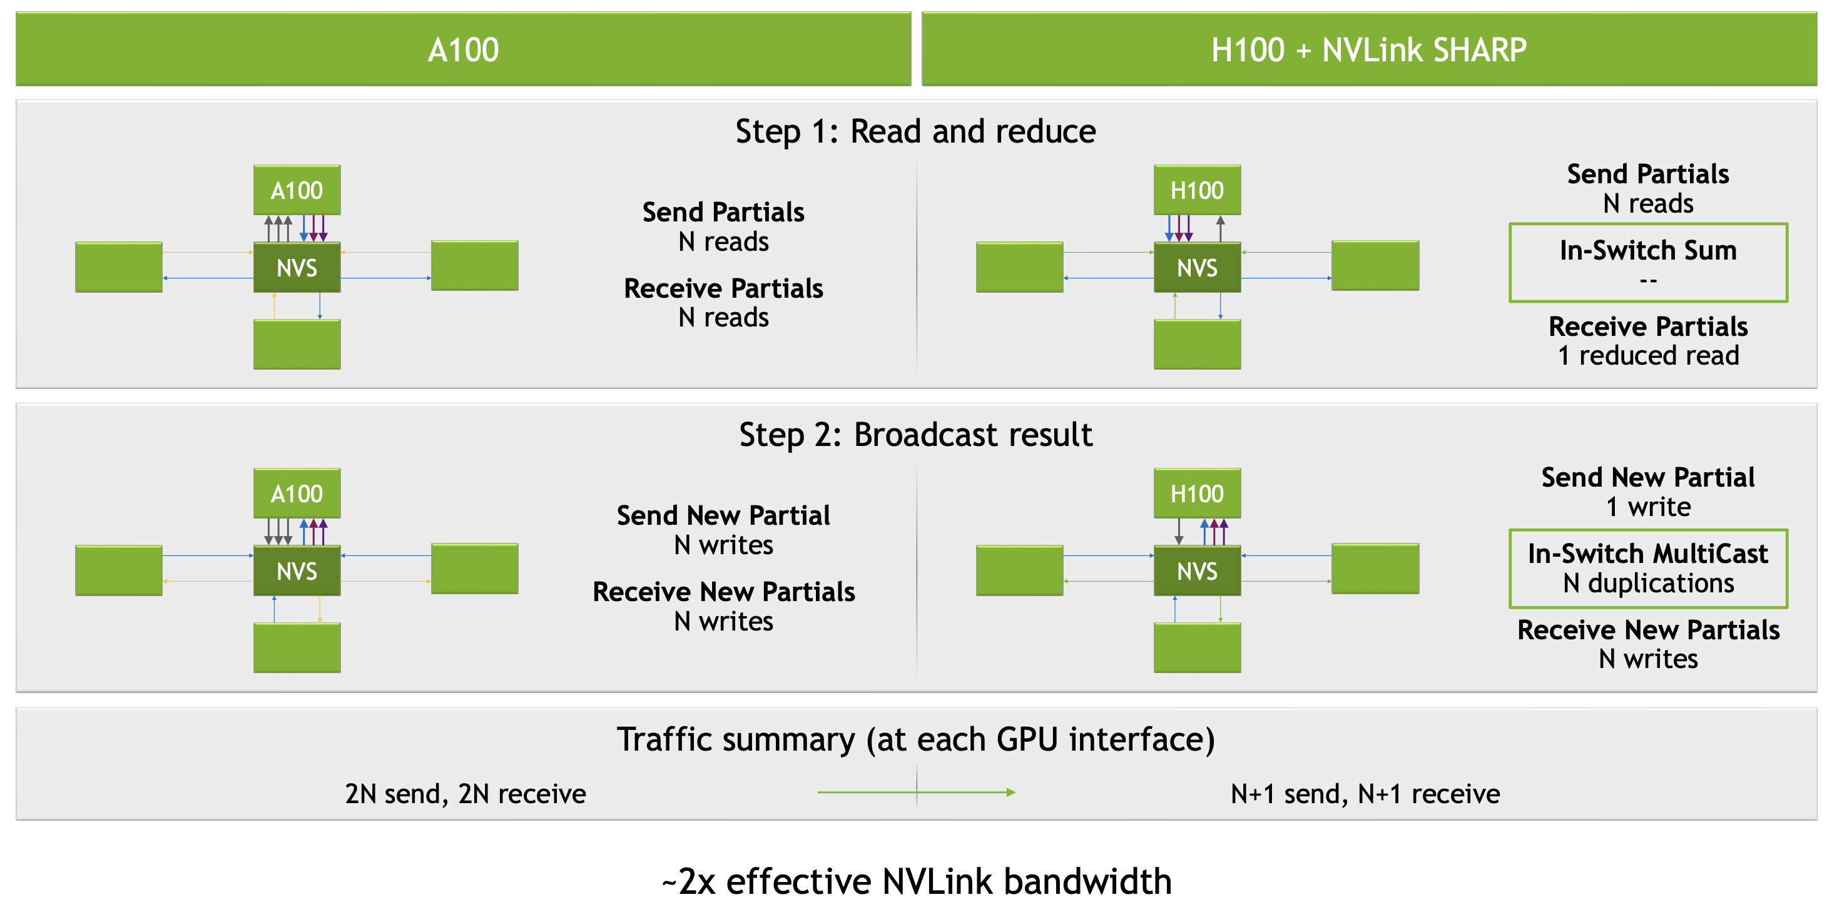
Use Case 3: SHARP for AI Param Aggregation
THE NVLINK-NETWORK SWITCH: NVIDIA’S SWITCH CHIP FOR HIGH COMMUNICATION-BANDWIDTH SUPERPODS, HotChips ‘22

Slide 29
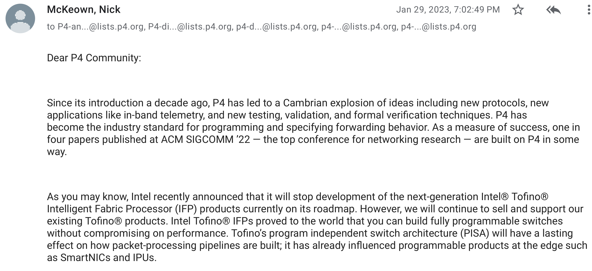
Why Intel Stopped Tofino

Slide 30
SmartNIC or Programmable Switch?
Host
Host
 | SmartNIC | Programmable Switch
Congestion control | DCQCN, TIMELY, MP-RDMA, IRN | HPCC, pFabric, DeTail, CP, NDP
Load balancer | VFP | SilkRoad
Key-value store | Pilaf, FaRM, DrTM, FaSST, KV-Direct | SwitchKV, NetCache, IncBricks
Aggregation | NetAgg, CamCube | SHARP, DAIET, SwitchML, ATP
Lock | DSLR | NetLock
Coordination / Replication | Consensus in a Box, DARE, APUS, Derecho, Mu | NetChain, NetPaxos, SpecPaxos, NOPaxos, Eris
Programming system | Floem, iPipe, StRoM, ClickNP, FairNIC, λ-NIC | SNAP, Frenetic, P4, P4visor, 𝜇P4, Domino, Lyra, Gallium
CPU
Mem
CPU
Mem
SmartNIC
SmartNIC
Programmable Switch

Slide 31
Contents
Trend 1: Intelligent Network Devices
SmartNIC: FPGA, ASIC, NP and DPU
Programmable Switch
Trend 2: Fast Interconnect
NVLink and CXL: Direct P2P with Memory Semantics
Convergence of AI and Cloud Networking

Slide 32
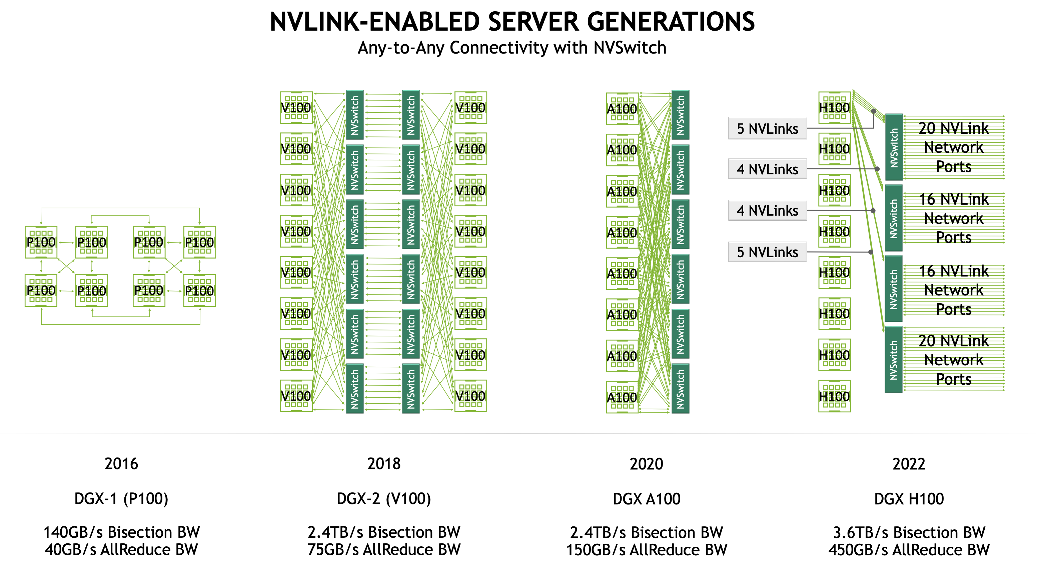
Trend 2: Fast Interconnect
THE NVLINK-NETWORK SWITCH: NVIDIA’S SWITCH CHIP FOR HIGH COMMUNICATION-BANDWIDTH SUPERPODS, HotChips ‘22

Slide 33
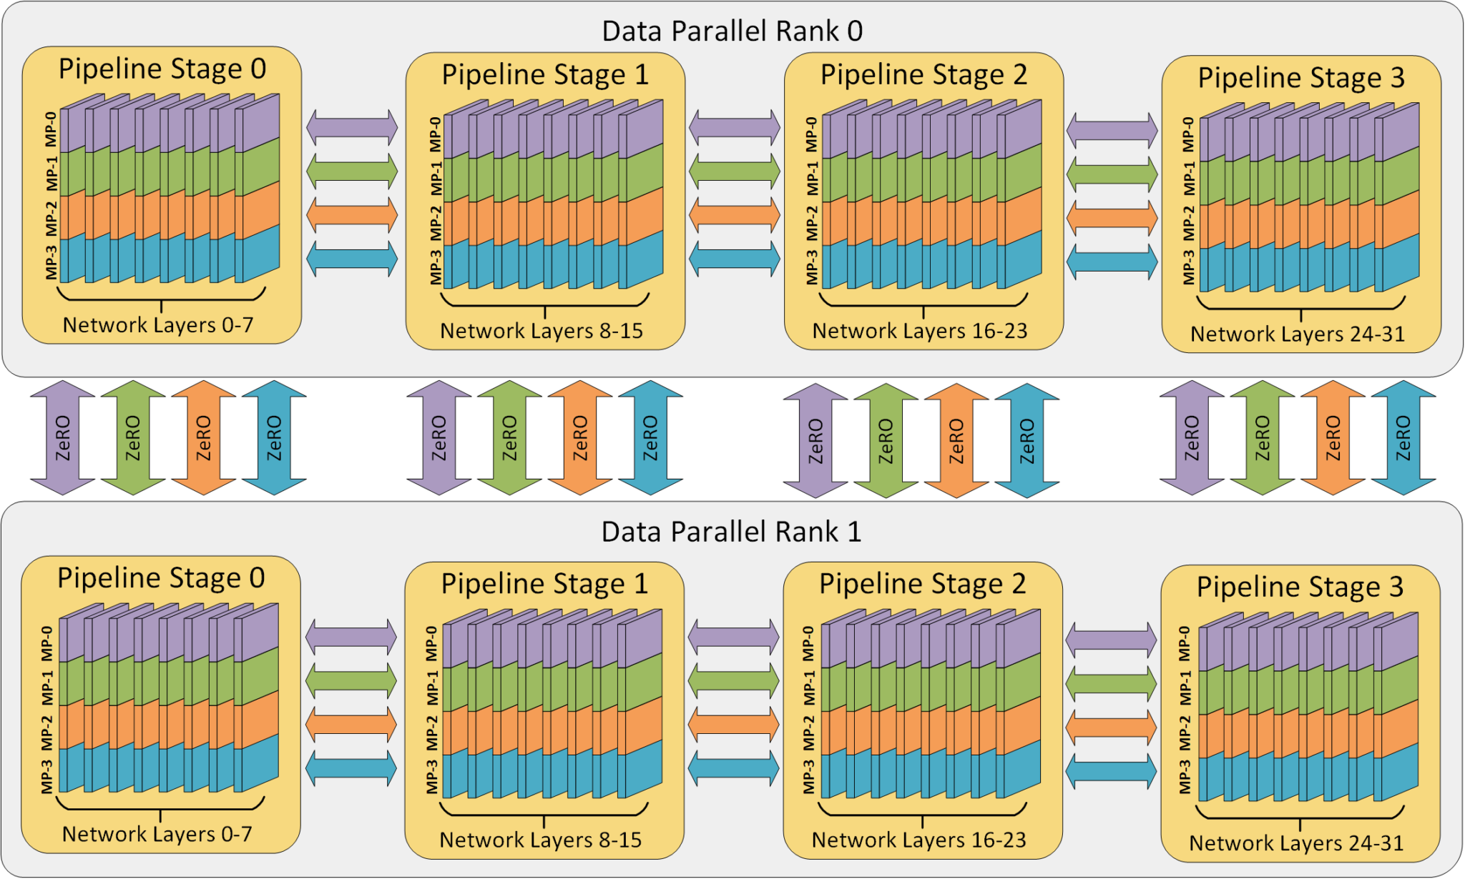
Why LLM Training Needs High Bandwidth

Slide 34
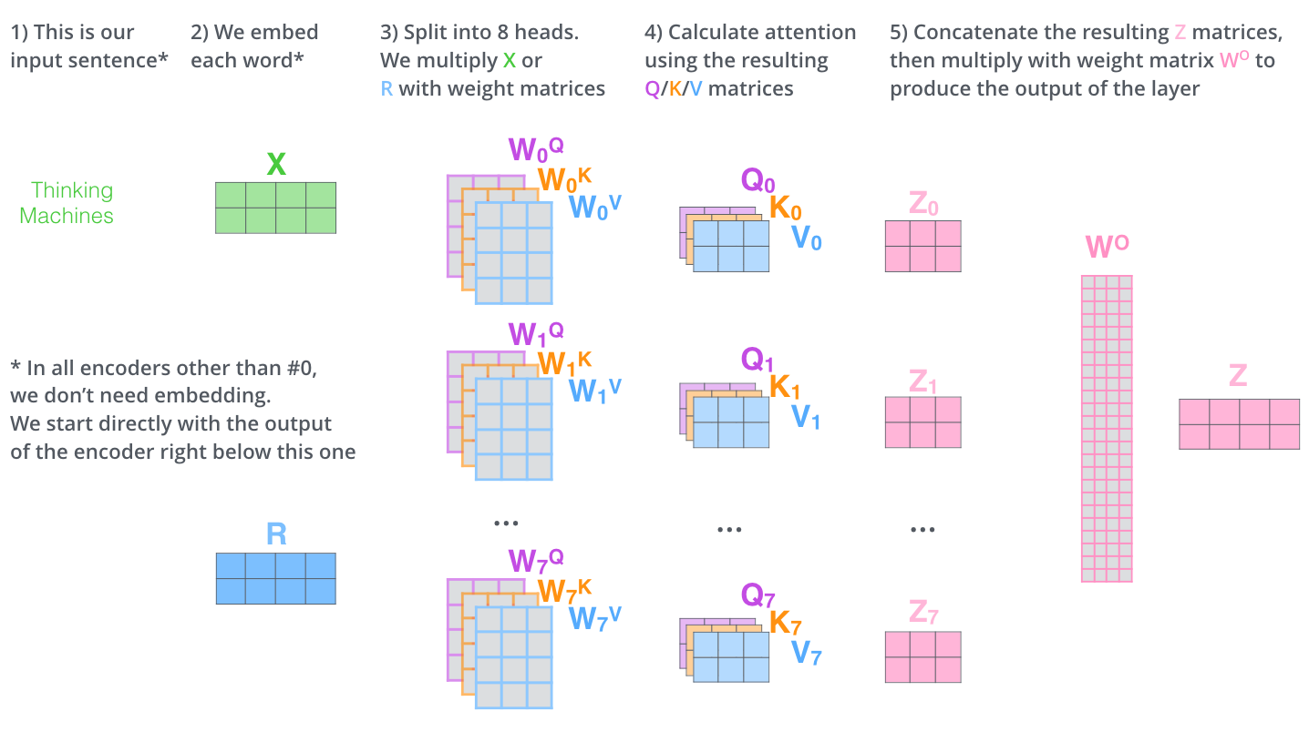
Tensor Parallelism Needs High Bandwidth
Back-of-envelope estimation for tensor parallelism in attention computation (QKV), excluding FFNN:
Computation cost is roughly: 3 * batch size * token length * (embedding size * embedding size / num GPUs) * 2 flops
Communication cost is roughly: Batch size * token length * embedding size * 2 bytes
Computation / Communication = 3 * embedding size / num GPUs
Example: LLaMA-2 70B, embedding size = 8192
Computation FLOPS of H100: 989T Tensor flops for 16 bit
If we use 8 GPUs for tensor parallelism and assume 100% FLOPS utilization:
Bandwidth >= Computation / (3 * embedding size / num GPUs) = 989T / (3 * 8192 / 8) = 321 GB/s
Bi-direction bandwidth >= 642 GB/s
That’s why we need 900 GB/s bandwidth for NVLink

Slide 35
Low Latency Is Not A Strict Requirement
Taking latency into account:
Communication time is roughly: (Batch size * token length * embedding size * 2 bytes / bandwidth) + latency
Computation time is roughly: 3 * batch size * token length * (embedding size * embedding size / num GPUs) * 2 flops / computation flops
Example: LLaMA-2 70B, embedding size = 8192, token length = 4096, batch size = 1
Communication time (NVLink) = (1 * 4096 * 8192 * 2 / 450G) + latency = 149 us + latency
Computation time = 3 * 1 * 4096 * (8192 * 8192 / 8) * 2 / 989T = 208 us
To achieve 100% FLOPS utilization: Latency <= 208 us – 149 us = 59 us
In datacenters NVLink/RDMA latency is typically <10 us, so latency is not a big problem for training.
However, latency predictability is important because congestion/PFC storm may bring >1ms high latency.

Slide 36
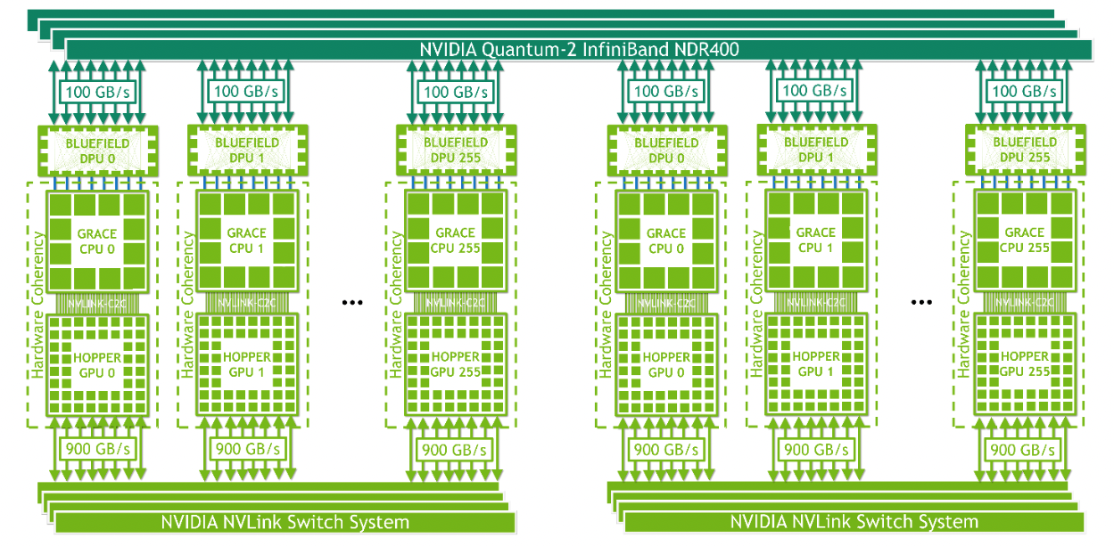
Direct Peer-to-Peer Interconnect

Slide 37
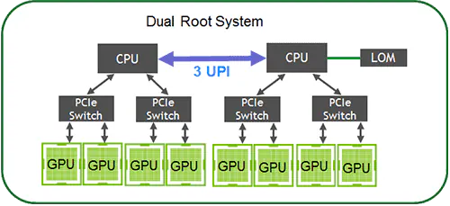
Convergence of Intra- and Inter-host Network
NIC
Network Switch
NIC

Slide 38
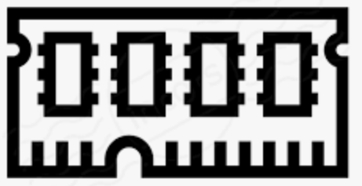
Memory Semantics
Program
Mem
Network
Mem
Program
Semantics
Example
010101010
Byte Stream
Socket send/recv
010
101
010
ZeroMQ / Kafka
RDMA send/recv
Message
W 0xA: 010
W 0xB: 101
R 0xC
Remote Memory Access
RDMA read/write /atomic
CXL Load/Store
Memory Semantics
Invoke A(010)
Invoke A(101)
Invoke B(010)
RPC
gRPC, Thrift

Slide 39
Exploiting Parallelism with Memory Semantics
RDMA is strictly in-order communication
Hard to utilize multiple network paths due to reordering cost at receiver
One lost packet blocks subsequent transactions from delivery
Hard to support page faults because a slow page-fault memory access would block all subsequent accesses
Many memory accesses can be executed out-of-order
Example: transferring multiple large tensors
Parallelize transfer over multiple network paths to improve bandwidth
A lost packet only blocks one transaction
Page-fault and other slow memory accesses can be processed out-of-order

Slide 40
Load/Store vs. Read/Write
Read/Write is asynchronous remote memory access
Requires multiple PCIe RTTs, min latency 1.6 us
CQE
⑨
App
①
WQE
Mem
doorbell
Data
⑧
②
③
⑥
PCIe
④
PCIe
⑤
NIC
NIC
⑦
Load/Store is synchronous remote memory access. CPU accesses network directly.
No PCIe, No WQE, CQE or doorbell, latency < 0.5 us
App
Mem
①
③
②
I/O die
I/O die
④

Slide 41
Load/Store is Not a Panacea
 | Load/Store | Read/Write
Programming | Sync | Async
Granularity | Cache line | User-specified message size
Latency | Low | High
Access efficiency of large data blocks | Low | High
Application transparency | Application imperceptible, can be used to extend local memory, achieving memory pooling | The application needs explicit access to remote memory; if used for memory expansion, the application needs to be modified
Hardware requirements | High, requires the NIC to work closely with the CPU | Low, the NIC can be in a detached form
Reliability | Large blast radius, a node failure will affect all nodes using the remote memory of that node; store instruction fault is difficult to capture | Easy to capture asynchronous remote access exceptions through the application, reducing the blast radius to the affected application
Cache coherence | Depends on whether the hardware supports it, but the overhead of hardware supporting cache coherence is high at a large scale | Not supported, the software explicitly copies between remote and local memory. In the case of sharing, it needs to coordinate with distributed locks to ensure consistency

Slide 42
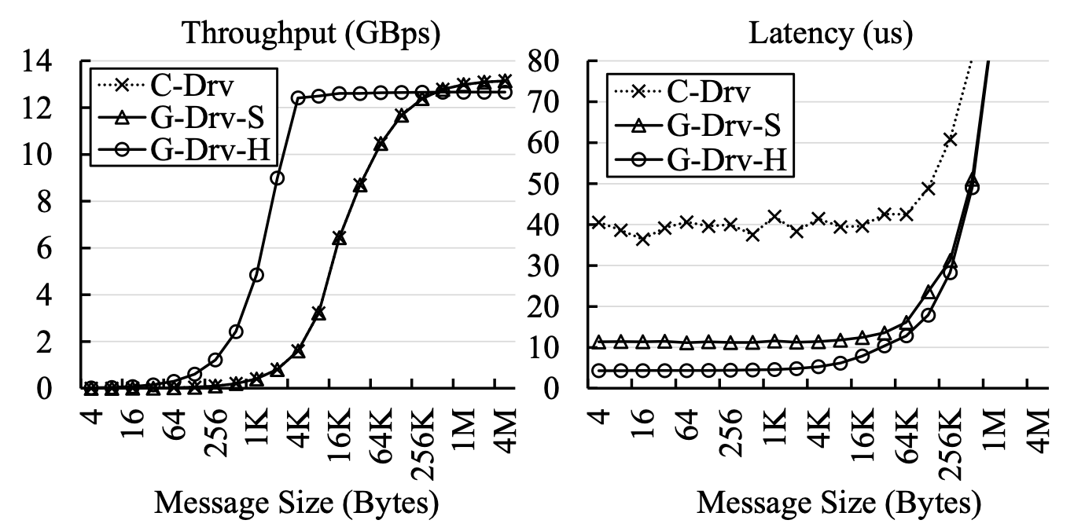
GPU Comm.: From Load/Store to Read/Write
ARK: GPU-driven Code Execution for Distributed Deep Learning, NSDI ‘23

Slide 43
Which Semantics to Pick?
Compute at Client
Compute at Server
(Home Node of Data)
Memory-mapped Load/Store
(CXL, Gen-Z, etc.)
In-Network Computation
SmartNIC Offloading
RPC on CPU
Asynchronous Read/Write
(one-sided RDMA)
Load/Store: low overhead per operation, but synchronous; may have cache and buffer
Read/Write: high overhead per operation, but each op can transfer a large block, and many ops can work in parallel
Switch (in-network): high throughput but low programmability and buffer size
SmartNIC: high parallelism but high PCIe latency and low buffer size
RPC on CPU: close to memory, easy to program but high cost

Slide 44
Contents
Trend 1: Intelligent Network Devices
SmartNIC: FPGA, ASIC, NP and DPU
Programmable Switch
Trend 2: Fast Interconnect
NVLink and CXL: Direct P2P with Memory Semantics
Convergence of AI and Cloud Networking

Slide 45
Convergence of AI and Cloud Networking
Cloud Network
AI Network

Slide 46
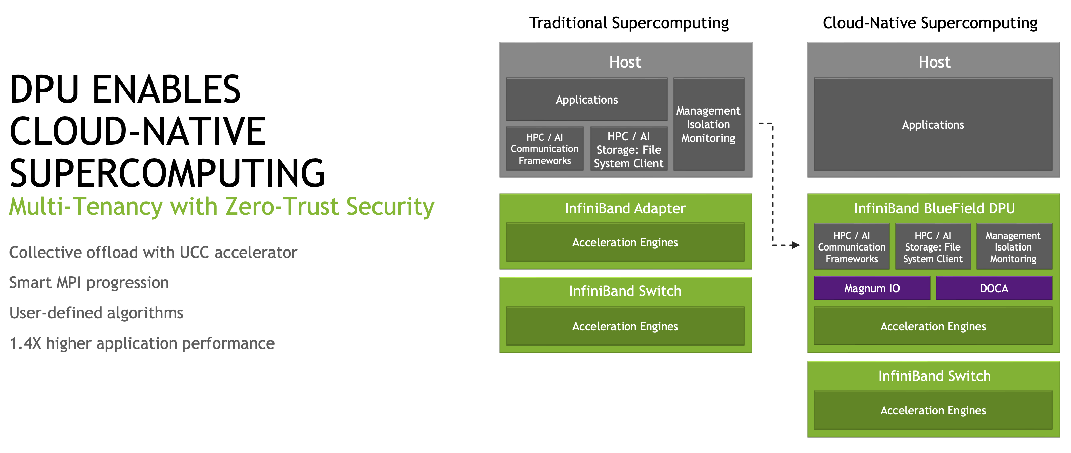
Convergence of AI and Cloud Networking
NVIDIA DATA CENTER PROCESSING UNIT (DPU) ARCHITECTURE, HotChips 2021

Slide 47
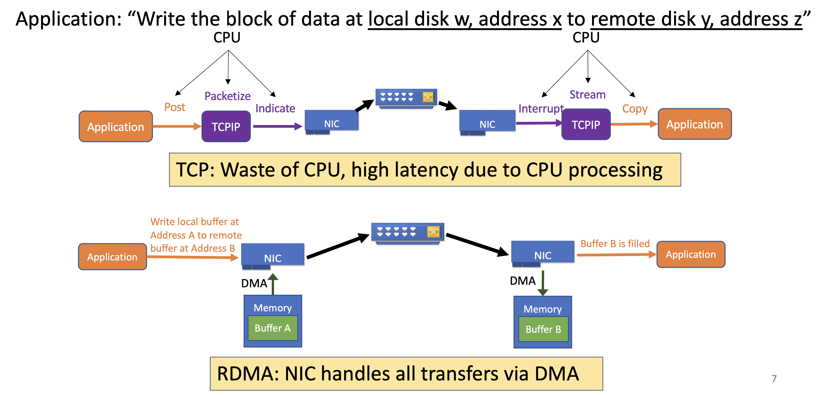
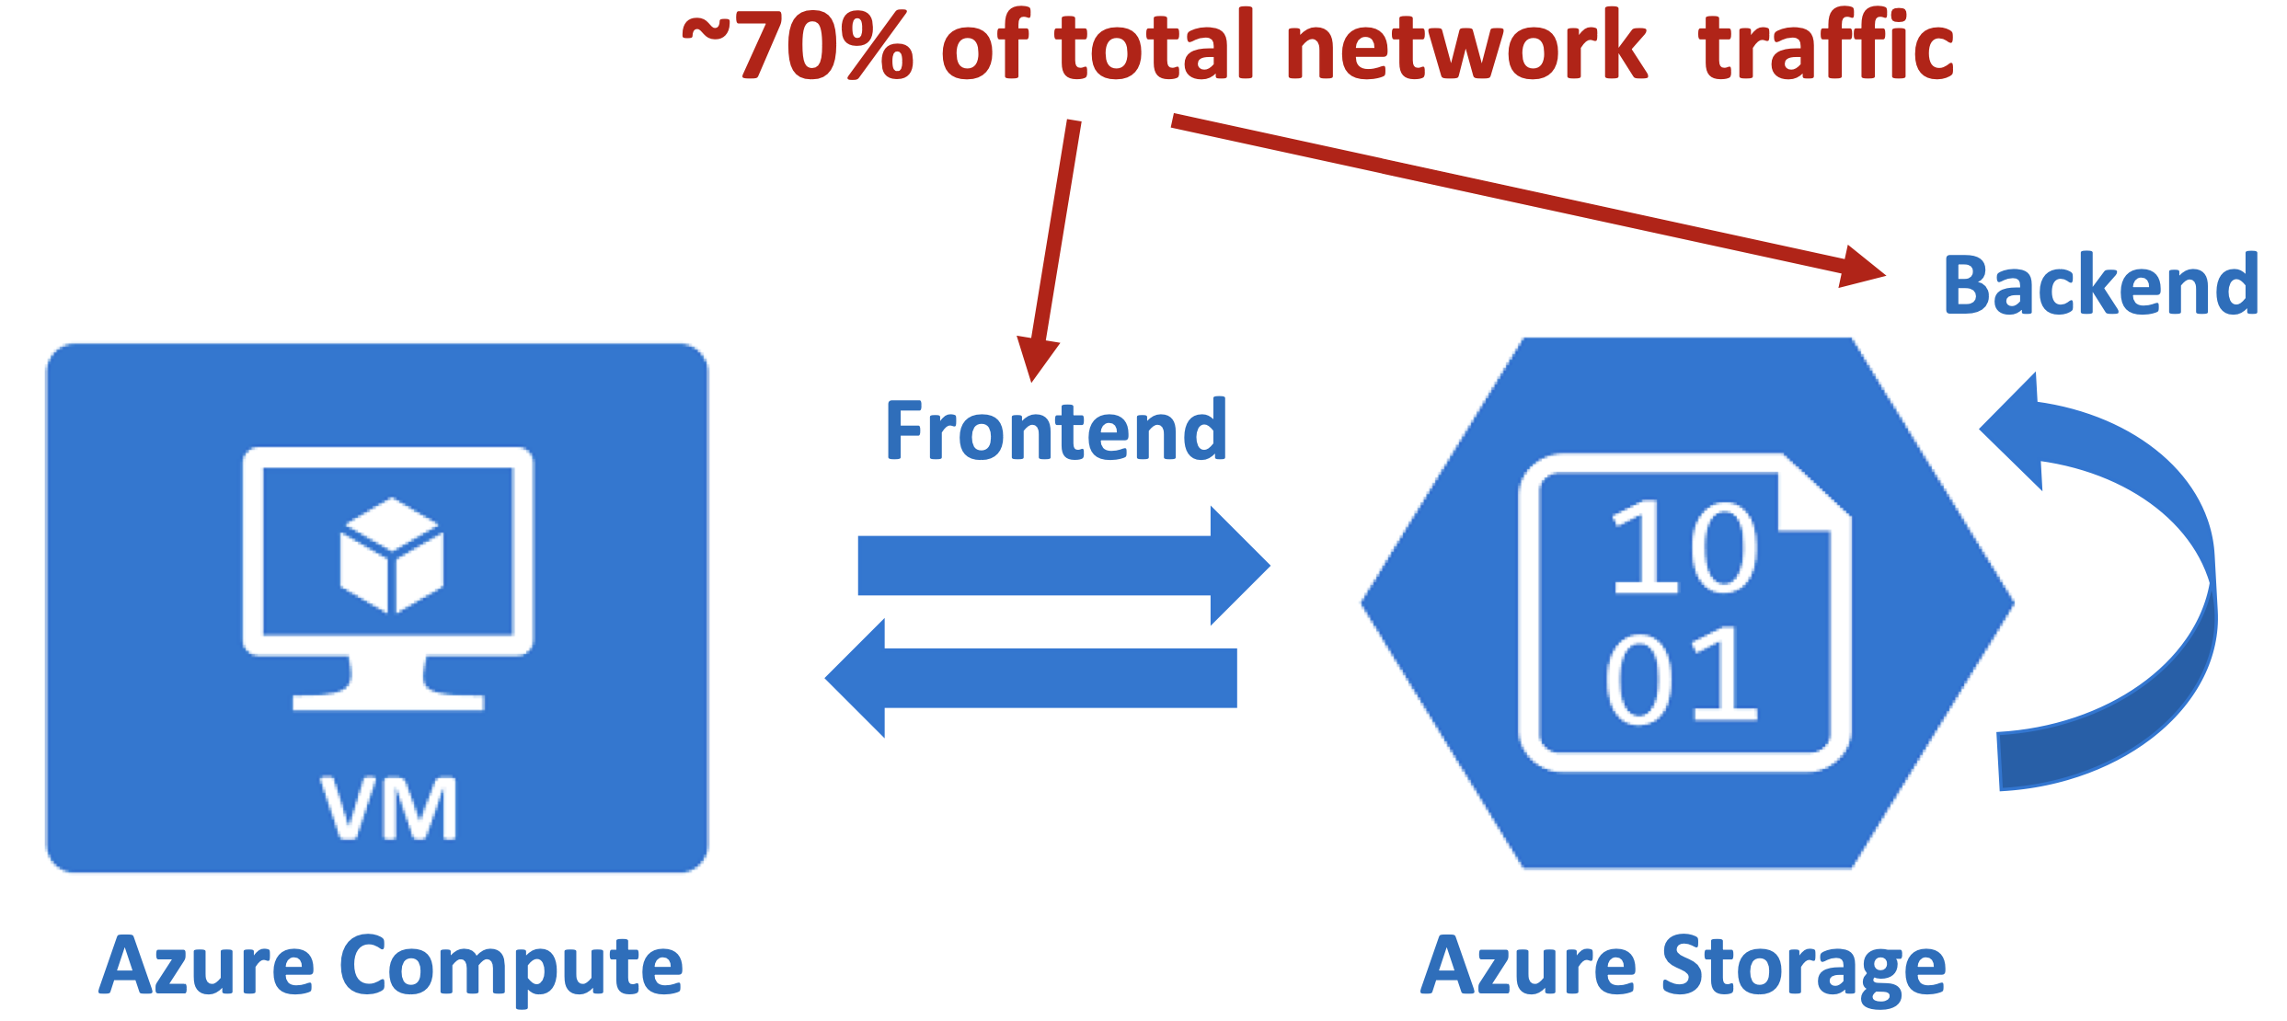
Region-scale RDMA for Disaggregated Storage
70% of Azure traffic is RDMA for disaggregated storage
Empowering Azure Storage with RDMA, NSDI ‘23

Slide 48
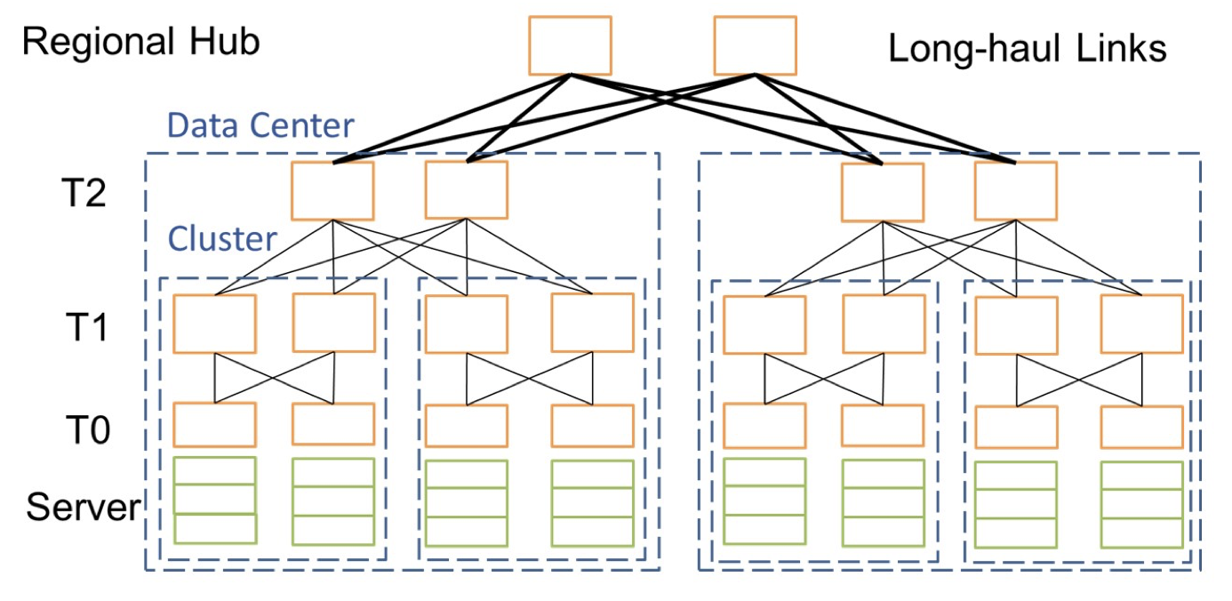
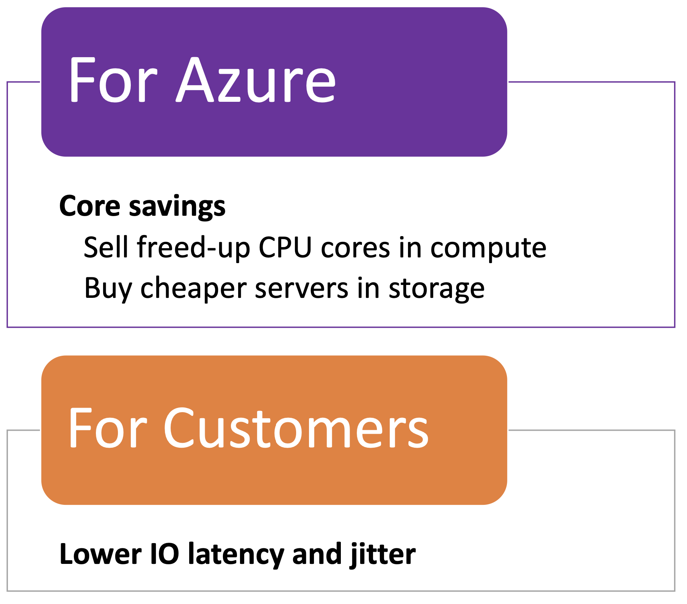
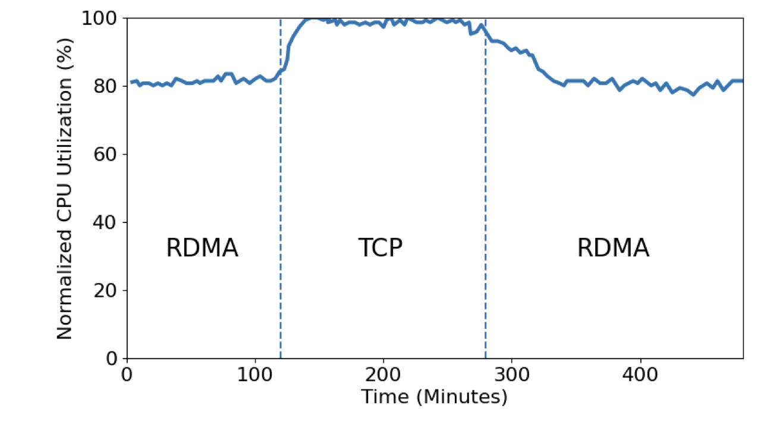
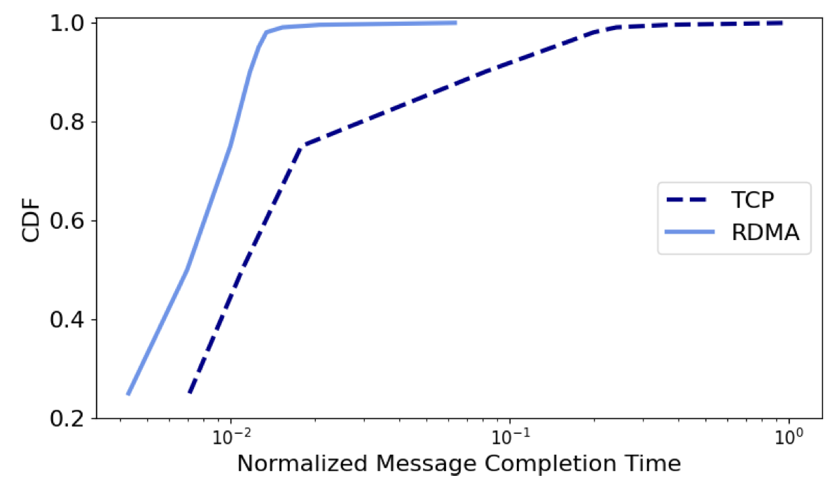
Region-scale RDMA for Disaggregated Storage
RDMA Benefits
Empowering Azure Storage with RDMA, NSDI ‘23
RDMA reduces CPU utilization
RDMA reduces storage latency

Slide 49
Region-scale RDMA for Disaggregated Storage
Challenges:
PFC Storm caused by malfunctioning NICs and switches
Interoperability of heterogenous NICs and switches
Scaling PFC and congestion control over long-haul (~100 km) links between AZs
Solutions:
PFC Watchdog on switches and SmartNICs to distinguish PFC Storm from congestion PFCs
Minimize PFC generation using per-flow E2E congestion control, BUT keep PFC to allow fast start and lower tail latency
Fine-tune DCQCN for NIC inter-op; Switch – SONiC: unified software stack
Jointly tune DCQCN params with switch buffers; sparse ECN marking; DCQCN does not suffer from RTT unfairness
Empowering Azure Storage with RDMA, NSDI ‘23

Slide 50
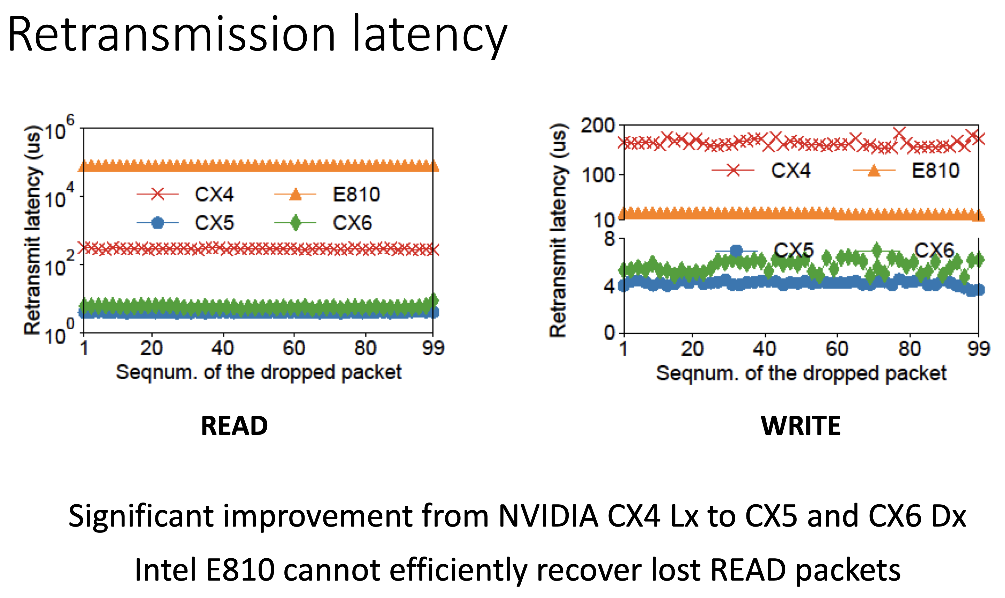
RDMA: The Devil is in the Details
Lumina: Understanding the Micro-Behaviors of Hardware Offloaded Network Stacks, SIGCOMM ‘23

Slide 51
Performance Isolation Problem of RDMA NICs
Husky: Understanding RDMA Microarchitecture Resources for Performance Isolation, NSDI ‘23

Slide 52
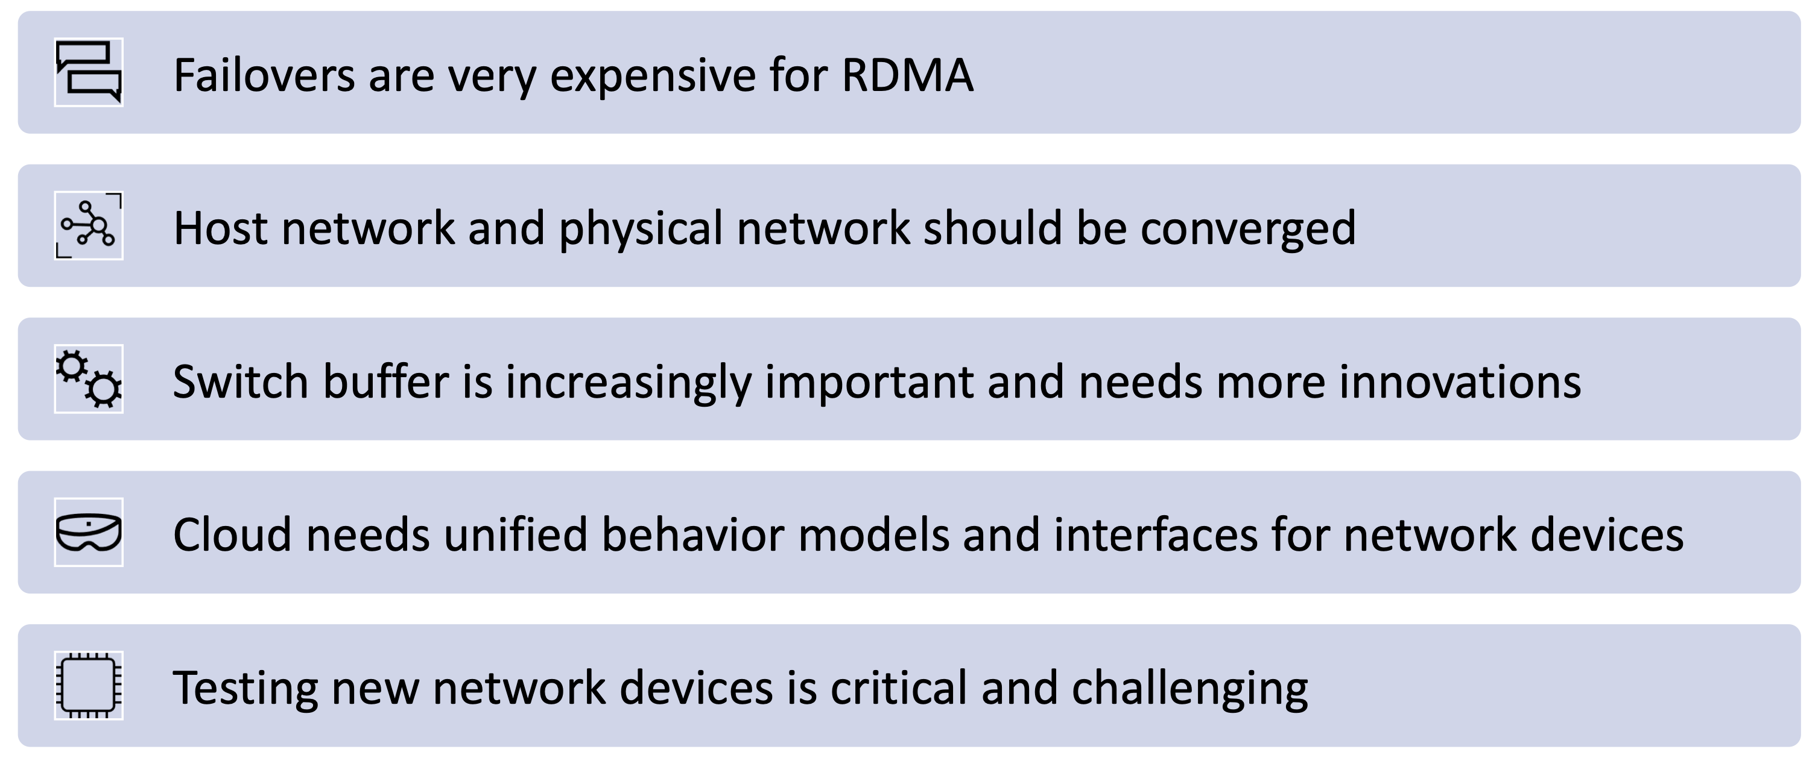
Lessons from Azure RDMA Deployment
Empowering Azure Storage with RDMA, NSDI ‘23

Slide 53
The Congestion Challenge
Domain-Specific Interconnection Networks in the Era of Domain-Specific AI Supercomputer, APNet ‘23 Keynote

Slide 54
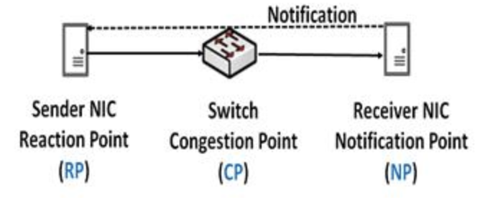
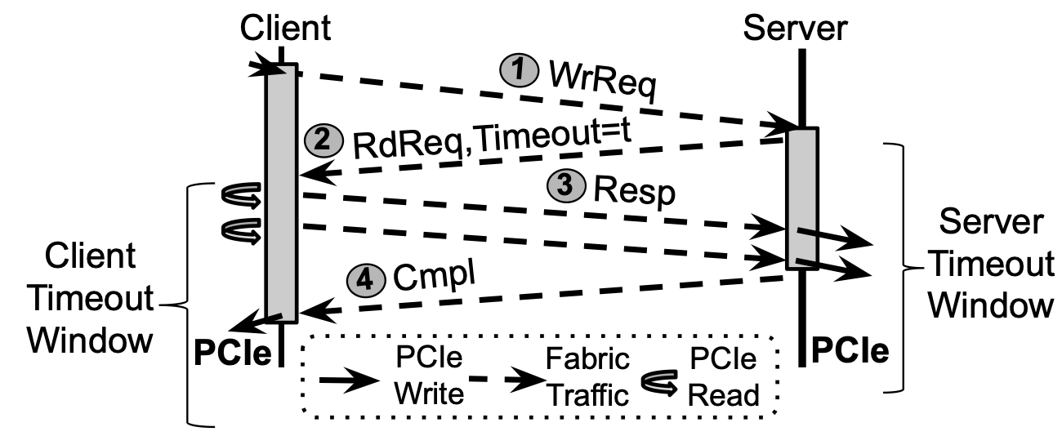
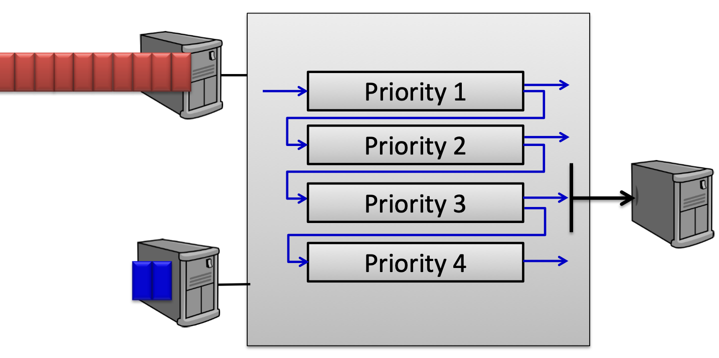
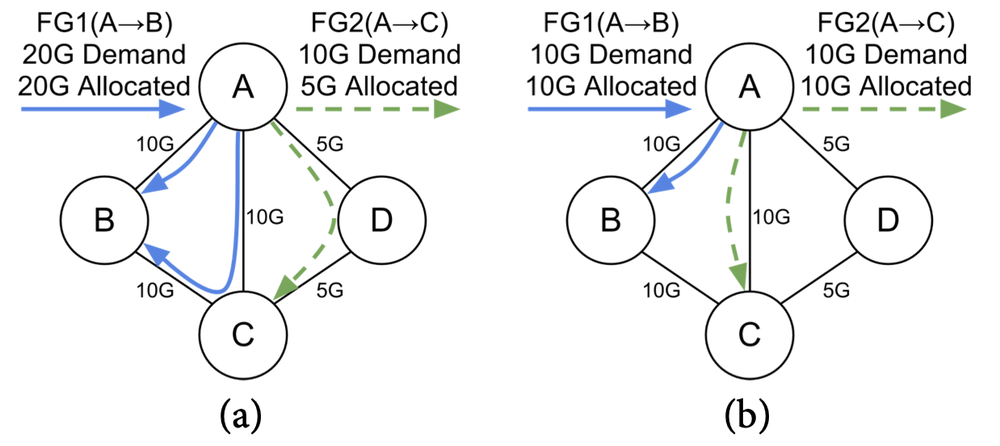
Predictable RDMA Network for AI/HPC
1. Congestion Control
(DCQCN)
2. End-to-end Flow Control
(1RMA)
3. Flow Scheduling
(PIAS)
4. Traffic Engineering
(B4 in WAN, ? in datacenters)

Slide 55
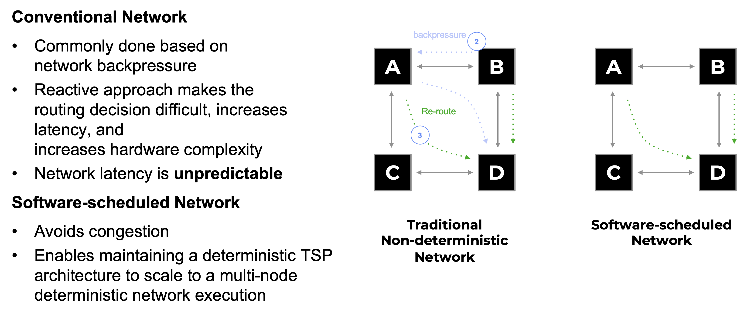
Predictable RDMA Network for AI/HPC
Domain-Specific Interconnection Networks in the Era of Domain-Specific AI Supercomputer, APNet ‘23 Keynote

Slide 56
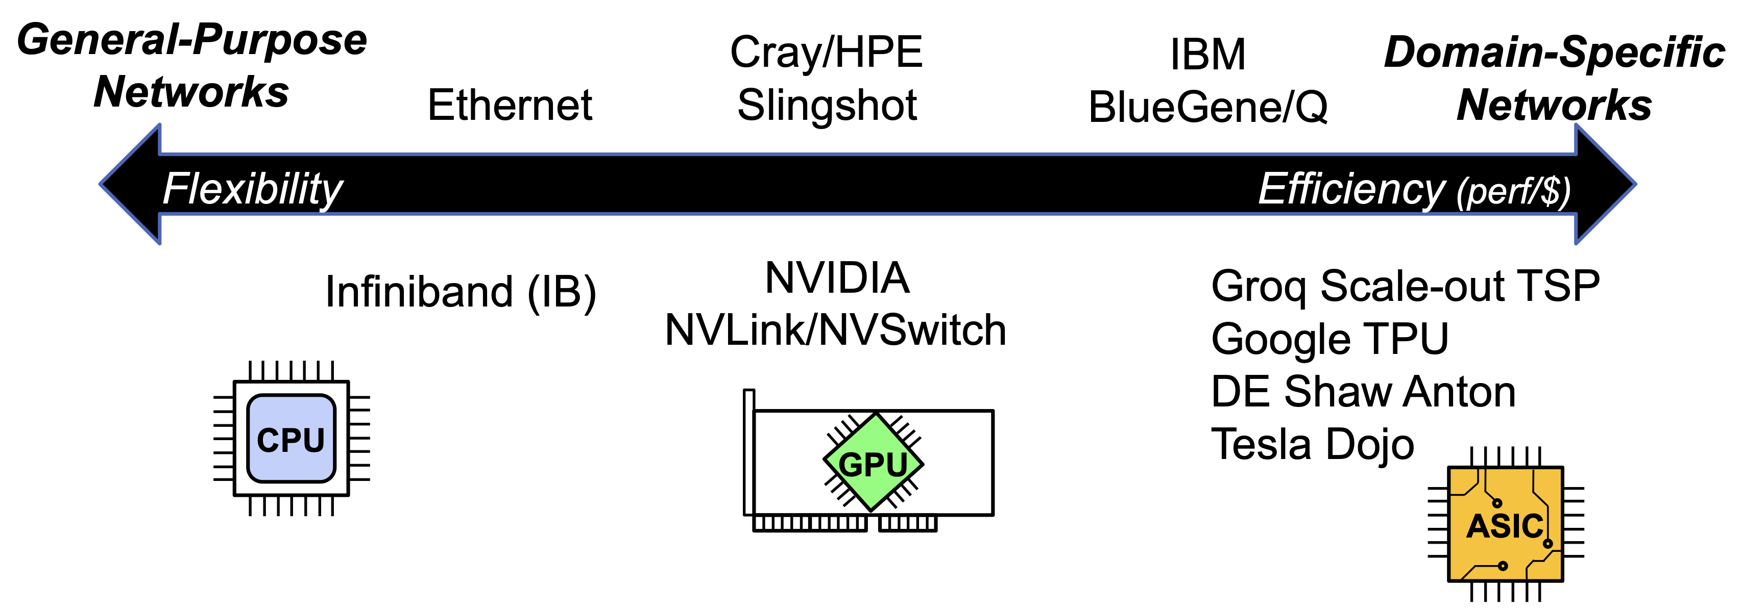
General-Purpose vs. Domain-Specific
Domain-Specific Interconnection Networks in the Era of Domain-Specific AI Supercomputer, APNet ‘23 Keynote

Slide 57
My View on the Debate
Programmability and scalability first
Programmability promotes ecosystem
Scalability enables a unified architecture for many scenarios
Identify bottlenecks in real systems before optimizing performance
Consider GPUs vs. DSAs
DSAs have higher performance but CUDA has the best ecosystem
The price of H100 ($30K~$40K) is 15~20x of its manufacturing cost ($2K)

Slide 58
Summary
Trend 1: Intelligent Network Devices
SmartNIC: FPGA, ASIC, NP and DPU
Programmable Switch
Trend 2: Fast Interconnect
NVLink and CXL: Direct P2P with Memory Semantics
Convergence of AI and Cloud Networking
Where should we put network intelligence?
The AI era is coming, so everything is going to be smart
SmartNICs for virtualization, switches for In-Network Telemetry, direct P2P among xPUs with memory semantics
Programmability and scalability first

Slide 59
Thanks!

