Slide 1
SocksDirect: Datacenter Sockets can be Fast and Compatible
Bojie Li*^{1,2} Tianyi Cui*³ Zibo Wang^{1,2} Wei Bai¹ Lintao Zhang¹
¹Microsoft Research ²USTC ³University of Washington
* Co-first authors

Slide 2
The Socket Communication Primitive
Server
Client
socket()
bind()
listen()
accept()
recv()
send()
close()
socket()
connect()
send()
recv()
close()
Notes:
As we all know, most applications use the socket primitive for inter-process communication, both within a same server and among different servers.

Slide 3
Socket: a Performance Bottleneck
Socket syscall time >> user application time
Socket latency >> hardware transport latency
Notes:
Traditionally, sockets are implemented in the OS kernel. We all know that kernel socket is very slow. To show this point, we profile several popular applications in data centers. We can see that 70% to 90% of CPU time is used in OS kernel, which means it is handling the socket system calls. If we could eliminate the overhead of OS kernel and all CPU time can be utilized by the user space application, the application throughput will improve by several times.
Next we look at the latency, and the problem is more severe than throughput. For communication between two directly connected servers, socket latency is 17x of RDMA. For intra-host communication, socket latency is 40x of shared memory queue. In this work, we try to answer one question: is this socket overhead an intrinsic property of the socket abstraction, or we can do something to eliminate the socket overhead?

Slide 4
High Performance Socket Systems
Kernel Optimization
User-space TCP/IP
Offload to RDMA NIC
User App
User App
User App
User App
User App
User App
Kernel VFS
User-space VFS
User-space VFS
User-space VFS
User-space VFS
Kernel TCP/IP
User-space TCP/IP
User-space TCP/IP
NIC RDMA API Hardware-based Transport
NIC packet API
NIC packet API
TCP/IP
Host 1
TCP/IP
Host 1
RDMA
Host 1
Host 2
Host 2
Host 2
NIC packet API
NIC packet API
NIC RDMA API
Kernel
User-space Stack
User-space VFS
User App
User App
User App
FastSocket, Megapipe, StackMap…
IX, Arrakis, SandStorm, mTCP, LibVMA, OpenOnload…
Rsocket, SDP, FreeFlow…
Notes:
There have been extensive research to improve the performance of socket systems.
The first category is to optimize the kernel. A socket stack basically divides into three layers. The first layer is the virtual file system, VFS, because each socket connection is regarded as a file in Linux, and a file descriptor is mapped for the socket. The second layer is the kernel TCP/IP stack that provides the transport function. The third layer is the hardware interface layer. Linux kernel uses a packet API.
The second category is to implement the VFS abstraction and TCP/IP transport in the user space. It not only move the kernel functions into user space, but also greatly simplify the functions, for example, use polling to avoid the interrupt and process scheduling overheads.
The third category is to offload the transport to the NIC. Here we recall some history of hardware-based transports. TCP offload is not a new thing. In 1990s, there has been Ethernet cards that

Slide 5
Linux Socket: from send() to recv()
Sender Host
Receiver Host
Application
Application
send() socket call
Wakeup process
recv() socket call
C library
C library
OS
OS
send() syscall
recv() syscall
Lock
Process Scheduling
Lock
VFS send
VFS recv
Copy data, allocate mem
Event Notification
Copy data, free mem
TCP send buffer
TCP recv buffer
TCP/IP
TCP/IP
Network packet
Network packet
Packet processing (netfilter, tc…)
Packet processing (netfilter, tc…)
Network packet
Network packet
NIC
NIC
Network packet

Slide 6
Round-Trip Time Breakdown
Type | Overhead (ns) | Linux |  | LibVMA |  | RSocket |  | SocksDirect
 |  | Inter-host | Intra-host | Inter-host | Intra-host | Inter-host | Intra-host | Inter-host | Intra-host
Per operation | Total | 413 |  | 177 |  | 209 |  | 53
 | C library shim | 12 |  | 10 |  | 10 |  | 15
 | Kernel crossing (syscall) | 205 |  | N/A |  | N/A |  | N/A
 | Socket FD locking | 160 |  | 121 |  | 138 |  | N/A
Per packet | Total | 15000 | 5800 | 2200 | 1300 | 1700 | 1000 | 850 | 150
 | Buffer management | 430 |  | 320 |  | 370 |  | 50
 | TCP/IP protocol | 360 |  | 260 |  | N/A |  | N/A
 | Packet processing | 500 | N/A | 130 |  | N/A |  | N/A
 | NIC doorbell and DMA | 2100 | N/A | 900 | 450 | 900 | 450 | 600 | N/A
 | NIC processing and wire | 200 | N/A | 200 | N/A | 200 | N/A | 200 | N/A
 | Handling NIC interrupt | 4000 | N/A | N/A |  | N/A |  | N/A
 | Process wakeup | 5000 |  | N/A |  | N/A |  | N/A
Per kbyte | Total | 365 | 160 | 540 | 381 | 239 | 212 | 173 | 13
 | Copy | 160 |  | 320 |  | 160 |  | 13
 | Wire transfer | 160 | N/A | 160 | N/A | 160 | N/A | 160 | N/A
Notes:
Categorize into per-operation, per-packet, per-kbyte overheads.
Linux: most overheads in NIC doorbell, DMA, handling NIC interrupt and process wakeup. Other overheads also contribute a large portion of overheads.
LibVMA:

Slide 7
SocksDirect Design Goals
Compatibility
Drop-in replacement, no application modification
Isolation
Security isolation among containers and applications
Enforce access control policies
High Performance
High throughput
Low latency
Scalable with number of CPU cores

Slide 8
SocksDirect: Fast and Compatible Socket in User Space
Monitor Process
ACL rules
Process 1
Process 2
Event queue
Event queue
Data
Data
Application
Shared Buffer
connect
send
recv
Application
accept
Request queue
Request queue
User Mode
Kernel Mode
Monitor: user-space daemon process to coordinate global resources and enforce ACL rules.
Processes as a shared-nothing distributed system: use message passing over shared-memory queues.

Slide 9
SocksDirect Supports Different Transports for Data
User App
User App
Mem Queue
Monitor
Mem Queue
libsd
libsd
Host 1
Mem Queue
TCP/IP
NIC RDMA API
NIC Packet API
RDMA
TCP/IP
NIC RDMA API
Host 2
libsd
Host 3
No SocksDirect
TCP/IP
User App
User App
Monitor

Slide 10
Remove the Overheads (1)
Type | Overhead | Linux RTT (ns) |  | SocksDirect RTT (ns)
 |  | Inter-host | Intra-host | Inter-host | Intra-host
Per operation | Total | 413 |  | 53
 | C library shim | 15 |  | 15
 | Kernel crossing (syscall) | 205 |  | N/A
 | Socket FD locking | 160 |  | N/A
Per packet | Total | 15000 | 5800 | 850 | 150
 | Buffer management | 430 |  | 50
 | TCP/IP protocol | 360 |  | N/A
 | Packet processing | 500 | N/A | N/A
 | NIC doorbell and DMA | 2100 | N/A | 600 | N/A
 | NIC processing and wire | 200 | N/A | 200 | N/A
 | Handling NIC interrupt | 4000 | N/A | N/A
 | Process wakeup | 5000 |  | N/A
Per kbyte | Total | 365 | 160 | 173 | 13
 | Copy | 160 |  | 13
 | Wire transfer | 160 | N/A | 160 | N/A

Slide 11
Remove the Overheads (2)
Type | Overhead | Linux RTT (ns) |  | SocksDirect RTT (ns)
 |  | Inter-host | Intra-host | Inter-host | Intra-host
Per operation | Total | 413 |  | 53
 | C library shim | 15 |  | 15
 | Kernel crossing (syscall) | 205 |  | N/A
 | Socket FD locking | 160 |  | N/A
Per packet | Total | 15000 | 5800 | 850 | 150
 | Buffer management | 430 |  | 50
 | TCP/IP protocol | 360 |  | N/A
 | Packet processing | 500 | N/A | N/A
 | NIC doorbell and DMA | 2100 | N/A | 600 | N/A
 | NIC processing and wire | 200 | N/A | 200 | N/A
 | Handling NIC interrupt | 4000 | N/A | N/A
 | Process wakeup | 5000 |  | N/A
Per kbyte | Total | 365 | 160 | 173 | 13
 | Copy | 160 |  | 13
 | Wire transfer | 160 | N/A | 160 | N/A

Slide 12
Token-based Socket Sharing
Socket is shared among threads and forked processes.
Many to one
One to many
Optimize for common cases.
Be correct for all cases.
Many to one
One to many
Transfer ownership of tokens via monitor.
Lock
Sender 1
Sender 1
Queue
Receiver
Queue
Receiver
Sender 2
Sender 2
Send
token
Lock
Receiver 1
Receiver 1
Sender
Queue
Sender
Queue
Receiver 2
Receiver 2
Receive
token

Slide 13
Handling Fork
Linux semantics requirement:
File descriptors need to be sequential (1,2,3,4,5…).
Sockets are shared for parent and child processes.
Transport limitations:
RDMA QP cannot be shared among processes.
Parent process
RDMA QP
3
5
RDMA QP
3
FD Table
5 (COW)
SHM (shared)
Shared pages
Socket Data
3
4
5
Socket Data
3
4
SHM (shared)
FD Table
3
4
SHM Queue
4
Child process
SHM (private)
RDMA QP
3 (on demand)
5
FD Table
5 (COW)
Socket Data
5

Slide 14
Remove the Overheads (3)
Type | Overhead | Linux RTT (ns) |  | SocksDirect RTT (ns)
 |  | Inter-host | Intra-host | Inter-host | Intra-host
Per operation | Total | 413 |  | 53
 | C library shim | 15 |  | 15
 | Kernel crossing (syscall) | 205 |  | N/A
 | Socket FD locking | 160 |  | N/A
Per packet | Total | 15000 | 5800 | 850 | 150
 | Buffer management | 430 |  | 50
 | TCP/IP protocol | 360 |  | N/A
 | Packet processing | 500 | N/A | N/A
 | NIC doorbell and DMA | 2100 | N/A | 600 | N/A
 | NIC processing and wire | 200 | N/A | 200 | N/A
 | Handling NIC interrupt | 4000 | N/A | N/A
 | Process wakeup | 5000 |  | N/A
Per kbyte | Total | 365 | 160 | 173 | 13
 | Copy | 160 |  | 13
 | Wire transfer | 160 | N/A | 160 | N/A

Slide 15
Per-socket Ring Buffer
head
head
tail
tail
Traditional ring buffer
SocksDirect per-socket ring buffer
Many sockets share a ring buffer
Receiver segregates packets from the NIC
Buffer allocation overhead
Internal fragmentation
One ring buffer per socket
Sender segregates packets via RDMA or SHM address
Back-to-back packet placement
Minimize buffer mgmt. overhead

Slide 16
Per-socket Ring Buffer
send_next
RDMA write data
head
tail
Sender side
Receiver side
RDMA write credits (batched)
Two copies of ring buffers on both sender and receiver.
Use one-sided RDMA write to synchronize data from sender to receiver, and return credits (i.e. free buffer size) in batches.
Use RDMA write with immediate verb to ensure ordering and use a shared completion queue to amortize polling overhead.

Slide 17
Remove the Overheads (4)
Type | Overhead | Linux RTT (ns) |  | SocksDirect RTT (ns)
 |  | Inter-host | Intra-host | Inter-host | Intra-host
Per operation | Total | 413 |  | 53
 | C library shim | 15 |  | 15
 | Kernel crossing (syscall) | 205 |  | N/A
 | Socket FD locking | 160 |  | N/A
Per packet | Total | 15000 | 5800 | 850 | 150
 | Buffer management | 430 |  | 50
 | TCP/IP protocol | 360 |  | N/A
 | Packet processing | 500 | N/A | N/A
 | NIC doorbell and DMA | 2100 | N/A | 600 | N/A
 | NIC processing and wire | 200 | N/A | 200 | N/A
 | Handling NIC interrupt | 4000 | N/A | N/A
 | Process wakeup | 5000 |  | N/A
Per kbyte | Total | 365 | 160 | 173 | 13
 | Copy | 160 |  | 13
 | Wire transfer | 160 | N/A | 160 | N/A

Slide 18
Payload Copy Overhead
Why both sender and receiver need to copy payload?
Sender
Receiver
App
Mem
NIC
NIC
Mem
App
send(buf, size);
DMA
Network packet
DMA read
DMA to socket buf
memcpy(buf, data, size);
Notify event (epoll)
DMA read
Wrong data
user_buf = malloc(size);
recv(user_buf, size);
Copy socket buf to user buf

Slide 19
Page Remapping
Send physical page
Sender
Receiver
Virtual addr
Virtual addr
New page
Data page
Old page
Problem: page remapping needs syscalls!
Map 1 page: 0.78 us
Copy 1 page: 0.40 us
Solution: batch page remapping for large messages
Map 32 pages: 1.2 us
Copy 32 pages: 13.0 us

Slide 20
Remove the Overheads (5)
Type | Overhead | Linux RTT (ns) |  | SocksDirect RTT (ns)
 |  | Inter-host | Intra-host | Inter-host | Intra-host
Per operation | Total | 413 |  | 53
 | C library shim | 15 |  | 15
 | Kernel crossing (syscall) | 205 |  | N/A
 | Socket FD locking | 160 |  | N/A
Per packet | Total | 15000 | 5800 | 850 | 150
 | Buffer management | 430 |  | 50
 | TCP/IP protocol | 360 |  | N/A
 | Packet processing | 500 | N/A | N/A
 | NIC doorbell and DMA | 2100 | N/A | 600 | N/A
 | NIC processing and wire | 200 | N/A | 200 | N/A
 | Handling NIC interrupt | 4000 | N/A | N/A
 | Process wakeup | 5000 |  | N/A
Per kbyte | Total | 365 | 160 | 173 | 13
 | Copy | 160 |  | 13
 | Wire transfer | 160 | N/A | 160 | N/A
Notes:
Go through very fast.

Slide 21
Process Wakeup Overhead
Problem: multiple processes share a CPU core
Linux process wakeup (mutex, semaphore, read): 2.8 ~ 5.5 us
Cooperative context switch (sched_yield): 0.2 us
Solution:
Pin each thread to a core
Each thread poll for some time slice, and sched_yield after then.
All threads on the core run in round-robin order.
Notes:
Go through very fast.

Slide 22
Summary: Overheads & Techniques
Kernel crossing (syscall) Monitor and library in user space. Shared-nothing, use message passing for communication.
TCP/IP protocol Use hardware-based transports: RDMA / SHM.
Locking of socket FDs Token-based socket sharing. Optimize common cases, prepare for all cases.
Buffer management Per-socket ring buffer.
Payload copy Batch page remapping.
Process wakeup Cooperative context switch.

Slide 23
Evaluation Setting
User App
User App
Mem Queue
Monitor
Mem Queue
libsd
libsd
Host 1
Mem Queue
NIC RDMA API
RDMA
NIC RDMA API
Host 2
libsd
User App
Monitor
Notes:
Use LD_PRELOAD to load libsd library.
Intra-host
Inter-host

Slide 24
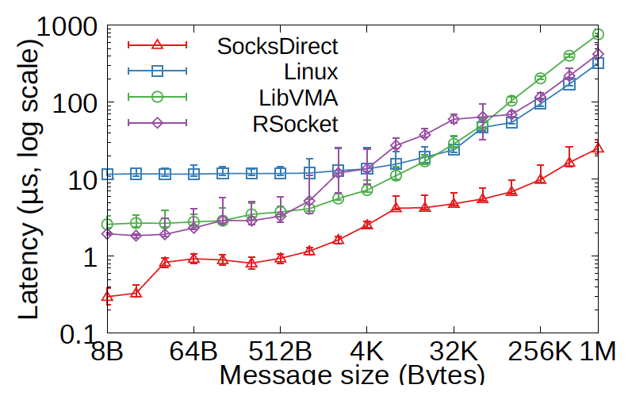
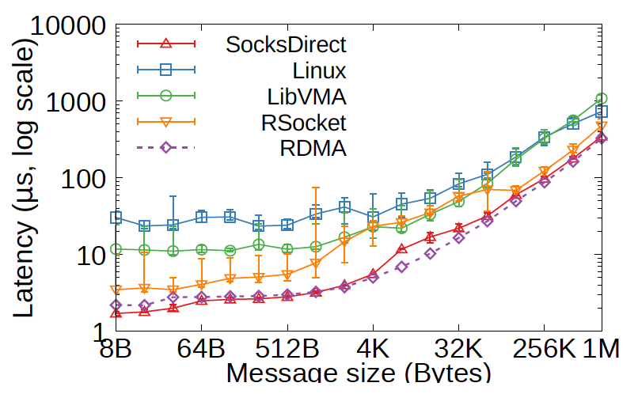
Latency
Intra-host
Inter-host
Notes:
Intra-host: 8B latency close to shared memory queue, 4x lower than Rsocket and LibVMA because they use NIC to forward intra-host packets. 35x lower than Linux.
Inter-host: 8B latency even lower than two-sided RDMA send and receive, because we use one-sided RDMA write. Half of Rsocket, performance gain due to buffer management. 7x lower than LibVMA because it needs batching. Latency 17x lower than Linux.

Slide 25
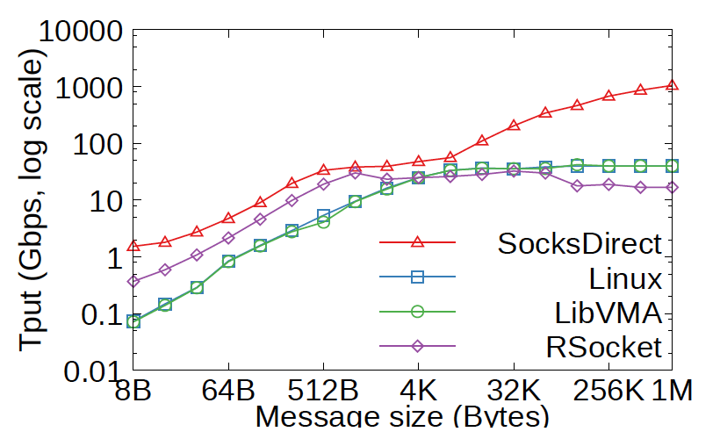
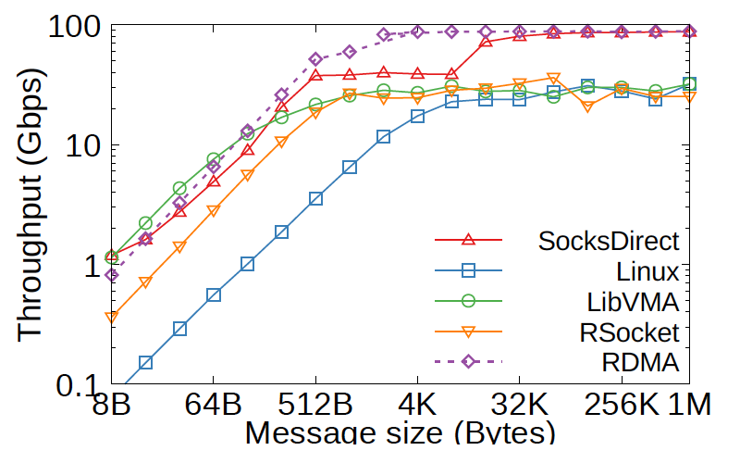
Throughput
Intra-host
Inter-host
Notes:
Intra-host: 8B message throughput 20x of Linux. At 8K it is closest to other systems because we need batching for zero copy, and it is only activated for >=16KB messages. Large messages 13x of Linux.
Inter-host: 8B message throughput 15x of Linux. One socket connection can saturate the 100Gbps link.

Slide 26
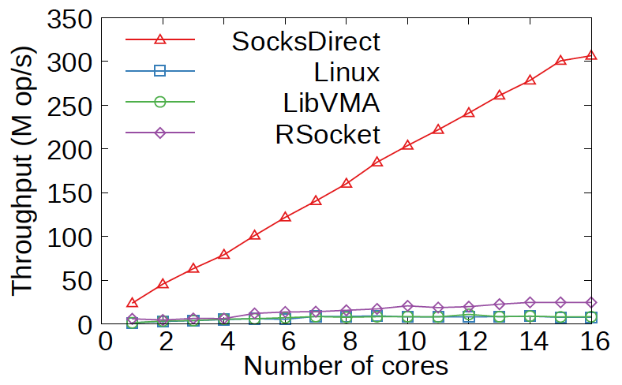
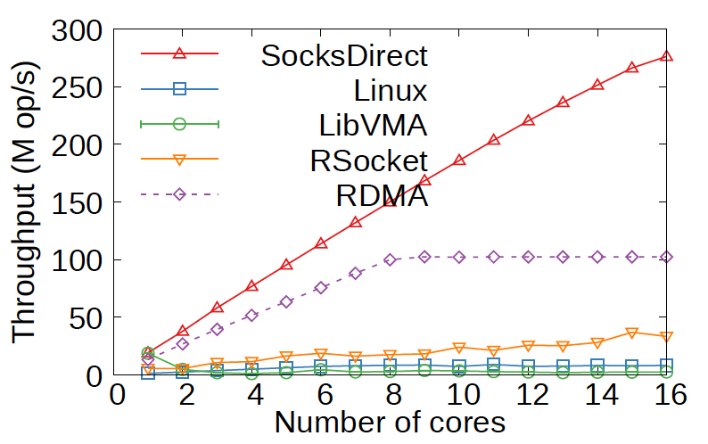
Multi-core Scalability
Intra-host
Inter-host
Notes:
Multi-core scalability: SocksDirect almost linearly scalable. Other systems not linearly scalable due to file descriptor locking and packet queue contention. With higher number of cores, the throughput is even worse.
For inter-host, SocksDirect has even higher throughput than bare metal RDMA, because we have batching.

Slide 27
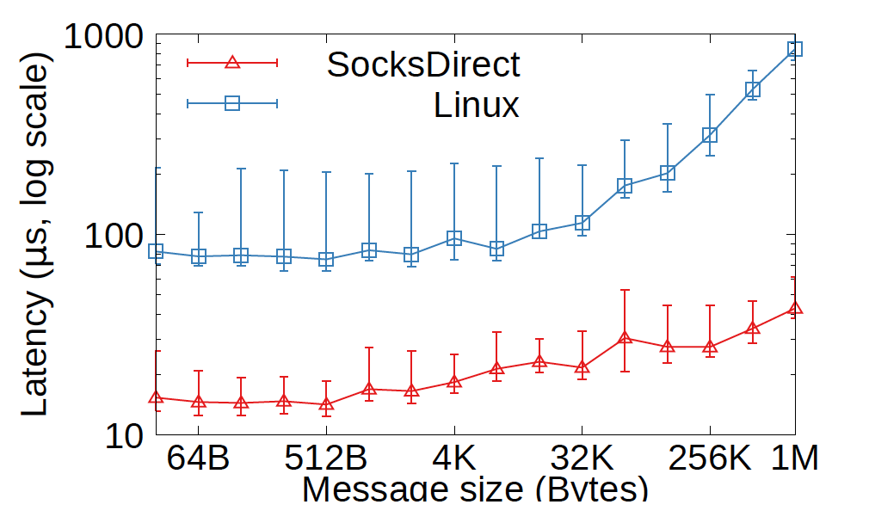
Application Performance
Nginx HTTP server request latency
Notes:
Nginx HTTP server between two hosts: small HTTP messages, 5x lower than Linux. For large message, 13x lower than Linux due to zero copy.

Slide 28
Limitations
Scale to many connections
RDMA scalability: under high concurrency, NIC cache miss will degrade throughput. Recent NICs have larger cache.
Connection setup latency: future work.
Congestion control and QoS
Emerging RDMA congestion control (e.g. DCQCN, MP-RDMA, HPCC) and loss recovery (e.g. MELO) mechanisms in hardware.
QoS: OVS offload in RDMA NICs, or use programmable NICs.
Scale to many threads
Monitor polling overhead

Slide 29
Conclusion
Contributions of this work:
An analysis of performance overheads in Linux socket.
Design and implementation of SocksDirect, a high performance user space socket system that is compatible with Linux and preserves isolation among applications.
Techniques to support fork, token-based connection sharing, allocation-free ring buffer and zero copy that may be useful in many scenarios other than sockets.
Evaluations show that SocksDirect can achieve performance that is comparable with RDMA and SHM queue, and significantly speedup existing applications.

Slide 30
Thank you!
Notes:
Thank you for listening!

Slide 32
High Performance Socket Systems
Kernel Optimization
FastSocket, Megapipe, StackMap…
Good compatibility, but leave many overheads on the table.
User-space TCP/IP Stack
IX, Arrakis, SandStorm, mTCP, LibVMA, OpenOnload…
Does not support fork, container live migration, ACLs…
Use NIC to forward intra-host packets (SHM is faster).
Fail to remove payload copy, locking and buffer mgmt overheads.
Offload to RDMA NIC
Rsocket, SDP, FreeFlow…
Lack support for important APIs (e.g. epoll).
Same drawbacks as user-space TCP/IP stacks.
Notes:
Kernel Optimization
Good compatibility, but leave many overheads on the table.
User-space TCP/IP Stack
Does not support fork, container live migration, ACLs…
Use NIC to forward intra-host packets (SHM is faster).
Fail to remove payload copy, locking and buffer mgmt overheads.
Offload to RDMA NIC
Rsocket, SDP, FreeFlow…
Lack support for important APIs (e.g. epoll).
Same drawbacks as user-space TCP/IP stacks.

Slide 33
The Slowest Part in Linux Socket Stack
Application
socket send / recv
Application
pipe read / write
Virtual File System
Virtual File System
TCP/IP Protocol
Loopback interface
10 us RTT
0.9 M op/s tput
8 us RTT
1.2 M op/s tput
TCP/IP protocol is NOT the slowest part!

Slide 34
Payload Copy Overhead
Solution: page remapping
②
B’
C
⑥
Sender
Receiver
B’
1
④
2
⑦
①
⑤
RDMA write
A
B
C
B’
③

Slide 35
Socket Queues
Monitor
3: S1→R1, 4: S1→R2, 5: S2→R2
Sender
FD
Socket Queues
Receiver
S1
3,4
3
R1
3
4
S2
5
5
R2
4,5

Slide 36
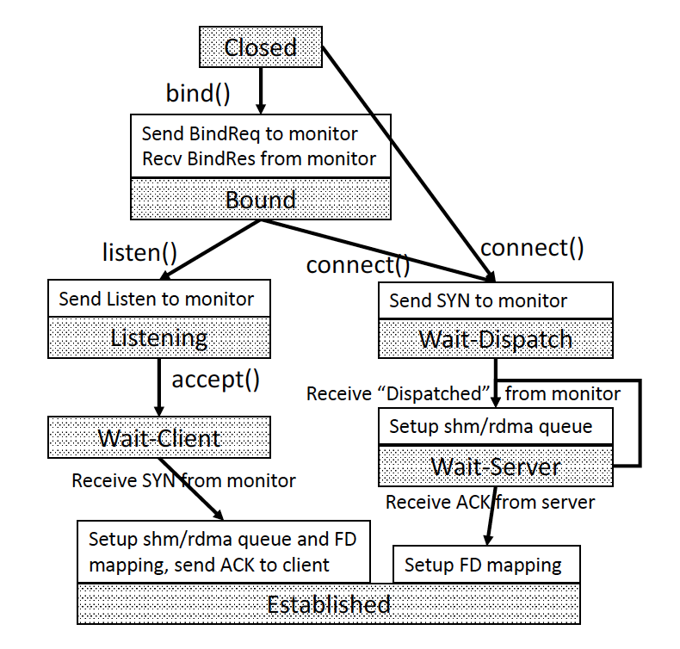
Connection Management
Connection setup procedure

Slide 37
Token-based Socket Sharing
Takeover: transfer token among threads.
Takeover request
Sender 1
Monitor
Data Queue
Receiver
Send
token
Takeover request
Sender 2
Send
token

Slide 38
Rethink the Networking Stack
SocksDirect
eRPC
LITE
Application
Communication primitive
Socket
RPC
LITE
Software Stack
HW/SW work split
RDMA
Packet
RDMA
NIC

